Slide 1
The Practice
Demonstrate Respect for your Experience- your experience is yours to own.
Translate your meaning- Say what you mean and mean what you say. Don’t say what you think others want to hear.
Listen to yourself- If you choose to blend in with crowd then you give up the opportunity to stand out from the crowd.
Give your accurate location-Own your experience in time
Demonstrate that you are coachable- We need to be open to self-discover without being concerned about popular opinion or hurt feelings.
Notes:
Don’t allow anyone to give you your experience
There is liberty and judgement in everything you do and say
And be the change you would like to see
All of us have been conditioned to believe much of what we believe.

Slide 2
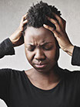
Trauma and the Nervous System
Learning Objective:
Learn how to identify and treat symptoms related to trauma in the body
This Photo by Unknown Author is licensed under CC BY-NC-ND

Slide 3
Acute Stress
You know the feeling when you’re behind on a seemingly all-important deadline and then you get a call from your child’s school asking you to come by or you barely miss a serious car accident.
Your heart might race, and your blood pressure might rise. Your sense of emergency might trigger a migraine or even chest pain.
Other possible symptoms include irritability, anxiety, sadness, headaches, back pain, and gut problems. These may appear for a short time and subside when the stress eases.
This Photo by Unknown Author is licensed under CC BY-NC

Slide 4
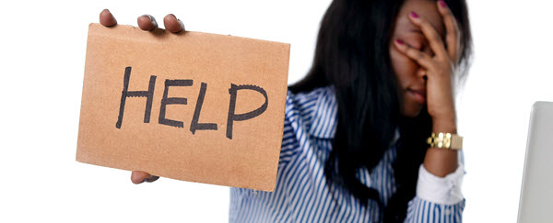
Chronic Stress
This is the grinding stress that wears us down over the years. It arises from serious life problems that may be fundamentally beyond our control: poverty, war, politics, or racism.
The demands are unrelenting, and you don’t know when they will stop.
If you had a traumatic childhood, you may experience life as chronically stressful even when the surface appears okay. You believe you are perpetually threatened by poverty or illness even when this is untrue.
Whether the cause lies in your mindset or difficult circumstances, many people stop fighting for change and begin to accommodate chronic stress.
This Photo by Unknown Author is licensed under CC BY-SA

Slide 5
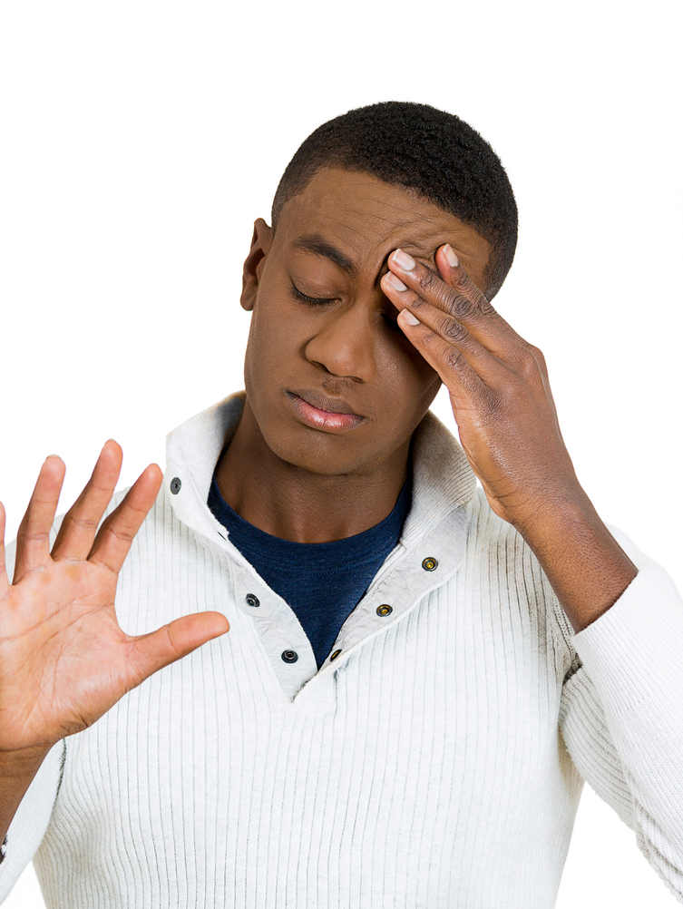
Microaggressions
Microaggressions are very specific: the kinds of remarks, questions, or actions that are painful because they have to do with a person's membership in a group that's discriminated (unjust) against or subject to stereotypes (widely held ideas of particular people).
And a key part of what makes them so disconcerting is that they happen casually, frequently, and often without any harm intended, in everyday life
This Photo by Unknown Author is licensed under CC BY-ND

Slide 6
Impact of Microaggressions
Research has shown that microaggressions, although they're seemingly small and sometimes innocent offenses, can take a real psychological toll on the mental health of their recipients.
This toll can lead to anger and depression and can even lower productivity and problem-solving abilities. It can also lead to a hostile environment

Slide 7
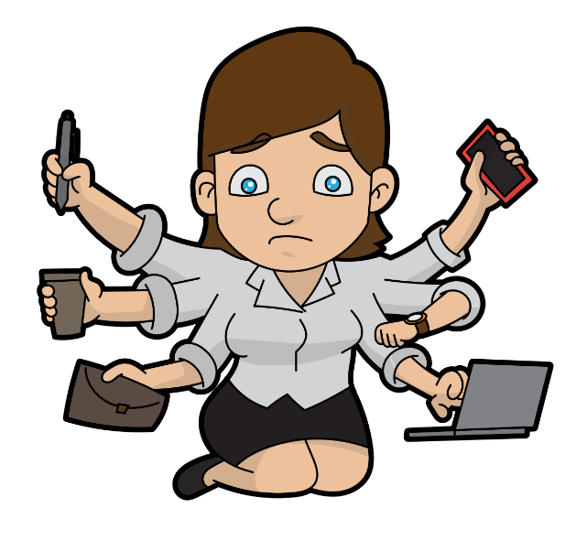
Chronic Stress/ Trauma
Trauma is the impact felt from high levels of chronic stress. This can be emotional or physical.
Heightened cortisol response
Impaired mental health
Maladaptive changes to brain architecture
Modified gene expression
Poor stress management and coping skills
Unhealthy lifestyle

Slide 8
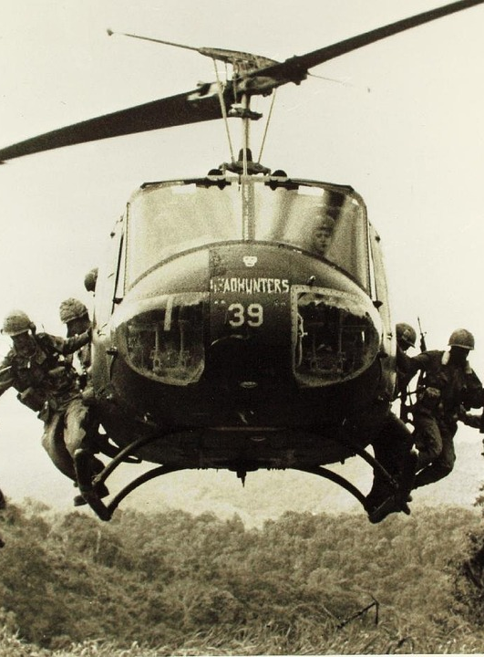
Trauma
This Photo by Unknown Author is licensed under CC BY-NC
Trauma is a deeply distressing or disturbing experience:
Tourism (911, Unabomber, Oklahoma City bombing)
Natural Disasters
Car accidents
Loss/death
Poverty
Rape
War

Slide 9
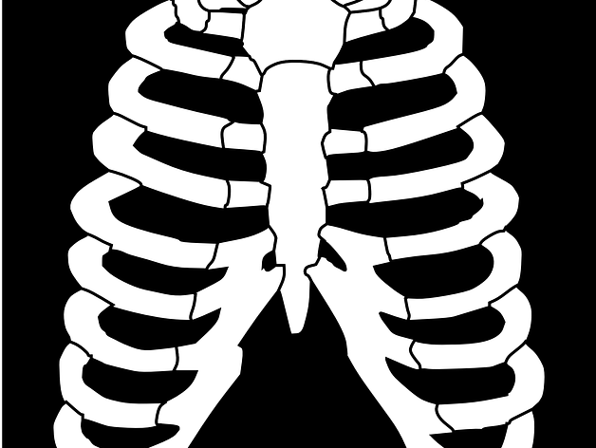
Trauma Bodies
From the bodies perspective safety or danger is neither situational nor based in cognitive feelings, rather they are physical visceral sensations the body use to sense safety or danger.
Danger can mean more than just bodily harm. It can mean a threat to what we do, say, think, care about, believe in, or yearn for.
The body will do what it needs to do to recover that sense of safety
Trauma sets in very quickly into the body; to quickly to involve the rational part of the brain.
Trauma can cause us to react to current events that seems wildly inappropriate, overcharged, or out of proportion.

Slide 10
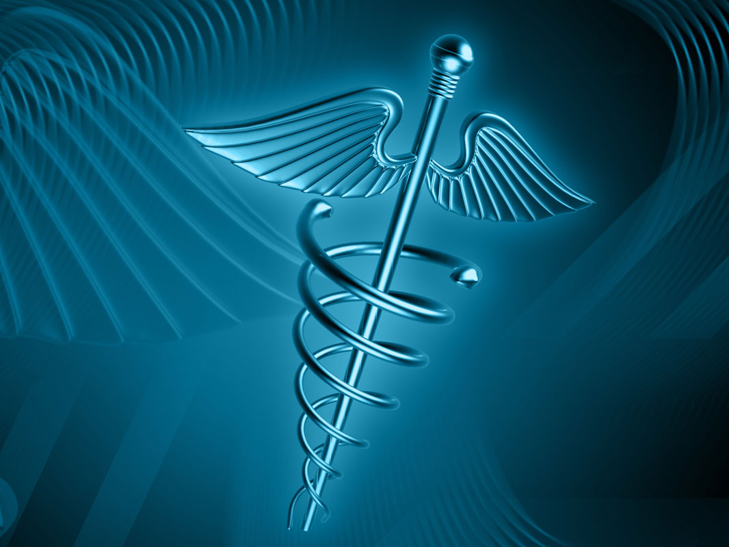
Trauma Bodies
Trauma lives in the body
It’s a spontaneous protective mechanism used by the body to stop any future potential harm.
It is a highly effective tool for safety and survival.
An embedded trauma response can manifest as fight, flee, or freeze
Trauma can get stuck in the body and will stays there until it is addressed
The body is where we live. It’s where we fear, hope, and react. It is where we constrict and relax. The body cares most about safety and survival.

Slide 11
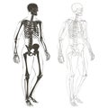
Trauma Bodies
There is something about an event, person, or situation that rekindles an old pain or discomfort, and the body tries to address it with reflective energy that is still stuck inside the nervous system.
The body then began to create strategies around the stuckness including extreme reactions, strange likes and dislikes, compulsions, seemly irrational fears, and unusual avoidance strategies over time.
This can be embedded in the body as a standard way of surviving and protecting itself.
When these strategies are repeated, they can be passed on to the next generation.
It can become the standard response in families, communities, and cultures.

Slide 12
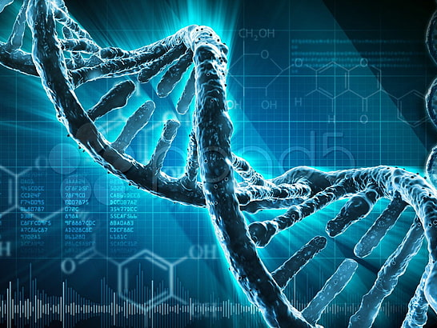
Trauma Bodies
Recent work through human genetics suggest that trauma is passed on through our DNA expression. Through the biochemistry of the human egg, sperm, and womb.
Our genes carry information that affects our health, our appearance, and personality.

Slide 13
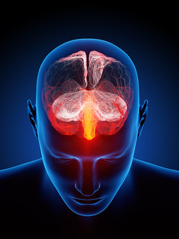
Unresolved Trauma
Can trigger real physical pain and disease
Lead to a range of self-destructive behavior
Takes a toll on our family life and interpersonal relationships
Trauma can be blocked out (consciously or unconsciously) but it doesn’t’ mean that he/she/them/they will not feel the effects of it.
The effects of unresolved trauma can be devastating. It can affect our habits and outlook on life, leading to addiction and poor decision making.

Slide 14
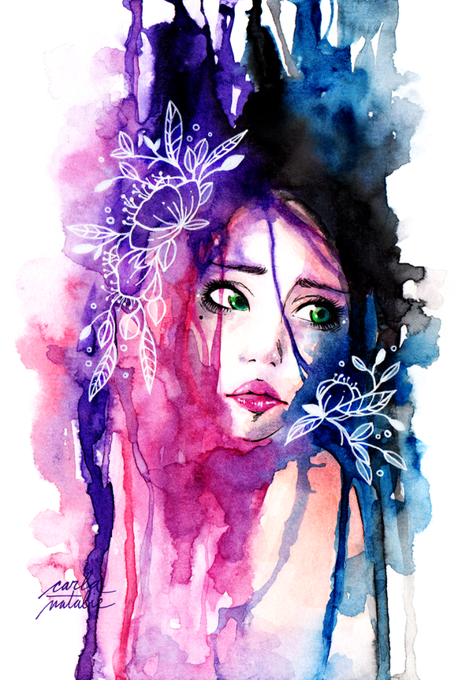
Effects OF Trauma
Induce anxiety, arrests the vocal process, and blocks the creative flow of authentic self-expression.
Trauma affects the involuntary nervous system, body, brain, and memory function.
It is hard to recognize this level of trauma therefore it get mislabeled or dismissed as being part of a person’s personality

Slide 15
Silence -vs- Voicelessness

Slide 16
Silence
People chose to remain silent to avoid conflict
When doing the right thing is not popular
When it’s perceived that speaking up will hurt their chances at success
When being to concerned about other people’s opinion
Not wanting to be labeled

Slide 17
My voice was taken……..
Dominance
Constant surveillance
Oppression
Direct Trauma
Vicarious Trauma
Microaggressions
Stereotypes
Prejudice
Gratitude
Not meeting societal standards
This Photo by Unknown Author is licensed under CC BY-ND

Slide 18
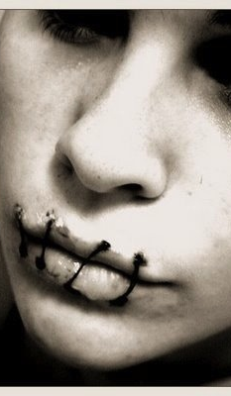
Voicelessness
Dominance sets the harm and control the room.
Deny me of my definition and control my story with your narrative.
Expectation of gratitude.
This Photo by Unknown Author is licensed under CC BY

Slide 19
Silence is the tool of white ideology
Your silence can be taken as consent
This Photo by Unknown Author is licensed under CC BY-SA-NC

Slide 20
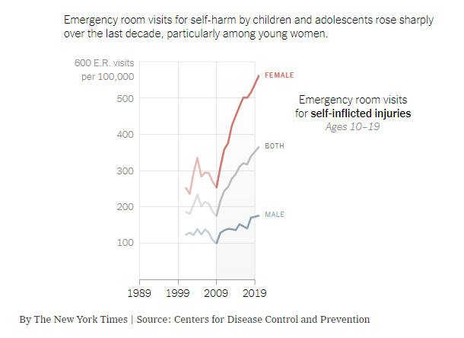
The State of Mental Health & Youth in the U.S.
In 2019, even before COVID-19, 13% of adolescents reported having a Major Depressive episode (HRSA, 2020)
60% increase from 2007
88% increase in emergency room visits by children and adolescents for anxiety, mood disorder and self harm (HRSA, 2020)
Suicide rates for people ages 10-24 were stable from 2000-2007 (National vital statistics, 2020)
Leaped to nearly 60% by 2018

Slide 21
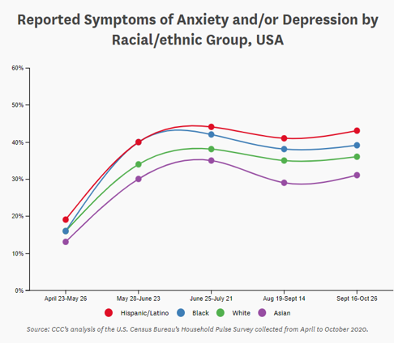
The State of Mental Health & Youth in the U.S.
Increase in Stressors over the last several years
COVID-19
Murder of George Floyd on May 25, 2020
Depression and Anxiety spiked the week following the murder, particularly among Black and Hispanic Youth (CCC, 2020)
2019-2020 – increase in children’s mental health related emergency visits (Leeb et al, 2020)
24% for children ages 5-11
31% for youth ages 12-17
Significant decline in primary and preventive services for children from 2019-2020 (CMS, 2020)
44% fewer (3.2 million) child screening services
Services include assessment of physical and cognitive development needs – can provide early detection of autism, developmental delay and other conditions
Limited Access to services due to social isolation

Slide 22
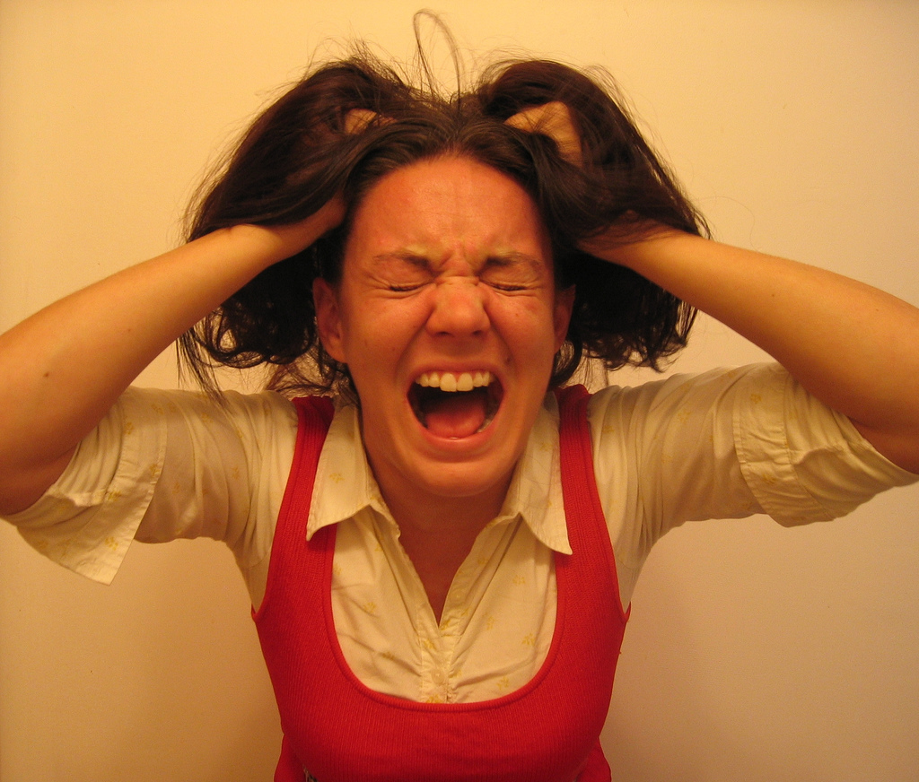
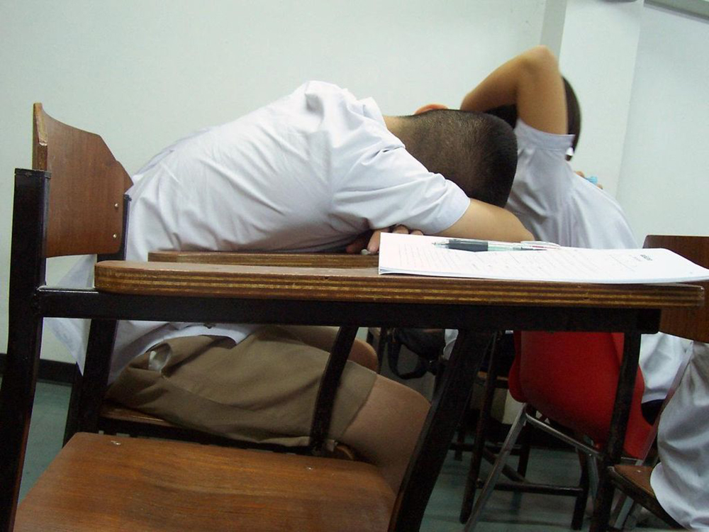
Indicating Factors:
Adolescents are getting less sleep, exercise, and in-person time with friends – all crucial for healthy development (Knell et al, 2019)
Mental Health Crisis is often attributed to the rise in social media, but solid data are limited, and findings are often contradictory
Limited access to care
Depression is most common among those with the least access to any health care, including MH
Severe shortage of therapists and treatment options
Insufficient research to explain the trend
Earlier onset of Puberty for girls at age 12 years old today from 14 years old in 1990

Slide 23
Evidence Of Bias
This Photo by Unknown Author is licensed under CC BY
Research shows when the providers and youth are of different cultures providers have more difficulty connecting
Ethnically matched providers tend to judge clients to a higher mental functioning than mismatched providers

Slide 24
Substance Use Among Youth (Post-COVID)

Slide 25
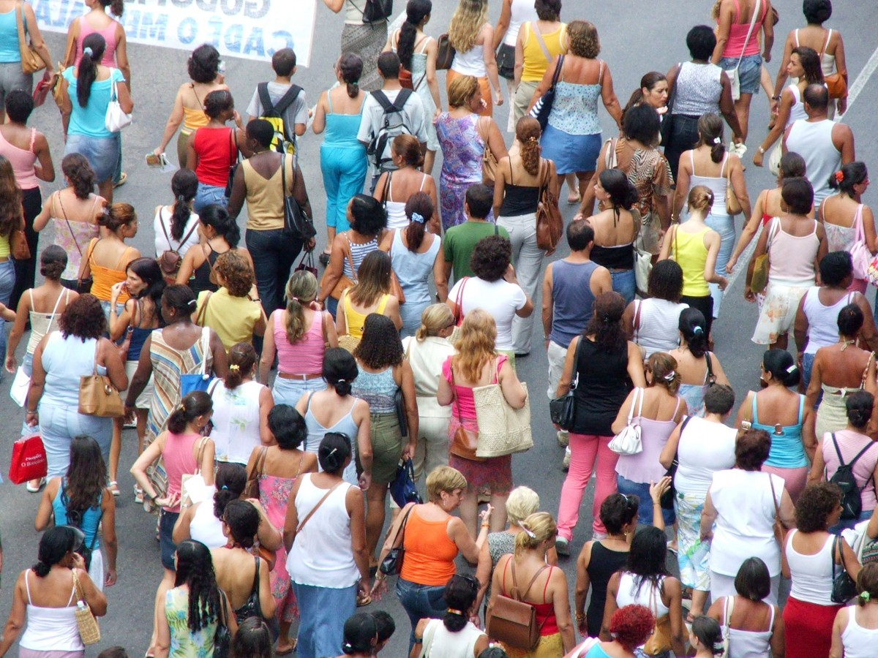
People who experience repeated, chronic, or multiple traumas, including historical trauma, are more likely to have more pronounced symptoms and consequences including: (CDC, 2014)
Substance abuse and dependence
Depression symptoms and disorder
Anxiety symptoms and disorder
Impairment in relational/social and other major life areas (including treatment)
Increased risk for mental illness and increases in symptom severity
Sleep disorders
Poor work performance
Financial stress
Smoking
Suicide attempts

Slide 26
Impact of Chronic Stress/Trauma in Youth
Unintended and adolescent pregnancies
Poor academic achievement
Heightened risk for intimate partner violence (IPV)
Numerous health problems, physical disorders, and conditions, including:
Liver disease
Heart disease
Sexually transmitted infections
Catastrophic expectancy
Emotional dysregulation

Slide 27
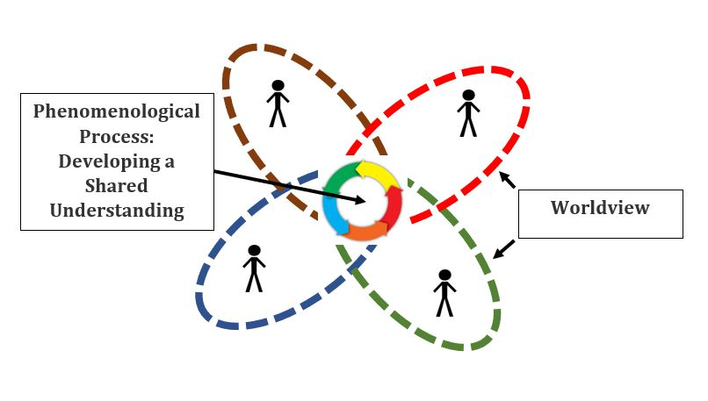
Different Worldview
Lack of understanding of unique life experiences-allows for rationalization, minimizing, or dismissal.
Lack of knowledge about cultural systems of healing-needs will not be met.
Lack of participation of in one’s own treatment-allows for early termination of services

Slide 28
Providers Awareness
A culturally skilled provider is one who moves from being culturally unaware to being culturally sensitive to his or her own cultural heritage while respecting the differences of others
The culturally skilled provider is aware of personal biases and the possible effects it can have on therapeutic outcomes
The culturally skilled provider is comfortable with difference of race, religion, sexuality, disabilities, etc
The culturally skilled provider acknowledges personal attitudes, beliefs, and feelings
This Photo by Unknown Author is licensed under CC BY

Slide 29
Culture & Diversity
Focus on lifestyle, cultural, values, and sociopolitical realities of minorities
Techniques used with Caucasians are inherently different from those needed when dealing with POC
POC historically terminate permanently after one session/treatment
POC underuse services available to them because they don’t feel seen or heard
This Photo by Unknown Author is licensed under CC BY

Slide 30
Trauma Informed Care
Given the prevalence of trauma, it is crucial that we practice incorporating trauma informed care.
Trauma informed care is an approach that focuses on Resilience and Strength.
It requires being self and culturally aware, being open to differences, recognizing our limitations and impact on others.
Responding to the effects of trauma while identifying the cause.

Slide 31
Let The Flames Burn Off Everything That No Longer Applies To You. Have The Courage To Be Different
Courage does not always roar. Sometimes courage is the quiet voice at the end of the day saying,
“I will try again tomorrow.”
And the day came when the risk to remain tight in a bud was more painful than the risk it took to BLOOM

Slide 32
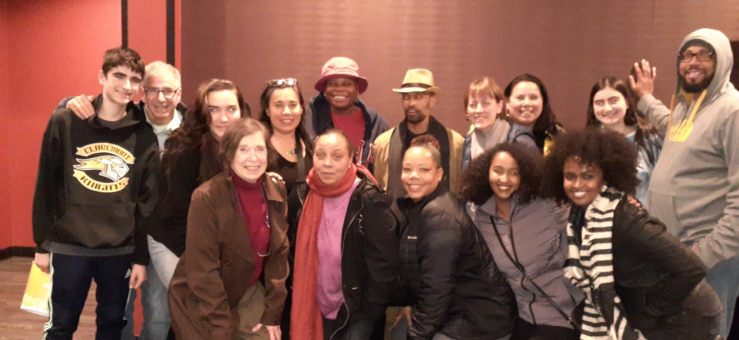
????QUESTIONS ????
Thank You

