Slide 1
Insight, and treatment engagement in psychotic disorders
New England MHTTC & MMHC Grand Rounds
Matcheri Keshavan, MD
April 17th, 2024
Notes:
DO NOT CHANGE THE FORMAT OF THIS TEMPLATE. If you are creating MHTTC-branded slides, you must use this template or one of the other approved templates in the Shared Folder.

Slide 2




Housekeeping Information
Participant microphones will be muted at entry
If you have questions during the event, please use the chat
This session is being recorded and it will be emailed to all participants once available.
If you have questions after
this session, please e-mail:
newengland@mhttcnetwork.org.
At the end of the month, we will send you a certificate of completion that you can submit to your particular board for continuing education credit. Please contact ifisher@c4innovates.com for more information on CEs after the event.

Slide 3
Acknowledgment
Presented in 2022 by the Mental Health Technology Transfer Center (MHTTC) Network.
This presentation was prepared for the New England Mental Health Technology Transfer Center (MHTTC) Network under a cooperative agreement from the Substance Abuse and Mental Health Services Administration (SAMHSA). All material appearing in this publication, except that taken directly from copyrighted sources, is in the public domain and may be reproduced or copied without permission from SAMHSA or the authors. Citation of the source is appreciated. Do not reproduce or distribute this publication for a fee without specific, written authorization from New England MHTTC. For more information on obtaining copies of this publication, email us at newengland@mhttcnetwork.org.
At the time of this publication, Miriam E. Delphin-Rittmon, Ph.D, served as Assistant Secretary for Mental Health and Substance Use in the U.S. Department of Health and Human Services and the Administrator of the Substance Abuse and Mental Health Services Administration.
The opinions expressed herein are the view of TTC Network and do not reflect the official position of the Department of Health and Human Services (DHHS), SAMHSA. No official support or endorsement of DHHS, SAMHSA, for the opinions described in this document is intended or should be inferred.
This work is supported by grants #1H79SM081775 from the Department of Health and Human Services, Substance Abuse and Mental Health Services Administration.
Presented 2022
Notes:
Always use acknowledgment slide on the 2nd slide and add your center’s information

Slide 4
Notes:
Always use Language Matters graphic as your third slide.

Slide 5
Insight, and treatment engagement in psychotic disorders
Matcheri S. Keshavan MD
Harvard Medical School; Massachusetts Mental Health Center and Beth Israel Deaconess Medical Center
No significant disclosures

Slide 6
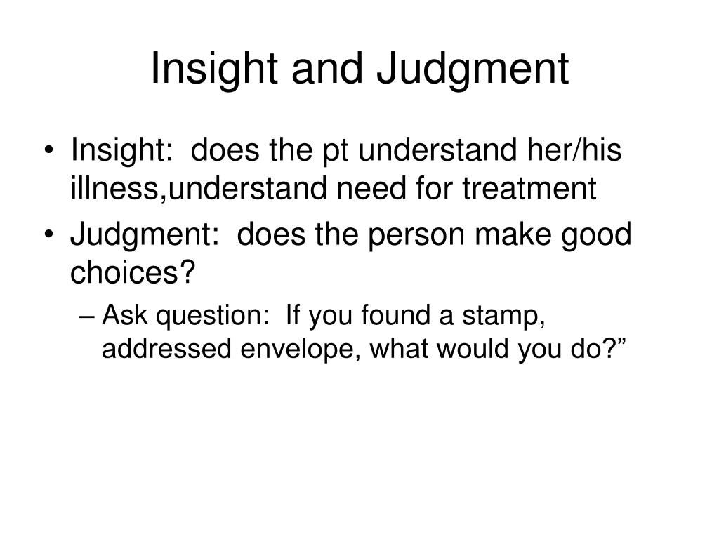



Treatment adherence refers to the degree to which a patient follows a treatment regime
Compliance vs adherence vs treatment engagement.. What is a better term?

Slide 7
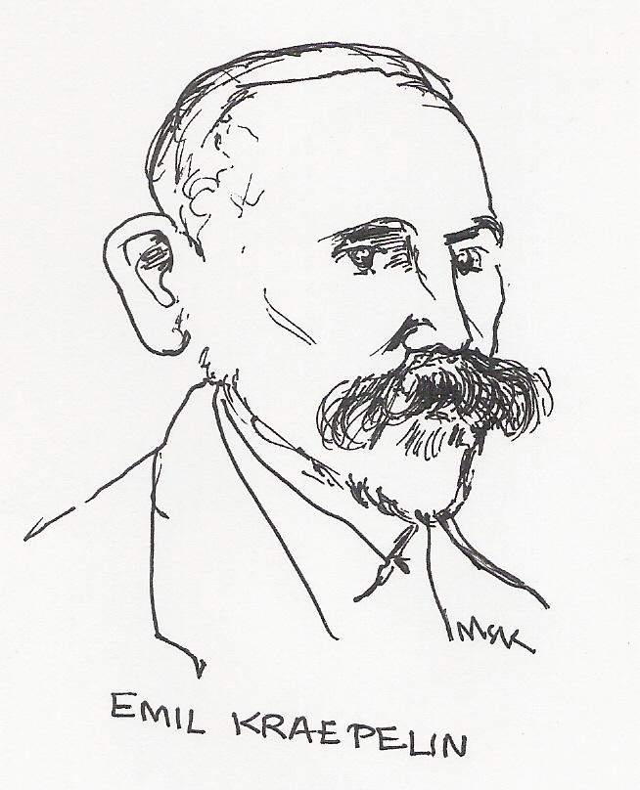
Emil Kraepelin, in 1919
“understanding of the disease disappears fairly rapidly as the malady progresses in an overwhelming majority of cases.”…

Slide 8
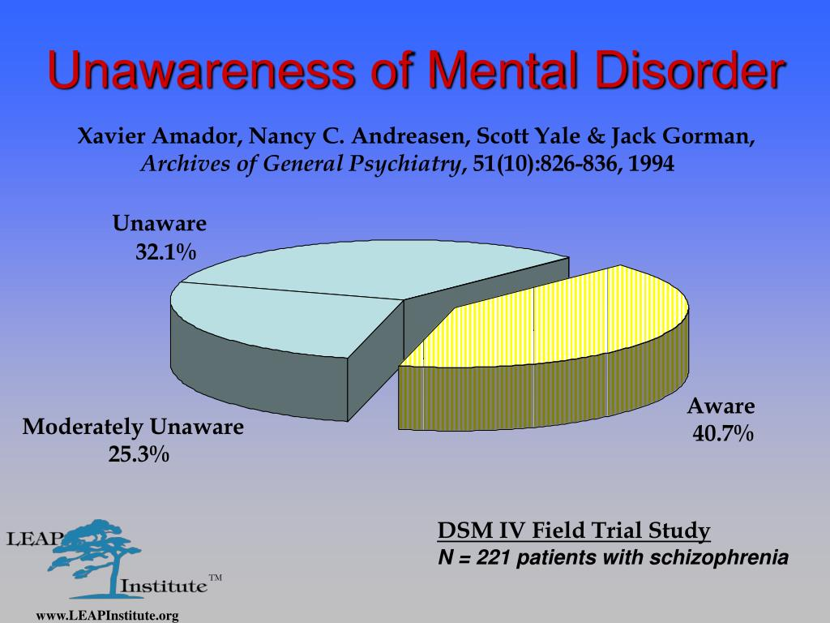

Slide 9
Insight is multi-dimensional
unawareness of illness,
misattribution of particular psychotic symptoms
unawareness of the need for treatment
(Amador et al., 1993).
My grand mother speaks to me inside my head
I know it’s not my grandmother, but a chip inside my head
I know I hear voices I shouldn’t be hearing, but I don’t need treatment

Slide 10
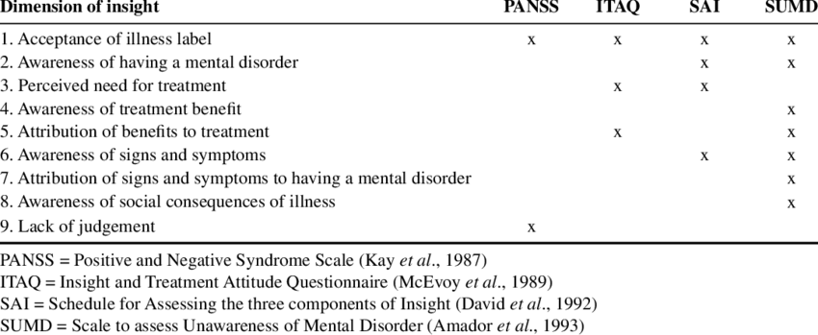
Assessing insight
Lack of insight vs pt-clinician disagreement
Lack of insight vs Denial

Slide 11
N=535
0.2
0.1
0
Cognitive Functioning
-0.1
Absent
Minimal
Mild
Severe
Moderate
Moderate-Severe
-0.2
-0.3
Insight Impairment
P<.0001
Keshavan et al Schiz Res 2004
Cognitive impairment strongly
correlates with poor insight

Slide 12
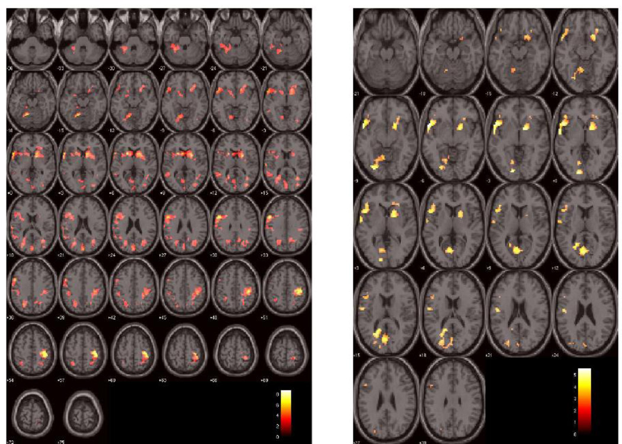
Unawareness
Misattribution
Brain and insight: an dfMRI study: Shad and Keshavan Schiz Res 2015

Slide 13
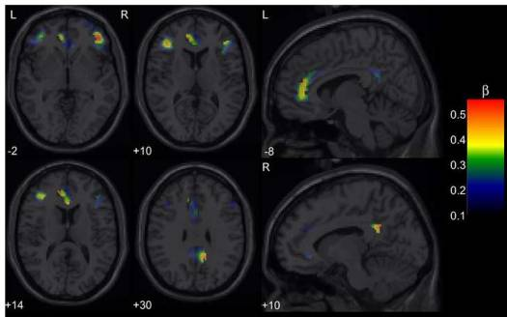

Future myopia
Brain correlates of foresight in schizophrenia
Eack, Prasad and Keshavan Schiz Res 2008

Slide 14
Can insight be improved?
Cognitive remediation can improve insight (Lalova et al 2013)
Metacognitive Insight and Reflection Therapy (Lysaker et al 2020)
Noninvasive neuromodulation prefrontal cortex (Blay et al 2021)
Clozapine may benefit (Pallanti et al 1999)

Slide 15
Treatment needs to be tailored to the component (s) of insight impairment
unawareness of illness,
misattribution of particular psychotic symptoms
unawareness of the need for treatment
My grand mother speaks to me inside my head
I know it’s not my grandmother, but a chip inside my head
I know I hear voices I shouldn’t be hearing, but I don’t need treatment
Cognitive remediation, metacognitive therapy
CBT
Motivational interviewing

Slide 16
Insight and adherence overlap,
but are not the same
Insight
Adherence

Slide 17
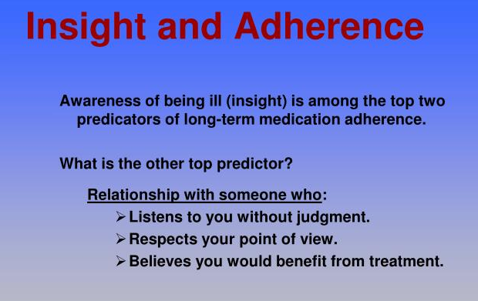

Slide 18

How many psychiatrists does it take to change a light bulb?
Just one, but the bulb will have to be ready to change

Slide 19
Treatment:
Efficacy
Safety
Simplicity
Inexpensive
Good Dr Patient
relationship
level of supervision
Person:
Insight
family support
Intelligence
Illness
Acceptance
Perception of severity
Perception of susceptibility
treatment
adherence
Treatment:
lack of Efficacy
side effects
Complex regime
Costly
Poor therapeutic alliance
Person:
Cultural barriers
family prejudice
Poor Insight
Stigma
Illness
Asymptomatic
Psychosis
grandiosity
Cognitive impairment
Perceived
benefits
Perceived
risks
Health belief model
(Perkins J Clin Psychiatry, 1999)

Slide 20
Patient perception of
Benefits Disadvantages
Benefits Disadvantages
treatment non adherence
treatment adherence

Slide 21
Adherence is a Continuum
Partial Adherence
Some meds taken —often erratically
Nonadherence
Satisfactory Adherence
Few or no
meds taken
0% Adherence to Prescribed Regimen 100%
Notes:
Numerous studies have shown that few people are fully compliant or fully noncompliant with medication. Most people with various disorders, including schizophrenia, fall somewhere in the middle, skipping doses at times. Conventional wisdom and clinical experience places satisfactory compliance at 70%-80% of prescribed medication, but there is accumulating data that suggest even a few missed days may be of importance.
This partial compliance is a critical impediment to successful treatment of schizophrenia.

Slide 22
Why Do Relapses Matter?
Time to get better increases with each episode
150
100
Days
50
0
1
2
3
Episode
Lieberman et al 1995

Slide 23
Nonadherence Across Medical and Psychiatric Disorders
100
90
80
70
60
50
40
30
20
10
0
Exercise
Flossing
Diabetes
Rh Arthritis
Asthma
Headache
Wt reduction
Hypertension
Depression
Strep throat
Schizophrenia
Non-adherence is highly common in schizophrenia,
especially early in illness

Slide 24
Results of the CATIE study
No clear winners in efficacy
Expected differences in side effects
74% discontinued meds by 18 months
  OLZ 64%
  RIS 74%
  ZIP 79%
  QUE 82%
  PERPH 75%
Lieberman et al NEJM 2005

Slide 25
Patients and Clinicians estimate of Adherence
100
%
80
60
40
20
0
Clinician
Patient
MEMS Cap
Pill Count

Slide 26
  Common Clinical Scenarios
Patient who believes he/she does not need meds
Patient who refuses meds
Patient non-adherent because meds not working
Patient non-adherent because of side effects
Patient does not show up for first appointment
Patient who frequently misses/forgets meds

Slide 27
21 year old college freshman admitted for not eating, declining grades,poor self care, and wandering the streets. Believes she is not ill, but admits to “whispering sounds cluttering her thoughts”
Therapeutic alliance: The LEAP approach
  Listen
  Empathize
  Agree
  Partner
  (Amador, I Am Not Sick: I Don’t Need Help, Vida Press, 2000)

Slide 28
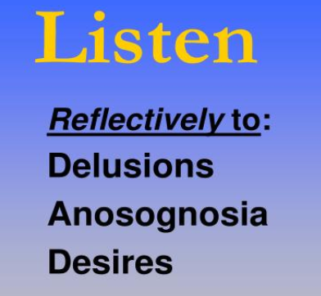
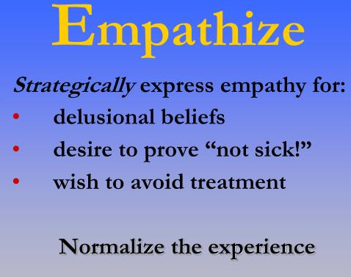
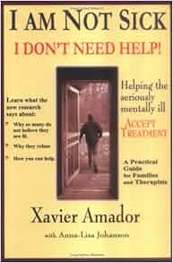
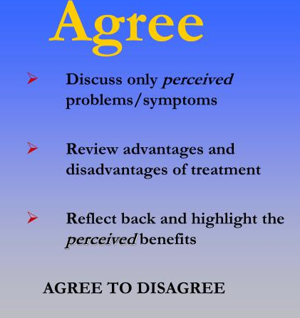
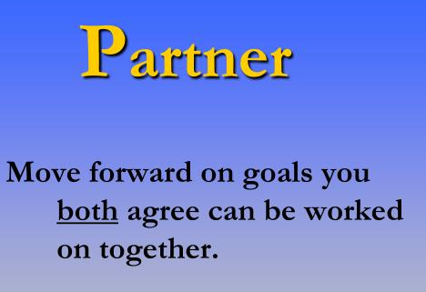

Slide 29
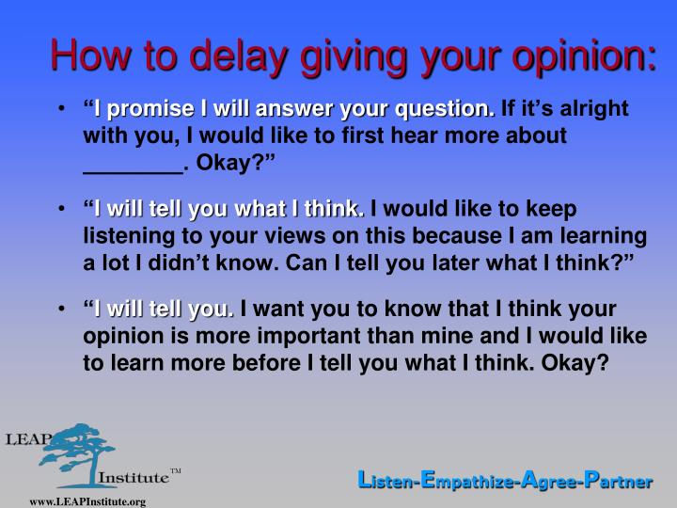

Slide 30
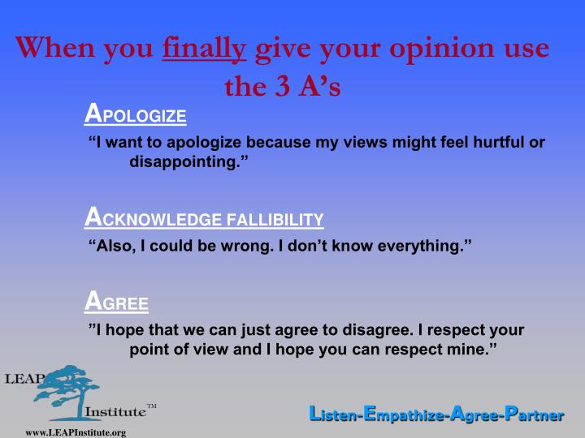

Slide 31
Patient is a 21 year old undergrad admitted for “odd” behavior of trying to climb a high rise building, and to patrol the downtown at night so that he can save lives. He does not believe he is ill, and refuses meds.
Listen to the patients concerns and goals of treatment
Psychoeducation
Identify and address barriers to treatment adherence
Elicit support from family
Consider second opinion
Court assisted treatment only after all other options tried

Slide 32
See a psychiatrist…For what?

Slide 33
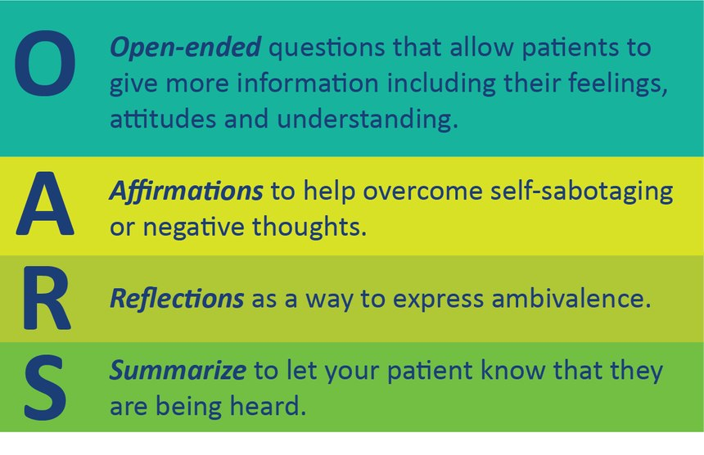
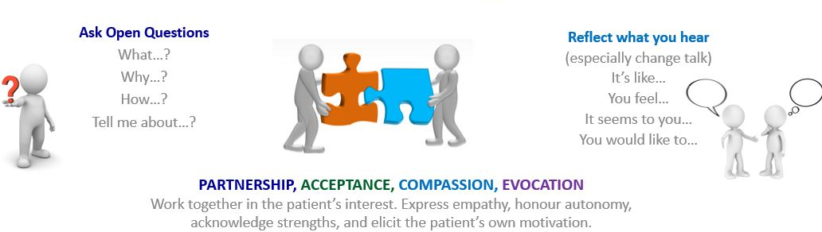
Motivational Interviewing Principles

Slide 34
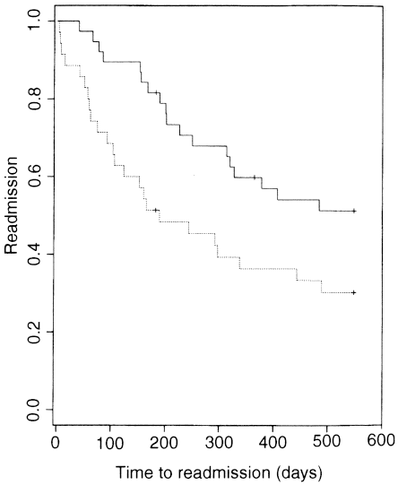
Compliance therapy
Treatment as usual
(Kemp et al, British J Psychiatry 1998)

Slide 36
24 year old engineer is seen in the ER for recent paranoia and auditory hallucinations. He is prescribed 2 mg risperdal and discharged. He is not seen again at clinic, but had presented at ER the following day believing he has “meningitis”
Options:
Proactively evaluate for medication side effects
Educate patient of potential side effects and what to do if they appear
Consider lowering dose if possible
Consider switching medication
Consider adding an agent to counteract the side effect

Slide 37
Neuroleptic Dysphoria
Predicts Treatment Refusal and Noncompliance
(Weiden et al)

Slide 38
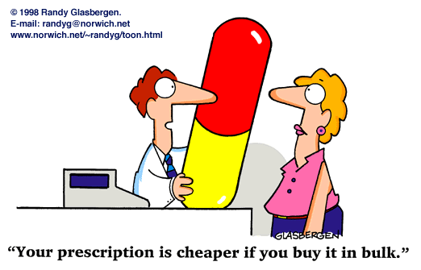
Economic side effects can affect compliance

Slide 39
34 year old unemployed lawyer is treated with
Olanzapine upto 40 mg per day for intractable beliefs that his family has been replaced by “replicas”. The resident during a reevaluation is puzzled that the patient has not put on any weight.
What is going on?

Slide 40
Options:
Patient Who fails to take Meds because of lack of efficacy.
Assess compliance, diagnosis
Appropriate dose/duration on medication?
Augmentation sttrategies
Alternative medications

Slide 41
Options:
Patient is a 28 year old man discharged from the inpatient service on friday. On Monday, nurses noted that he forgot to take his follow-up instructions. He missed his appt on Wednesday, but showed up a year later with a severe psychotic decompensation.
Enhance therapeutic continuity
If patient is not accessible by phone consider sending letter
Improve social supports, services
Evaluate barriers to treatment

Slide 42
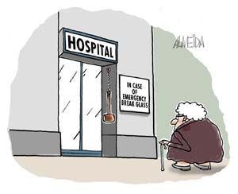
Poor access to health care is a major barrier

Slide 43
A26 year old woman with 3 young children is prescribed geodon 40 bid, clozapine 50 bid, lithium 600 mg, depakote 500 q am and 750 mg q hs and cogentin 1 mg po bid. One day, the police are called mid-day to see since she does not answer her door and children are crying inside.
Keep track of prescription amounts and expected refill dates
Coordinate information with the pharmacy
Identify barriers to taking medications
Consider pill box, cues for patient, help from family
Assess adherence regularly ( pt reports, reports by care givers, pill counts, plasma levels

Slide 44
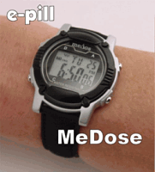

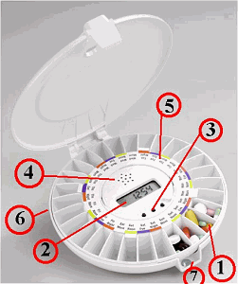
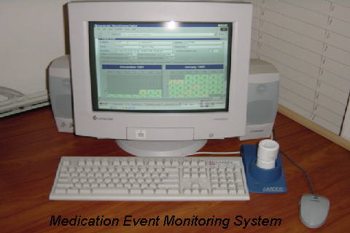
Cues to Act
Meds handled by another person (direct observation of medication taking)
Visually prominent placement of medication
Pill Boxes prepared by pharmacy, patient or another person
Alarm watches/ Electronic caps
Appointment reminders (i.e., phone calls)
Daily checklist to monitor symptom and side effects
Elicit help from pt supports

Slide 45
Medication Event Monitoring System (MEMS caps)

Slide 46
Pharmacological Approaches
to Improve Adherence
Depot conventionals
Risperdal microspheres (Consta)
Olanzapine depot
Paliperidone depot
Aripiprazole Maintena
Aripiprazole Lauroxil (Aristada)
Ariprazole Mycite
Plasma level monitoring

Slide 47
How do we choose among the long acting injectables?
 | Haloperidol | Fluphenazine | Risperidone | Paliperidone | Olanzapine
Formulation | Decanoate | Decanoate | Microspheres | Nanocrystals of 9-OH metabolite of risperidone | Pamoate aqueous suspension
Dose | 50-150 mg every 3-4 weeks (~ 10 times oral dose) Initial loading dose recommended by some | 12.5- 25 mg administered every two weeks | 25- 50 mg administered every two weeks | Initially 234 mg followed by 156 mg 8 days later, then recommended mainenance 117 mg monthly | 210 mg x 2 weeks, 300 mgx 2 weeks, then 405 mg q monthly
Initial Oral supplementation | Yes | Yes | Yes | No | No
Cost | + | + | +++ | +++ | +++
 | monthly | Once in 2 weeks | Once in 2 weeks | Monthly | Monthly
Side effects | EPS++, prolactin elevations++ | EPS++, prolactin elevations++ | Weight gain ++, metabolic syndrome++, prolactin elevations++ | Weight gain++, metabolic syndrome++, prolactin elevations++ | Weight gain +++, metabolic syndrome+++, prolactin elevations+, post-injection delirium*
* Need to observe post-injection for at least 3 hours.

Slide 48
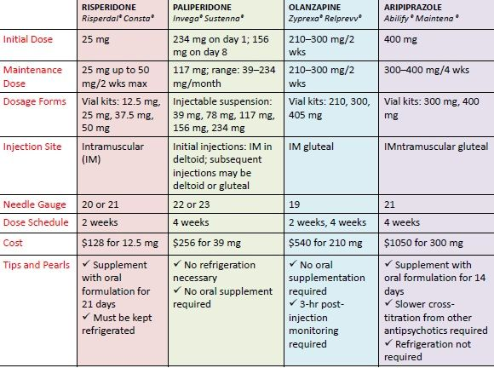
Atypical LAIs
Aripiprazole aristada
441 mg (1.6 mL), 662 mg (2.4 mL), and 882 mg (3.2 mL).
IM deltoid
or gluteal
22
4- 6 weeks
Oral ariprrazole
For at least 2 weeks prior to
initiation
one 675 mg injection of ARISTADA INITIO and one 30 mg dose of oral aripiprazole in conjunction with the first ARISTADA injection
Invega Trinza
273 mg
273-819 mg
Prefilled
syringes
273-819 mg
IM gluteal
22G
12 weeks
Sustenna for at least 4 months
before
Starting
Trinza

Slide 49
Take home points: Insight
Insight is multi-dimensional
Insight is strongly correlated with adherence
Impaired insight be related to altered brain structure and function
One aspect of insight, Foresight may be related to adherence
Metacognitive therapy, Cognitive remediation, neuromodulation and clozapine may improve insight, but more studies are needed

Slide 50
Take home points: adherence
Patient who refuses meds
Patient non-adherent because meds not working
Patient non-adherent because of side effects
Patient does not show up for first appointment
Patient who frequently misses/forgets meds/appts
Patient who believes he/she does not need meds
Improve therapeutic alliance; rapid acting meds; involuntary meds as last resort
Dosage adjustment; consider medication switch, clozapine
Dosage adjustment; consider medication switch; monitor & educate re. Side effects
Improve hospital to clinic continuity; make care more accessible and patient friendly
Cues to remember; memory aids such as pillboxes and alarm watches; phone call reminders; Risperdal Consta
Compliance therapy; continuing psychoeducation; cognitive remediation

Slide 51
Thank you!

Slide 52
The purpose of the MHTTC Network is technology transfer - disseminating and implementing evidence-based practices for mental disorders into the field.
Funded by the Substance Abuse and Mental Health Services Administration (SAMHSA), the MHTTC Network includes 10 Regional Centers, a National American Indian and Alaska Native Center, a National Hispanic and Latino Center, and a Network Coordinating Office.
Our collaborative network supports resource development and dissemination, training and technical assistance, and workforce development for the mental health field. We work with systems, organizations, and treatment practitioners involved in the delivery of mental health services to strengthen their capacity to deliver effective evidence-based practices to individuals.
Our services cover the full continuum spanning mental illness prevention, treatment, and recovery support.
MHTTCnetwork.org
Sign-Up for Newsletter
MTTC News

