Slide 1




Module 1: Foundations of Comprehensive School Mental Health
National School Mental Health Best Practices:
Implementation Guidance Modules
for States, Districts, and Schools
Notes:
Welcome to Module 1 of National School Mental Health Best Practices: Implementation Guidance Modules for States, Districts, and Schools – Foundations of Comprehensive School Mental Health.
Module content was developed by the National Center for School Mental Health in partnership with the Mental Health Technology Transfer Center (MHTTC) Network.

Slide 2
Disclaimer
The opinions expressed herein are the views of the Mental Health Technology Transfer Center Network and the National Center for School Mental Health and do not reflect the official position of the Department of Health and Human Services (DHHS), SAMHSA. No official support or endorsement of DHHS, SAMHSA, for the opinions described in this document is intended or should be inferred.
National School Mental Health Implementation Guidance Modules
Notes:
Disclaimer

Slide 3
Public Domain Notice
Public Domain Notice
All material appearing in this publication except that taken directly from copyrighted sources is in the public domain and may be reproduced or copied without permission from SAMHSA.
Do not reproduce or distribute this publication for a fee without specific, written authorization from the MHTTC NCO.
All material appearing in this publication should be appropriately cited using the recommended citation below. If content is removed, added, or adapted from the original material in this publication, these modifications should be clearly noted.
Recommended Citation
National Center for School Mental Health and MHTTC Network Coordinating Office. (2019). Trainer manual, National School Mental Health Best Practices: Implementation Guidance Modules for States, Districts, and Schools. Palo Alto, CA: MHTTC Network Coordinating Office.
National School Mental Health Implementation Guidance Modules
Notes:
Disclaimer

Slide 4

Agenda
Module 1: Foundations of Comprehensive School Mental Health
Agenda
Implementation Guidance Modules Overview and Target Audience
Alignment with School Mental Health Quality Assessment
What Is Comprehensive School Mental Health?
Core Features
Value
District Examples
National School Mental Health Implementation Guidance Modules
Notes:
This module will begin with an overview of this school mental health resource.
We will describe how the implementation guidance modules align with the School Mental Health Quality Assessment (SMH-QA), which is composed of the national performance indicators for school mental health quality.
Comprehensive school mental health will be defined and core features identified.
We will also describe the value of school mental health and share examples of district successes with advancing school mental health systems.

Slide 5


Curriculum Development
Implementation Guidance Modules Development
National School Mental Health Best Practices: Implementation Guidance Modules for States, Districts, and Schools was co-developed by the Mental Health Technology Transfer Center (MHTTC) Network and the National Center for School Mental Health (NCSMH).
National School Mental Health Implementation Guidance Modules
Notes:
National School Mental Health Best Practices: Implementation Guidance Modules for States, Districts, and Schools was co-developed by the Mental Health Technology Transfer Center (MHTTC) Network and the National Center for School Mental Health (NCSMH).

Slide 6
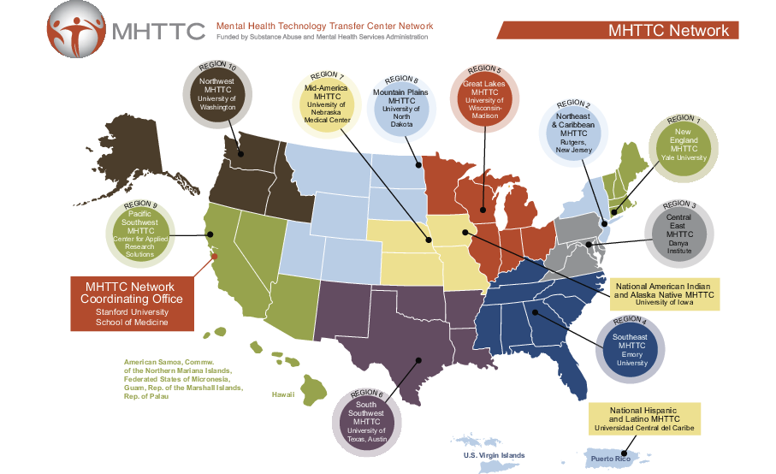
Mental Health Technology Transfer Center
Mental Health Technology Transfer Center (MHTTC) Network
Established in 2018 with funding from the Substance Abuse and Mental Health Services Administration (SAMHSA)
  10 Regional Centers
  National Hispanic & Latino Center
National American Indian and Alaska Native Center
Network Coordinating Office
Visit the MHTTC website at https://mhttcnetwork.org/
National School Mental Health Implementation Guidance Modules
Notes:
The MHTTC Network is funded by SAMHSA. The MHTTC Network includes 10 Regional Centers, a National American Indian & Alaskan Native Center, a National Hispanic & Latino Center, and a Network Coordinating Office. The Network Coordinating Office, housed at Stanford University School of Medicine, serves as the focal point and provides leadership, infrastructure, and support to the MHTTC Network.

Slide 7

National Center for School Mental health
National Center for School Mental Health (NCSMH)
Established in 1995 with funding from the Health Resources and Services Administration
The NCSMH mission is to strengthen policies and programs in school mental health to improve learning and promote success for America’s youth.
Visit the NCSMH website at www.schoolmentalhealth.org
National School Mental Health Implementation Guidance Modules
Notes:
The National Center for School Mental Health at the University of Maryland School of Medicine is funded in part by the Health Resources and Services Administration to lead the National Quality Initiative focused on comprehensive school mental health services.
The NCSMH mission is to strengthen policies and programs in school mental health to improve learning and promote success for America's youth.
The NCSMH focuses on advancing school mental health research, training, policy, and practice at the local, state, and national/federal levels.

Slide 8
Curriculum Overview
Overview of Implementation Guidance Modules
Mod 1
Mod 2
Mod 3
Mod 4
Mod 6
Mod 7
Foundations of Comprehensive School Mental Health
Needs Assessment & Resource Mapping
Mental Health Promotion for All (Tier 1)
Early Intervention and Treatment (Tiers 2/3)
Funding and Sustainability
Mod 8
Impact
Mod 5
Screening
Teaming
Notes:
This resource has eight modules, each designed for delivery in one-hour in-person sessions.
This resource contains trainer and participant manuals (with slides, worksheets, and other resources referenced in the modules).

Slide 9

Target Audience
District teams that can influence, develop, and oversee
school mental health systems at the school district and building levels.
District teams may include:
  School District Leaders (e.g., Superintendent, School Board)
  School Administrators (e.g., Principal, Assistant Principal)
  District Mental Health Director or Student Services Supervisor (e.g., Director of Student Services, District Supervisor School Psychologists/Social Workers/Counselors)
  Community Behavioral Health Agency Supervisor/Director (e.g., clinical director of an agency that provides school-based services in the district)
  Youth/Family Advocate or Consumer
National School Mental Health Implementation Guidance Modules
Notes:
The primary audience for this training is District teams that can influence, develop, and oversee school mental health systems at the school district and building levels.
District teams may include:
School District Leaders (e.g., Superintendent, School Board)
School Administrators (e.g., Principal, Assistant Principal)
District Mental Health Director or Student Services Supervisor (e.g., Director of Student Services, District Supervisor School Psychologists/Social Workers/Counselors)
Community Behavioral Health Agency Supervisor/Director (e.g., clinical director of an agency that provides school-based services in the district)
Youth/Family Advocate or Consumer

Slide 10
Quality Indicators
Quality Indicators
Best Practices
Each module aligns with the national performance domains and indicators of comprehensive school mental health system quality.
National School Mental Health Quality Assessment (SMH-QA; NCSMH, 2019)
Quality indicators have best-practice guidelines
Used to self-assess indicator implementation and guide strategic quality improvement planning
National School Mental Health Implementation Guidance Modules
Notes:
Each module aligns with the national performance domains and indicators of comprehensive school mental health system quality. These domains and indicators were established as part of the National Quality Initiative on School Health, and were developed through an iterative process led by the National Center for School Mental Health with significant and diverse stakeholder input from the field.
All domains and indicators are part of the National School Mental Health Quality Assessment (SMH-QA), which can be completed by teams as they engage with National School Mental Health Best Practices: Implementation Guidance Modules for States, Districts, and Schools. The SMH-QA provides district and school teams a framework for assessing the quality of their school mental health system and engaging in strategic quality improvement.
Many of the quality indicators include best-practice guidelines that can be used to self-assess indicator implementation and to guide strategic quality improvement planning.
Quality indicators are noted by a tab in the upper left corner of the slides within each module.

Slide 11
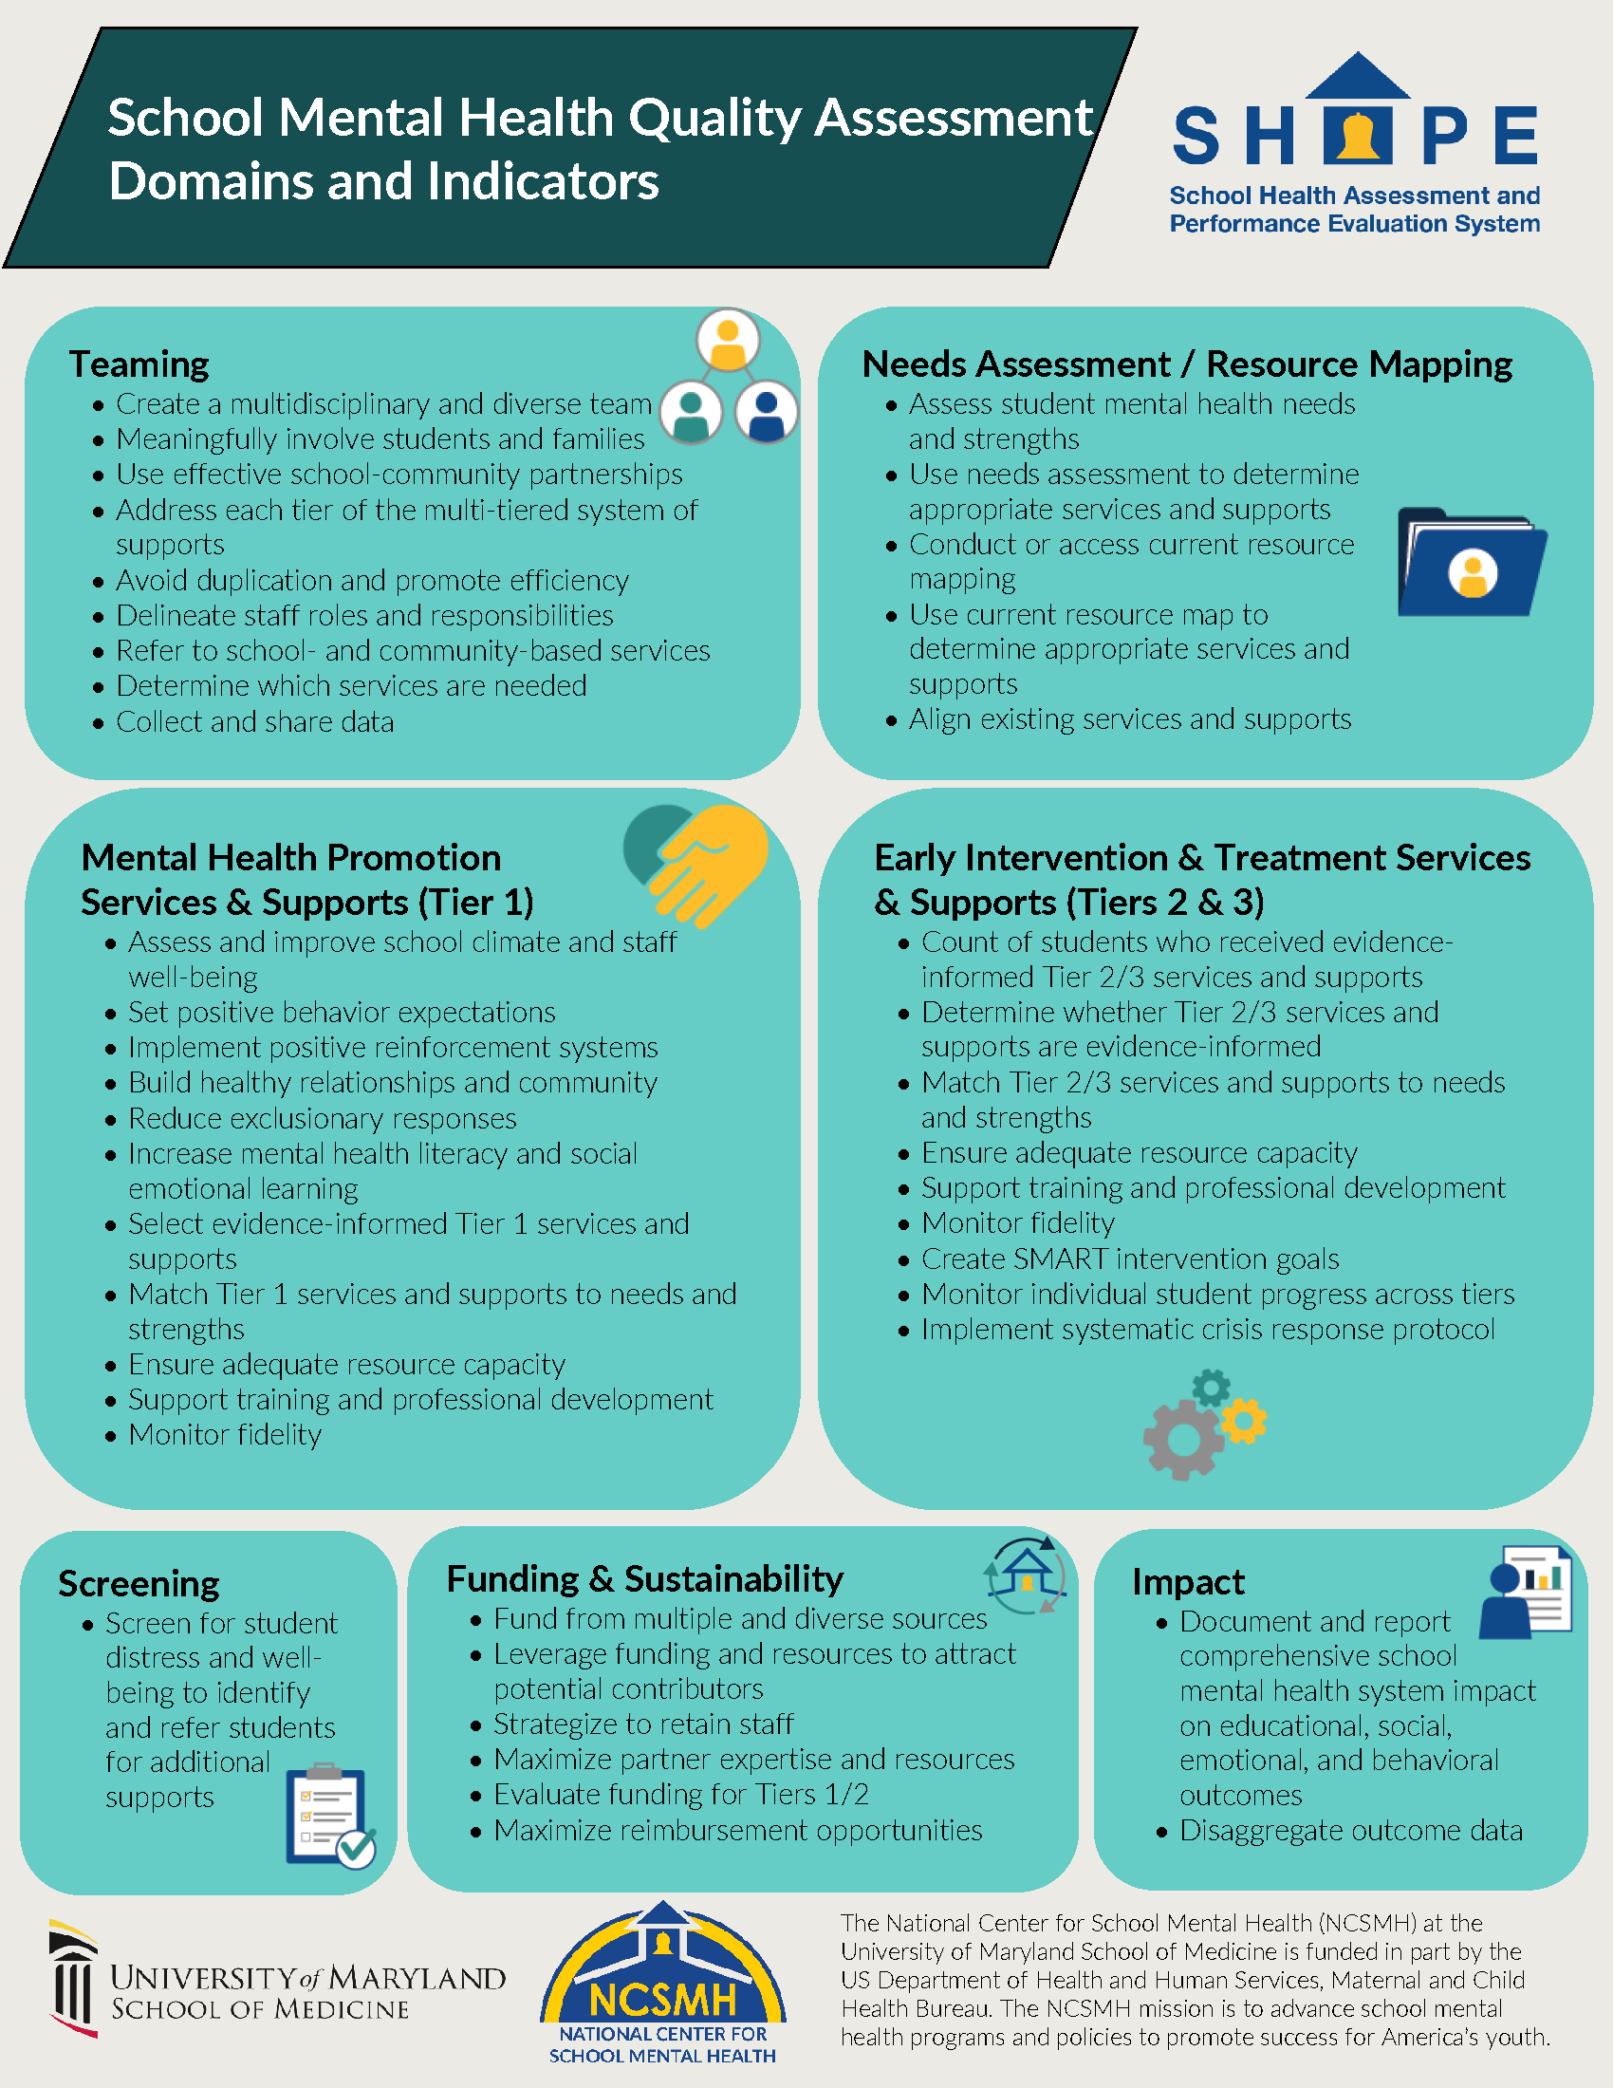
Overview of School Mental Health Quality Domains and Indicators
Overview of School Mental Health Quality Domains and Indicators
Resources
Quality Domains
Teaming
Needs Assessment and Resource Mapping
Mental Health Promotion Services and Supports (Tier 1)
Early Intervention and Treatment Services and Supports (Tiers 2/3)
Screening
Funding and Sustainability
Impact
National School Mental Health Implementation Guidance Modules
(NCSMH, 2023)
Notes:
Each module also contains resources, as indicated by the resources tab in the top right of the slide.
Many of the resources are included at the end of each module, following the slide deck.
This resource provides an overview of the School Mental Health Quality Domains and Indicators.

Slide 12

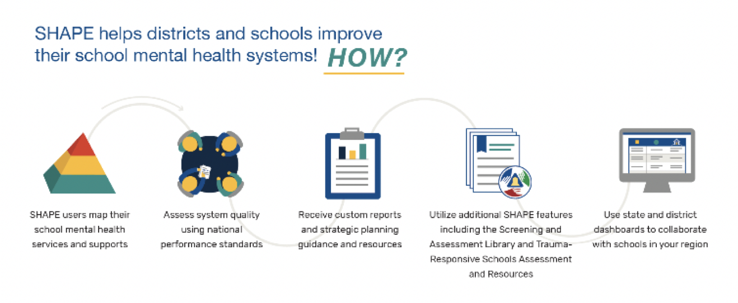
SHAPE Systems
School Health Assessment and Performance Evaluation (SHAPE) System
www.theSHAPEsystem.com
12
(NCSMH, 2019)
Notes:
The School Health Assessment and Performance Evaluation (SHAPE) System (www.theSHAPEsystem.com) is a public-access, web-based platform that offers schools, districts, and states a workspace and targeted resources to support school mental health quality improvement.
SHAPE was developed by the National Center for School Mental Health (NCSMH), in partnership with the field, to increase the quality and sustainability of comprehensive school mental health systems.
SHAPE houses the National School Mental Health Census and the School Mental Health Quality Assessment (SMH-QA, district and school versions).

Slide 13

Assessments & Reports
(NCSMH, 2019)
Notes:
SHAPE has several features to support district and school teams including school and district profiles and a quality assessment with targeted resources.
School and District Profiles collect information and provide a snapshot of the multi-tiered services and supports, staffing, financing, and data systems of your school’s or district’s comprehensive school mental health system.
Quality Assessment and Individualized Reports offer individuals and teams the opportunity to complete the National School Mental Health Quality Assessment (SMH-QA, School and District versions) and to receive tailored reports that illustrate degree of implementation from emerging to mastery. Individualized reports then provide guidance on strategic quality improvement planning.
SHAPE also hosts District and State Dashboards to provide state leaders the opportunity to systematically view the landscape of school mental health within their districts and districts the opportunity to do the same within their schools. This information may guide state and district technical assistance and quality improvement support efforts.

Slide 14

Targeted Resources & Guides
(NCSMH, 2019)
Notes:
The system provides individuals and teams with quality improvement guides and resources.

Slide 15

Screening & Assessment Library
(NCSMH, 2019)
Notes:
In addition to the quality improvement tools, SHAPE offers additional tools including the Screening and Assessment Library and the Trauma-Responsive Schools Assessment.
The Screening and Assessment Library provides information about and links to free assessment measures that can be used within school mental health. The library allows for filtering based on focus area, assessment purpose, student age, language, reporter, and cost.
The Trauma Responsive Schools Implementation Assessment (TRS-IA) offers district and school teams an evidence-informed tool to assess their trauma-responsiveness. The TRS-IA is composed of eight domains, and was co-developed by the National Child Traumatic Stress Network, Treatment and Services Adaptation Center for Resilience, Hope, and Wellness in Schools in partnership with the NCSMH.

Slide 16

Earn Shape Recognition
(NCSMH, 2019)
Notes:
District and school teams can achieve SHAPE recognition when they complete the National School Mental Health Census and the Quality Assessment. Recognition may increase opportunities for federal, state, and local grant funding.

Slide 17
What Is Comprehensive School Mental Health?
Notes:
Let’s define comprehensive school mental health and its core features.

Slide 18
Comprehensive School Mental Health Systems
Provide a full array of supports and services that promote positive school climate, social emotional learning, mental health, and well-being, while reducing the prevalence and severity of mental illness
Built on a strong foundation of district and school professionals, including administrators and educators, specialized instructional support personnel (e.g., school psychologists, school social workers, school counselors, school nurses, other school health professionals) in strategic partnership with students, families, and community health and mental health partners
Assess and address the social and environmental factors that impact health and mental health
National School Mental Health Implementation Guidance Modules
Notes:
Comprehensive school mental health systems provide a full array of supports and services that promote positive school climate, social emotional learning, mental health, and well-being, while reducing the prevalence and severity of mental illness.
Comprehensive school mental health systems are built on a strong foundation of district and school professionals, including administrators and educators, specialized instructional support personnel (e.g., school psychologists, school social workers, school counselors, school nurses and other school health professionals), in strategic partnership with students, families, and community health and mental health partners.
These systems also assess and address the social and environmental factors that affect mental health, including public policies and social norms that shape mental health outcomes. Effective comprehensive school mental health systems contribute to improved student and school outcomes including greater academic success, reduced exclusionary discipline practices, improved school climate and safety, and enhanced student social-emotional-behavioral functioning.

Slide 19

Core Features
Core Features
Educators and Student Instructional Support Personnel
  Adequate staffing and support
  Trained to address student mental health in schools
Collaboration and Teaming
  Youth and families
  Community health/mental health and other partners
Multitiered System of Supports
  Mental health promotion support (Tier 1)
  Early intervention and treatment services and supports (Tiers 2-3)
Evidence-Informed Services and Supports
Cultural Responsiveness and Equity
Data-Driven Decision-Making
Notes:
There are several core features of comprehensive school mental health systems. Each of these will be examined in more depth here and throughout the training.
Core Features include:
Educators and Student Instructional Support Personnel
Collaboration and Teaming
Multitiered System of Supports
Evidence-Informed Services and Supports
Cultural Responsiveness and Equity
Data-Driven Decision-Making
Several successful state and local examples of these core features provide a road map to achieve wide scale adoption of comprehensive school mental health systems across the United States, and will be used as examples throughout this training resource.

Slide 20
Educators and Student Instructional Support Personnel
District and school professionals are the foundation of comprehensive school mental health systems.
  Administrators and Educators
  Student Instructional Support Personnel
    School Psychologists
    School Counselors
    School Social Workers
    School Nurses
    Other Health Professionals
Consider nationally recognized staffing ratios.
Community partners should augment existing supports and services in a strategic and integrated way.
National School Mental Health Implementation Guidance Modules
Notes:
It is important to have a full array of school and district professionals, including specialized instructional support personnel, who are well-trained to support the mental health needs of students in the school setting.
District and school professionals are the foundation of comprehensive school mental health systems.
Administrators and Educators need to be trained in how to promote student mental health and to identify and refer students in need of extra mental health supports.
Student Instructional Support Personnel include a variety of professionals trained to support student mental health in the school context. These include:
School Psychologists
School Counselors
School Social Workers
School Nurses
Other Health Professionals
Consider nationally recognized staffing ratios – Each Student Instructional Support Personnel professional organization has nationally recognized staffing ratios. Districts and schools should consider whether they have sufficiently invested in these personnel in alignment with needs and recommended ratios.
When community providers partner with schools, they should augment existing supports and services in a strategic and integrated way instead of replacing or being walled off from school professionals.

Slide 21

Collaboration and Teaming
Students
Families
Schools
Community health and mental health
Policymakers
Funders
National School Mental Health Implementation Guidance Modules
Notes:
Collaboration and teaming among students, families, schools, community partners, policymakers, funders, and providers addresses the interconnected academic, social, emotional, and behavioral needs of all students.

Slide 22
Examples of Partnership
  School-community advisory group
  Needs assessment process and program selection
  Family-centered procedures
  Communications
  Evaluating programs and communicating results
National School Mental Health Implementation Guidance Modules
Notes:
Students and families should be involved in all levels of school mental health systems, including planning, development, implementation, evaluation, and training.
There are several ways that students and families can be involved in school mental health systems. Some examples include:
Participation in a school-community advisory group
Involvement in needs assessment process and program selection
Involvement in developing family-centered procedures for mental health referral, service provision, follow-up, and crisis care
Development of communications about school mental health services to students and families
Evaluating programs and communicating results to parents, community, and funders
In addition, there is good research to show that students have better outcomes in school and in mental health treatment when families are engaged.

Slide 23

Community Partnerships
Partnerships between schools and community mental health organizations are purposeful, and designed to:
Augment the abilities of schools to address barriers to learning and promote social-emotional well-being
Provide a broader array of supports, including mental health promotion, prevention, and intervention within a multi-tiered system of support
Improve access to mental health care
National School Mental Health Implementation Guidance Modules
Notes:
Partnerships between schools and community mental health organizations are purposeful, and designed to augment the abilities of schools to integrate student mental health into education.
Community partners can help to augment services within the school building and can link students to other services and supports in the community. In addition, they can help to champion what schools are doing to support mental health with key leadership, including boards of education and policymakers.
Successful and sustainable school mental health systems integrate partners to complement the mental health supports and services offered by districts and schools. The roles and responsibilities of school and community partners will differ based on unique resources and needs.
In many schools, community partners are integrated across all tiers of support, but are primarily involved in more intensive treatment supports for youth with identified mental health challenges.

Slide 24
Multitiered System of Supports
Multitiered System of Supports (MTSS)
Tier 3
Targeted interventions for
students with serious concerns
that affect daily functioning
Professional development and support for a healthy school workforce
Family-School-Community partnerships
Tier 2
Supports and early intervention for students identified through needs assessments as at risk for mental health concerns
Tier 1
Promotion of positive social, emotional, and behavioral skills and overall wellness for all students
Notes:
A full array of tiered, evidence-based processes, policies, and practices, called a multi-tiered system of supports (MTSS), promotes mental health and reduces the prevalence and severity of mental illness. Based on principles of prevention, the tiers of support layer on one another so that students with higher-level needs continue to receive supports that promote positive mental health among all students.
Many schools deliver instructional or behavioral intervention to students in varying intensities as part of this MTSS to address the academic needs of the larger student body and not just students with identified disabilities. Based on a public health framework, prevention is an underlying principle at all three tiers, with Tier 1 focused on promoting mental health and preventing occurrences of problems, Tier 2 preventing risk factors or early-onset problems from progressing, and Tier 3 individually intervening to address more serious concerns that affect student daily functioning.
Matching the range of academic, behavioral, and social needs within a school involves layering of interventions from universal approaches to targeted programming for students with mild impairment and, for some students, adding on individualized interventions linked to the lower-tiered structures.
The MTSS approach ensures that all students may access the service array, including students in both general and special education, and that all students will have exposure to universal mental health supports. The number of tiers in an MTSS can vary, though many districts employ a 3-tiered model:
Mental health promotion services and supports (Tier 1) are mental health-related activities, including promotion of positive social, emotional, and behavioral skills and well-being, which are designed to meet the needs of all students regardless of whether or not they are at risk for mental health problems. These activities might also include efforts to support a positive school climate and staff well-being. These activities can be implemented school-wide, at the grade level, and/or at the classroom level.
Examples include school-wide curricular lessons and grade-level or classroom presentations for all students regardless of whether or not they are at risk for mental health problems.
Early intervention services and supports (Tier 2) to address mental health concerns are provided for students who have been identified through needs assessments, screening, referral, or other school teaming processes as experiencing mild distress or functional impairment, or being at risk for a given problem or concern. When problems are identified early and supports put in place, positive youth development is promoted and problems can be eliminated or reduced.
Examples include small group interventions for students identified with similar needs (e.g., chronically absent students), brief individualized interventions (e.g., motivational interviewing, problem solving), mentoring, and/or low-intensity classroom-based supports such as a daily report card or daily teacher check-in.
Treatment services and supports (Tier 3) to address mental health concerns are provided for students who are already experiencing significant distress and functional impairment.
Examples include individual, group, or family therapy for students who have identified, and often diagnosed, social, emotional, and/or behavioral needs.

Slide 25
Key Considerations in MTSS
Key Considerations in MTSS
Needed supports and services are fluid.
  Students need different levels of support at different times throughout development.
Tiers are layered.
  Students who receive higher levels of support continue to benefit from universal mental health promotion supports.
Invest in mental health promotion!
  Effective mental health promotion (Tier 1) supports can reduce the degree of need for higher-level supports in a school or district.
Provide more intensive and targeted services and supports at the individual, group, or family level to address mental health concerns.
  Students at risk for more serious mental health concerns (Tier 2) are able to participate in programs and supports that address their risk factors and promote positive social-emotional-behavioral learning.
  Students already experiencing mental health concerns (Tier 3) have individualized services and supports that can improve mental health and overall well-being.
National School Mental Health Implementation Guidance Modules
Notes:
Some things to consider when implementing a multitiered system of support include:
Needed supports and services are fluid.
Students need different levels of support at different times throughout development.
Tiers are layered.
Students who receive higher levels of support continue to benefit from universal mental health promotion supports.
Invest in prevention!
Effective mental health promotion (Tier 1) supports can reduce the degree of need for higher-level supports in a school or district.

Slide 26

Evidence-Informed Supports and Services
Evidence-Informed Supports and Services
Services and supports that are backed by scientific and/or practice-based evidence
  Teams need a system to evaluate evidence
Ongoing monitoring of implementation success
Systematic, reliable data informs decisions about student supports and services
National School Mental Health Implementation Guidance Modules
Notes:
Implementing evidence-based practices and emerging best practices enhances the quality of the supports and services provided to students.
It is important that:
Services and supports are backed by scientific and/or practice-based evidence of implementation success and achieving the desired outcomes.
Teams need a system in place to evaluate the evidence for any service or support being considered or already being provided.
Ongoing monitoring of implementation success is crucial for continuous quality improvement.
Decisions about which services are most likely to benefit individual students are grounded in systematic, reliable data.

Slide 27

Sources of Evidence
Evidence-based practice registries
Research literature
Evidence-based practice developers
Schools implementing the service or support
National School Mental Health Implementation Guidance Modules
Notes:
There are many sources of evidence to refer to when developing and implementing your school mental health system. Research-based evidence and practice-based evidence are equally of value for districts to consider. Overall, it is imperative that districts have a strong commitment to continuous quality improvement, which can include referring to the evidence on a regular basis to make decisions.

Slide 28

Cultural Responsiveness and Equity
Responsive to the specific cultural values, beliefs, and behaviors of families and communities
Ensure access to mental health supports and services in a manner that is equitable and reduces disparities across all students
National School Mental Health Implementation Guidance Modules
Notes:
In all aspects of a comprehensive school mental health system, it is critical to consider and be responsive to the specific cultural values, beliefs, and behaviors of families and communities, and to ensure access to mental health supports and services in a manner that is equitable and reduces disparities across all students.
Stigma, cultural adaptations of evidence-based practices, reducing health disparities and disproportionality, meaningful family partnership representing all families, and cultural competence are considered in all aspects (e.g., planning, development, implementation, evaluation, training) of comprehensive school mental health services and supports.

Slide 29
Equity in Mental Health Framework Recommendations
Mental health and well-being of all students
Guidance to various student subgroups
Diverse and culturally competent faculty and staff
National and international equity issues/events
Accessible, safe communication and effective response system
Culturally and linguistically appropriate services and supports
Disaggregate key data points
Adapted from the Equity in Mental Health Framework (www.equityinmentalhealth.org)
Notes:
Key recommendations from the Equity in Mental Health Framework include:
Identify and promote the mental health and well-being of all students as a district priority.
Engage students to provide guidance on matters of student mental health and well-being for various student subgroups.
Actively recruit, train, and retain a diverse and culturally competent faculty and staff.
Create opportunities to engage around national and international issues/events about equity.
Support and promote accessible, safe communication to school leadership and an effective response system.
Select and implement services and supports that are culturally and linguistically appropriate to your student body and surrounding community.
Disaggregate key data points such as referrals, access to care, and effectiveness of supports by subgroups of students to evaluate indicators of equity.

Slide 30
Data-Driven Decision-Making
Data Sources in Schools:
Mental health screenings and assessments
School climate surveys
Grades
Attendance/seat time
Performance test scores
Office referrals
Suspensions/expulsions
Achievement/benchmark test scores
Behavioral observations
Crisis incidents
Observations and other data/information should be used to make fair, objective decisions about:
Identifying student mental health needs
Matching students to appropriate services and supports
Monitoring progress to evaluate student response to interventions
Changing student services and supports over time as appropriate
National School Mental Health Implementation Guidance Modules
Notes:
Collection and use of data in decision-making monitors student needs and progress, assesses the quality of implementation, and evaluates the effectiveness of supports and services.
Observations and other data/information should be used to make fair, objective decisions about:
Identifying student mental health needs
Matching students to appropriate services and supports
Monitoring progress to evaluate student response to interventions
Changing student services and supports over time as appropriate
Sources of data often available in schools include:
Mental health screenings and assessments
School climate surveys
Grades
Attendance/seat time
Performance test scores
Office referrals
Suspensions/expulsions
Achievement/benchmark test scores
Behavioral observations
Crisis incidents

Slide 31
Reflection
Comprehensive School Mental Health Core Features Checklist:
Educators and Student Instructional Support Personnel
  Adequate staffing and support
  Trained to address student mental health in schools
Collaboration and Teaming
  Youth and families
  Community health/mental health and other partners
Multitiered System of Supports
  Mental health promotion support (Tier 1)
  Early intervention and treatment services and supports (Tiers 2-3)
Evidence-Informed Services and Supports
Cultural Responsiveness and Equity
Data-Driven Decision-Making
Reflection:
Which core features are your district doing very well – throughout the district or in select school(s)?
Which core features do you wish were more consistently present in all your schools?
How do you think families would respond to the question of which core features are the school or district doing well?
Notes:
Reflection:
Which core features are your district doing very well – throughout the district or in select school(s)?
Which core features do you wish were more consistently present in all your schools?
How do you think families would respond to the question of which core features is the school or district doing well?
As a reminder, core features of comprehensive school mental health include:
Educators and Student Instructional Support Personnel
Collaboration and Teaming
Multitiered System of Supports
Evidence-Informed Services and Supports
Cultural Responsiveness and Equity
Data-Driven Decision-Making

Slide 32
The Value of Comprehensive School Mental Health
Notes:
Now we will turn to the value of comprehensive school mental health.
Why is providing mental health supports and services in schools important?

Slide 33
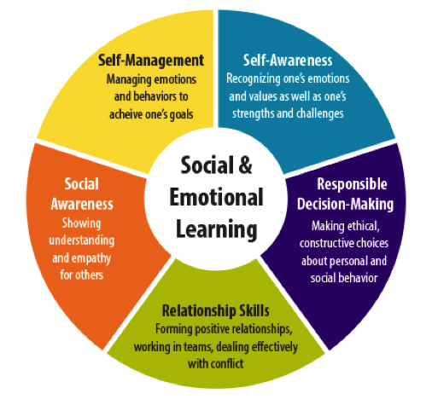
Mental Health Promotion
What 1 skill would you wish for all graduating students to possess?
www.casel.org
National School Mental Health Implementation Guidance Modules
Notes:
Ask yourself the question: What one skill would you wish for all graduating students to possess? [Allow time for reflection – ask the audience for some of their answers]
Although there is great emphasis on academic skills in school, when asked about the skills that are important for graduating students, most people identify social-emotional competencies as a priority.
This wheel is from the Collaborative for Academic, Social, and Emotional Learning – CASEL – and reflects the five domains of social emotional learning:
Self-management
Self-awareness
Responsible decision-making
Relationship skills
Social awareness
Not only is the development of positive mental health and socially and emotionally competent students part of the mission of schools, improving students’ mental health and social emotional competence improves their academic performance.

Slide 34
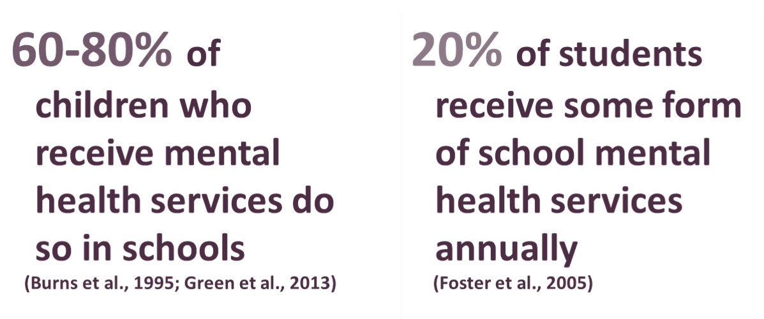
Schools are the primary mental health service provider for children.
Mental Health Intervention
.
.
National School Mental Health Implementation Guidance Modules
Notes:
In addition to mental health promotion, we know that schools are the primary mental health service provider for students with identified needs.
Mental health challenges often first emerge at school (Richardson, Morrissette & Zucker, 2012), and school-based services are often the more accessible and less stigmatizing than other community mental health services.

Slide 35
School Mental Health Impact
School Mental Health Impact
NCSMH, 2019
Notes:
There is growing data to support the accessibility and impact of school mental health.
As noted, students who participate in social emotional learning programs do better academically and socially than those who don’t.
Also, a positive school climate and social emotional learning improves school safety and decreases bullying.
In addition to schools being the place where most students receive mental health services, youth are six times more likely to complete mental health treatment in schools than in other community settings.

Slide 36
School Mental Health Outcomes
Improvements in social and self-awareness, decision-making capacity, and relationship skills (Durlak et al., 2011)
Better academic outcomes (Durlak et al., 2011; Kase et al., 2017)
Fewer special education referrals and decreased need for restrictive placements (Bruns et al., 2004)
Fewer disciplinary actions (Flannery et al., 2014; Taylor et al., 2017)
Increased student engagement and feelings of connectedness to school (Greenberg et al., 2005)
National School Mental Health Implementation Guidance Modules
Notes:
When comprehensive school mental health systems are put in place, the research suggests that students experience:
Improvements in self and social awareness, decision-making capacity and relationship skills
Better academic outcomes
Fewer special education referrals and decreased need for restrictive placements
Fewer disciplinary actions
Increased student engagement and feelings of connectedness to school

Slide 37

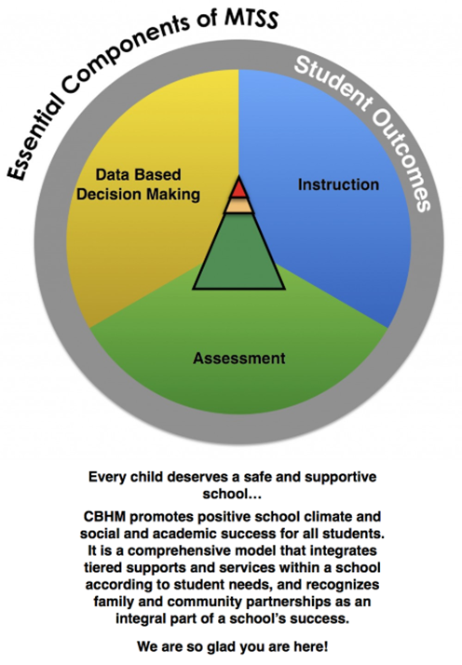
District Example
District Example
Resources
Boston Public Schools Comprehensive Behavioral Health Model
https://cbhmboston.com/
National School Mental Health Implementation Guidance Modules
Notes:
Guided by the Massachusetts Department of Elementary and Secondary Education Behavioral Health Framework, Boston Public Schools uses a Comprehensive Behavioral Health Model. The mission is to ensure that all students have a safe and supportive school where they can be successful. The model is based on what they call the “Lighthouse” three-tiered model of service delivery. The model integrates universal screening and positive skill instruction, including social emotional learning, for all students. This model also actively promotes family and community partnerships as part of their work.

Slide 38

Wisconsin’s School Mental Health Initiative
Resources
State Example
3 supporting grants:
  Safe Schools Healthy Students
  Project AWARE
  School Climate Transformation
State School Mental Health Framework
www.schoolmentalhealthwisconsin.org/
Notes:
Several states have developed frameworks or guidance for districts on the components of comprehensive school mental health. Let’s look to Wisconsin as an example of how a state has provided a framework to its districts for how to do comprehensive school mental health.
Wisconsin
Wisconsin’s School Mental Health Initiative benefitted from three large-scale grants being awarded in 2014: Safe Schools Healthy Students, Project AWARE, and School Climate Transformation. Braided funding from these projects allowed over 100 schools in the state to receive school mental health professional development, technical assistance, and coaching. Teaming efforts through a state management team and community management teams helped to advance strategic school mental health advancement. Central to Wisconsin’s school mental health system advancement was the adoption of a School Mental Health Framework in the state. The School Mental Health Framework defines and outlines key elements to implement comprehensive school mental health systems in districts and schools across Wisconsin. The framework offers the foundational elements to help build and sustain school mental health systems. The Framework is designed to integrate mental health and wellness supports into a multi-tiered system of support. Using the tenets of this framework, districts and schools can build and sustain a comprehensive school mental health system. For more information about school mental health in Wisconsin,
visit https://dpi.wi.gov/sspw/mental-health or www.schoolmentalhealthwisconsin.org/

Slide 39

Colorado’s School Mental Health Toolkit
Resources
State Example
Blueprint for school mental health services
Tool for community members, schools, local leaders, and districts
Includes 10 best practices, including strategies for implementing, funding, and sustaining mental health services in schools
https://www.mentalhealthcolorado.org/resources/school/
Notes:
Colorado’s School Mental Health Toolkit offers a blueprint for school mental health services and guides community members, schools, local leaders, and districts through 10 best practices, including strategies for implementing, funding, and sustaining school mental health services in schools. The toolkit can help individuals make the case for an array of school mental health practices, including screenings, suicide prevention, and wellness plans.

Slide 40

Discussion and Strategic Planning
Strategic Planning
State a specific goal for your district related to comprehensive school mental health.
List 3 potential action steps to move this goal forward.
Discussion
How does this content fit with your district’s understanding and implementation of the core features of comprehensive school mental health?
National School Mental Health Implementation Guidance Modules
Notes:
We will now consider how this module and quality indicators fit with your understanding and implementation of the core features of comprehensive school mental health.
Please work together with your group to state a specific goal for your district and then consider 3 potential action steps that could reasonably be taken to move the goal forward.

Slide 41
Resources
Resources
Boston Public Schools Behavioral Health Services. (n.d.). Comprehensive behavioral health model. https://cbhmboston.com/what-is-cbhm/
Burns, B. J., Costello, E. J., Angold, A., Tweed, D., Stangl, D., Farmer, E. M., & Erkanli, A. (1995). Children’s mental health service use across service sectors. Health Affairs, 14(3), 147–159.
Bruns, E. J., Walrath, C., Glass-Siegel, M., & Weist, M. D. (2004). School-based mental health services in Baltimore: Association with school climate and special education referrals. Behavior Modification, 28, 491–512. https://doi.org/10.1177/0145445503259524
Collaborative for Academic, Social, and Emotional Learning (CASEL). (n.d.). What is SEL? https://casel.org/what-is-sel/
Durlak, J. A., Weissberg, R. P., Dymnicki, A. B., Taylor, R. D., & Schellinger, K. B. (2011). Child Development, 82(1), 405–432. The impact of enhancing students’ social and emotional learning: A meta‐analysis of school‐based universal interventions. https://doi.org/10.1111/j.1467-8624.2010.01564.x
Flannery, K. B., Fenning, P., Kato, M. M., & McIntosh, K. (2014). Effects of school-wide positive behavioral interventions and supports and fidelity of implementation on problem behavior in high schools. School Psychology Quarterly, 29, 111–124. https://doi.org/10.1037/spq0000039
Foster, S., Rollefson, M., Doksum, T., Noonan, D., Robinson, G., & Teich, J. (2005). School mental health services in the United States, 2002-2003. Substance Abuse and Mental Health Services Administration. https://files.eric.ed.gov/fulltext/ED499056.pdf
Green, J. G., McLaughlin, K. A., Alegría, M., Costello, E. J., Gruber, M. J., Hoagwood, K., Leaf, P. J., Olin, S., Sampson, N. A., & Kessler, R. C. (2013). School mental health resources and adolescent mental health service use. Journal of the American Academy of Child & Adolescent Psychiatry, 52(5), 501–510. https://doi.org/10.1016/j.jaac.2013.03.002
Greenberg, M. T., Domitrovich, C. E., Graczyk, P. A., & Zins, J. E. (2005). The study of implementation in school-based preventive interventions: Theory, research, and practice. Promotion of Mental Health and Prevention of Mental and Behavioral Disorders 2005 Series V3, 21.
National School Mental Health Implementation Guidance Modules

Slide 42
Resources (continued)
Resources
Kase, C., Hoover, S., Boyd, G., West, K. D., Dubenitz, J., Trivedi, P. A., Peterson, H. J., & Stein, B. D. (2017). Educational outcomes associated with school behavioral health interventions: A review of the literature. Journal of School Health, 87(7), 554–562. https://doi.org/10.1111/josh.12524
Mental Health Colorado. (n.d.). School mental health toolkit. Retrieved from https://www.mentalhealthcolorado.org/schooltoolkit/
National Center for School Mental Health. (2019). Comprehensive school mental health core features checklist. http://bit.ly/2Ungx29
National Center for School Mental Health. (2019). School mental health matters infographic. http://bit.ly/2NKpG25
National Center for School Mental Health. (2023). School mental health national quality assessment: Overview of domains and indicators. Retrieved from https://www.schoolmentalhealth.org/media/som/microsites/ncsmh/documents/shape/SMHQA-Domains-and-Indicators-2023.pdf
National Center for School Mental Health. (2023). School mental health quality assessment. https://theshapesystem.com/
National Center for School Mental Health. (2024). The SHAPE System. http://theshapesystem.com/
Rose, E. & MacPhee, J. (2017). Equity in mental health framework. The Steve Fund and JED Foundation. Retrieved from https://equityinmentalhealth.org
Taylor, R. D., Oberle, E., Durlak, J. A., & Weissberg, R. P. (2017). Promoting positive youth development through school-based social and emotional learning interventions: A meta-analysis of follow-up effects. Child Development, 88, 1156–1171. http://doi.org/10.1111/cdev.12864
Wisconsin Department of Public Instruction. (2015, December). The Wisconsin School Mental Health Framework: Integrating school mental health with positive behavioral interventions & supports. https://dpi.wi.gov/sites/default/files/imce/sspw/pdf/mhframework.pdf
National School Mental Health Implementation Guidance Modules

Slide 43
This work is supported by grant SM081726 from the Department of Health and Human Services, Substance Abuse and Mental Health Services Administration.
Module content was developed by the National Center for School Mental Health in partnership with the MHTTC Network Coordinating Office.
Acknowledgments
National School Mental Health Implementation Guidance Modules

