Slide 1




Module 5: Mental Health Promotion for All (Tier 1)
National School Mental Health Best Practices:
Implementation Guidance Modules
for States, Districts, and Schools
Notes:
Welcome to Module 5 of National School Mental Health Best Practices: Implementation Guidance Modules for States, Districts, and Schools – Mental Health Promotion for All (Tier 1). Module content was developed by the National Center for School Mental Health in partnership with the Mental Health Technology Transfer Center (MHTTC) Network.

Slide 2
Disclaimer
The opinions expressed herein are the views of the Mental Health Technology Transfer Center Network and the National Center for School Mental Health and do not reflect the official position of the Department of Health and Human Services (DHHS), SAMHSA. No official support or endorsement of DHHS, SAMHSA, for the opinions described in this document is intended or should be inferred.
National School Mental Health Implementation Guidance Modules
Notes:
Disclaimer

Slide 3
Disclaimer
Public Domain Notice
All material appearing in this publication except that taken directly from copyrighted sources is in the public domain and may be reproduced or copied without permission from SAMHSA.
Do not reproduce or distribute this publication for a fee without specific, written authorization from the MHTTC NCO.
All material appearing in this publication should be appropriately cited using the recommended citation below. If content is removed, added, or adapted from the original material in this publication, these modifications should be clearly noted.
Recommended Citation
National Center for School Mental Health and MHTTC Network Coordinating Office. (2019). Trainer manual, National School Mental Health Best Practices: Implementation Guidance Modules for States, Districts, and Schools. Palo Alto, CA: MHTTC Network Coordinating Office.
National School Mental Health Implementation Guidance Modules
Notes:
Disclaimer

Slide 4

Agenda
Definition
Value
Quality Indicators and Best Practices
Strategic Planning
National School Mental Health Implementation Guidance Modules
Notes:
In this module, we will review the definition of mental health promotion and its value in schools. This module has two main parts. The first is about specific types of services and supports that may be included within the array of your mental health promotion offerings. The second is about quality indicators and best practices to ensure that any mental health promotion (Tier 1) service or support provided is of high quality.

Slide 5
What is Mental Health Promotion?
Activities to foster positive social, emotional, and behavioral skills and well-being of all students regardless of their level of risk for mental health problems.
What Is Mental Health Promotion?
National School Mental Health Implementation Guidance Modules
Notes:
Mental health promotion (also known as Tier 1 services and supports) are mental health-related activities to foster positive social, emotional, and behavioral skills and well-being of all students. These activities might also include efforts to support positive school climate and staff well-being.
Mental health promotion strategies are provided universally, meaning to all students and even staff in the school building, regardless of risk or protective factors related to mental health.

Slide 6

The Value of Mental Health Promotion in Schools
The Value of Mental Health Promotion in Schools
Promotes well-being and educational success for all students
Serves as foundation for Tiers 2 and 3 mental health services and supports
Produces cost savings by investing in mental health promotion and early intervention (versus treatment)
Decreases stigma about mental health and illness
Promotes school staff well-being
Mental health is part of overall health, and students must be healthy enough to learn, and teachers healthy enough to teach
National School Mental Health Implementation Guidance Modules
Notes:
Mental health promotion (Tier 1 services and supports) provide the foundation of a comprehensive, multitiered system of support.
Mental health promotion reaches all students, including those who are at risk for developing mental health conditions and those who have a higher level of need, so it truly benefits everyone. In addition, mental health promotion activities produce long-term cost savings by preventing the onset or severity of later mental health conditions that require more expensive and intensive mental health treatment.
Mental health promotion activities decrease stigma about mental health and illness, especially Tier 1 services that are focused on mental health awareness for everyone in the school community.
There are increasing efforts to promote the mental health and wellness of our school staff, who often experience high levels of stress in the process of serving, teaching, and caring for our students and their families.
Finally, it is important to remember that mental health is a component of health. Students must be healthy enough to learn and teachers must be healthy enough to teach.

Slide 7

Tier 1 Services and Supports
Tier 1 Services and Supports
  Activities that Support Positive and Inclusive School Climate
  Teacher and School Staff Well-being
  Positive Behaviors and Relationships
  Positive Discipline Practices
  Mental Health Literacy
  Social Emotional Learning
National School Mental Health Implementation Guidance Modules
Notes:
First we will discuss specific types of Tier 1 services and supports. These are examples of commonly implemented mental health promotion activities, but certainly do not represent a complete list. Your district may have different types of mental health promotion programs or activities.
This is a list of the quality indicators for the Mental Health Promotion domain.
For each of these indicators we will discuss best practices, resources, and helpful tips.

Slide 8
What is School Climate?
What Is School Climate?
School Climate
Safety
Environment
Engagement
Relationships
Respect for Diversity
School Participation
Environmental Safety
Physical Safety
Substance Use
Physical Environment
Academic Environment
Wellness
Disciplinary Environment
https://safesupportivelearning.ed.gov/safe-and-healthy-students/school-climate
Notes:
The first type of mental health promotion activity we will discuss is assessing and improving the school climate. A positive school climate is related to student well-being and academic success. Research indicates it can improve attendance, achievement, retention, and graduation rates.
According to the Safe and Supportive Schools Model, developed by a national panel of researchers and other experts, a positive school climate involves the following:
Engagement – including strong relationships between students, teachers, families, and schools and strong connections between schools and the broader community.
Safety – involving schools and school-related activities where students are safe from violence, bullying, harassment, and substance use.
Environment – including appropriate facilities, well-managed classrooms, available school-based health supports, and a clear, fair disciplinary policy.

Slide 9
Quality Indicator: School Climate
Quality Indicator
Best Practices
Plan how data will be collected, stored, analyzed, and shared.
Assess multiple dimensions of school climate.
Obtain input from a variety of groups.
Assess school climate in multiple ways.
Allow anonymous input.
Align with the school/district vision.
Select evidence-based assessment tools.
To what extent did your district/school use best practices to assess school climate?
National School Mental Health Implementation Guidance Modules
Notes:
Consider: To what extent did your district/school use best practices to assess school climate?
Best practices for this indicator include:
Develop a clear plan for how data will be collected, stored, analyzed and shared.
Assess multiple dimensions of school climate including student engagement, student-staff/student-student/staff-staff relationships/family-staff/community-staff, inclusiveness, and racial/cultural climate.
Disaggregate school climate data based on demographics (i.e., age, sex, gender identity and expression, race, ethnicity, national origin, religion, sexual orientation, disability status, language, and socioeconomic status) to identify differences by demographic group.
Obtain input from representative individuals across a variety of groups including students, their caregivers, administrators, instructional staff, non-instructional staff and community stakeholders (including school mental health and health providers).
Assess school climate using more than one modality for input (e.g., surveys, interviews, focus groups, school administrative data).
Allow anonymous input on surveys and other data collection.
Align the data collected with school vision of school climate and improvement strategies.
Select evidence-informed, culturally relevant tools.

Slide 10
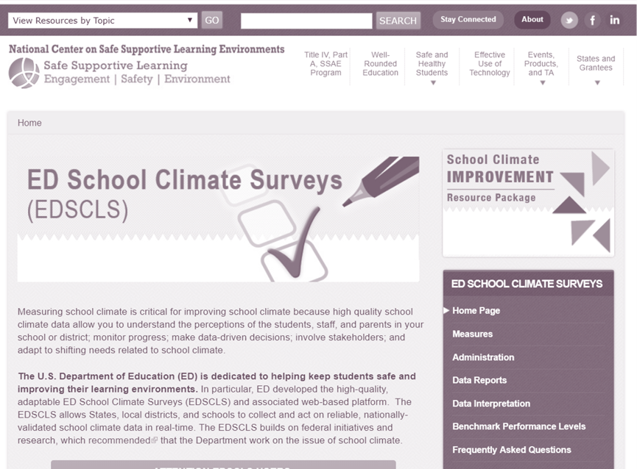
School Climate Assessment Tool
Resources
School Climate Assessment Tool
School Climate Measurement Tool and Web-based Platform
  U.S. Department of Education School Climate Surveys (EDSCLS)
  Web-based administration
  Student, parent, and instructional and non-instructional staff versions
  Free, custom reports
  Data stored locally
  https://safesupportivelearning.ed.gov/edscls/
National School Mental Health Implementation Guidance Modules
Notes:
Several states have developed their own school climate assessments.
At the federal level, the ED School Climate Surveys (EDSCLS) was developed by the U.S. Department of Education (ED). It is free and includes a web-based administration platform with school climate surveys for middle and high school students, parents/guardians, and instructional and non-instructional staff. English and Spanish versions of the surveys are available for students and parents.
The platform processes school climate data and provides a report in real time. The data can be stored in a district’s own data system, and the Department of Education will not have access to the data.

Slide 11

District Example
A large, urban school district implemented a district-wide school climate survey, collected annually in the spring from teachers, students, and parents. A summary of results was provided to principals within 2 months. To interpret the information and generate data-informed school climate improvement plans, the district hosted listening sessions over the summer at each school. Students, teachers, and parents provided feedback and suggested school climate improvements for the upcoming school year. An informational flyer was posted in schools, sent home to parents, and placed in staff mailboxes to thank respondents for participating, share survey findings, and announce the listening session date/time.
National School Mental Health Implementation Guidance Modules
Notes:
This is a district example of how to disseminate and use school climate data to plan improvements.
As part of dissemination, a report summary was developed and provided to principals; listening sessions were hosted for students, teachers, and parents; and informational flyers were posted in schools.
It may be helpful to share school climate findings with the broad school community and to obtain input on how to integrate the findings into school climate improvement plans.

Slide 12
Reflection
Has your district engaged in school climate assessment?
If yes:
  What has worked well?
  What are areas for improvement?
If no:
  What are the barriers?
  What ideas to you have to move school climate assessment forward?
Reflection:
How is the school climate assessment going in your district?
National School Mental Health Implementation Guidance Modules
Notes:
Reflection:
How is school climate going in your district? If you have engaged in school climate assessment, what is working well and are there areas for improvement?
If you haven’t engaged in school climate assessment yet, what ideas do you have to move school climate assessment forward?

Slide 13
Improving school climate
Quality Indicator
Best Practices
Designate or form a core school climate planning team.
Align school climate efforts with other school improvement efforts.
Ensure data are used to select priority areas.
Assess the impact of school climate improvement activities.
Embed school climate improvement into policy, practice, and systems in the school.
To what extent did your district/school use best practices to improve school climate?
National School Mental Health Implementation Guidance Modules
Notes:
Consider: To what extent did your district/school use best practices to improve school climate?
One common pitfall of any data collection effort is not using the data to drive conversations and decisions about improvement. As mentioned in the previous district example, creating feedback loops to those who contributed school climate data will help improve future response rates. However, it is also critical to engage students, parents, and staff in the design and implementation of school climate improvement efforts.
Best practices for this indicator include:
Designate or form a core school climate planning team that includes broad representation of educators, administrators, mental health and health staff, youth, family members, community partners.
Align and integrate school climate efforts with other school improvement efforts, including academic improvement efforts.
Ensure that data from school climate measures are used to select priority areas of focus and activities to promote school climate improvement.
Share and discuss results from school climate assessment with diverse stakeholders (students, families, educators, community partners, administrators, mental health and health professionals) in a manner that is engaging, easy to understand, and invites feedback.
Embed school climate improvement into policies, practices, and systems in the school with transparency.
Use data to assess the impact of school climate improvement activities.
Use disaggregated data to identify and address inequities and disparities in school climate for student groups across relevant demographics (e.g., age, disability, ethnicity, gender identity and expression, language, national origin, race, religion, sexual orientation, sex, socioeconomic status).
Involve groups who reported worse school climate in school climate improvement planning and implementation.
Implement school climate initiatives with an explicit focus on equity and reducing disparities.

Slide 14

Resources
School Mental Health Quality Guide:
Mental Health Promotion Services and Supports (Tier 1)
Provides guidance to advance school mental health quality and sustainability
Includes:
  Background
  Best practices
  Action steps
  Examples from the field
  Resources
NCSMH, 2023
National School Mental Health Implementation Guidance Modules
Notes:
This resource, School Mental Health Promotion Services and Supports (Tier 1) Quality Guide, was developed by the National Center for School Mental Health and covers best practices and practical tips from the field in school mental health promotion services and supports. It also includes a number of customizable mental health promotion resources, some of which are also featured as resources through out this module and included in your participant guide.

Slide 15
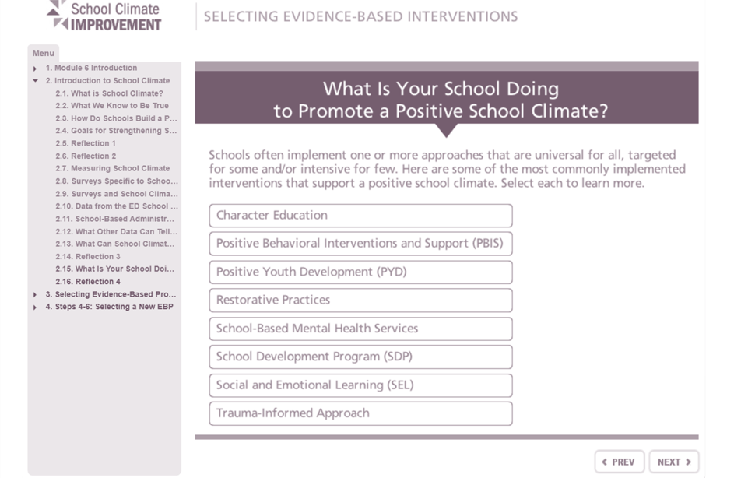
School Climate Improvement Resources
Resources
School Climate Improvement Resources
National Center on Safe Supportive Learning Environments (NCSSLE) https://safesupportivelearning.ed.gov/safe-and-healthy-students/school-climate
School Climate Improvement Resource Package
  Quick Guide
  Reference Manual
  Action Guides
  Data Interpretation Resources
  Online Modules
  Self-Assessments
National School Mental Health Implementation Guidance Modules
Notes:
To help schools and districts improve school climate, the National Center on Safe Supportive Learning Environments developed the School Climate Improvement Resource Package (SCIRP).
The SCIRP includes a variety of resources to support various groups in school climate improvement efforts. The resource package includes a quick guide, reference manual, action guides, data interpretation resources, online training modules, and self-assessments.

Slide 16

School Climate Interventions
School Climate Interventions
Character Education
Positive Behavioral Interventions and Supports
Positive Youth Development
Restorative Practices
School Mental Health Services
School Development Program
Social and Emotional Learning
Trauma-Informed Approach
National School Mental Health Implementation Guidance Modules
Notes:
Before implementing school climate interventions, districts and schools should determine what initiatives, programs, or interventions are most likely to improve the specific type of school climate needs identified through a school climate assessment.
This list includes some of the most frequently implemented interventions to support a positive school climate.
Trainer Note: Additional resources on this topic include:
https://safesupportivelearning.ed.gov/scirp/data-interpretation-resources
https://inclusiveschools.org/ways-to-improve-school-climate
https://www.schoolclimate.org/about/our-approach
https://safesupportivelearning.ed.gov/sites/default/files/NCSSLE_SCIRP_QuickGuide508_0.pdf
https://www.wested.org/resources/school-climate-improvement-toolkit/

Slide 17

Why Focus on School Staff Well-Being?
Why Focus on School Staff Well-Being?
Teachers are stressed.
Teachers are leaving the profession in alarming numbers.
  10% leave after 1 year.
    In urban districts, up to 70% leave within 1 year.
  17% leave within 5 years.
Teacher stress impacts students.
National School Mental Health Implementation Guidance Modules
Notes:
Next, we’re going to discuss best practices and strategies to assess and promote teacher and staff well-being assessment.
You might be wondering why it is important to focus on school staff well-being.
First of all, many teachers experience high levels of stress and burnout.
Large class size, often including many students with significant social, emotional, and behavioral needs, may contribute to this stress. In addition, many teachers report limited resources, poor physical space, high workload, low pay, mounting paperwork, and a high level of responsibility for student success.
Unfortunately, stress and burnout is contributing to teachers leaving the profession in alarming numbers. About 10% leave after 1 year (70% leave after 1 year in urban districts) and 17% leave after 5 years.
Teacher stress directly impacts students. Teachers who are stressed demonstrate more negative interactions with students, including greater sarcasm and aggression, and responding negatively to mistakes.

Slide 18
Assess teacher and staff well-being
Quality Indicator
Best Practices
To what extent did your district/school use best practices to assess teacher and staff well-being?
Select evidence-based, culturally relevant assessment tools.
Establish a clear process for collecting, analyzing, and storing data.
Conduct well-being assessments.
Assess staff well-being regularly.
Ensure privacy and anonymity.
Assess a range of well-being components.
National School Mental Health Implementation Guidance Modules
Notes:
Consider: To what extent did your district/school use best practices to assess teacher and staff well-being?
Best practices for this indicator include:
Select evidence-informed, culturally relevant assessment tools and processes.
Establish a clear process and system for collecting, analyzing, and storing data.
Facilitate well-being assessment with teachers and all school staff using multiple methods of data collection (i.e., paper/pencil and electronic assessments, affinity groups, focus groups).
Assess staff well-being regularly (at least annually).
Assess for strengths and needs for both individual and collective well-being.
Ensure privacy of information and anonymity when assessing staff well-being using surveys, interviews, focus groups, or other means.
Assess a range of well-being components (e.g., physical, occupational, emotional, racial, cultural, environmental, intellectual, social, mental, spiritual)
Assess for secondary traumatic stress, compassion fatigue, and burnout.
Check for any disparities in self-reported well-being among subgroups of educators (e.g., BIPOC teachers, special education teachers, first year teachers)

Slide 19
Staff Well-Being Assessment Tools
Resources
Staff Well-Being Assessment Tools
  Resilience at Work (Winwood et al., 2013)
  Professional Quality of Life (PROQOL) https://proqol.org/ (Hudnall Stamm, 2009)
  Health-Related Quality of Life (HRQOL) https://www.cdc.gov/hrqol/index.htm
  Organizational Well-Being Inventory for Schools (OWBI-S; Hoover et al., 2023) https://shape.3cimpact.com/owbi
  Teacher Subjective Wellbeing Questionnaire https://osf.io/z8rg5/ (Renshaw et al., 2015)
National School Mental Health Implementation Guidance Modules
Notes:
There are several staff well-being assessment tools available, including:
Resilience at Work Scale – Developed by Winwood, Colon, and McEwen (2013), this is a 20-item scale to capture “resilience promoting” behaviors at work.
Professional Quality of Life (PROQOL) – This free measure includes 30 items to assess compassion satisfaction and fatigue https://proqol.org/.
Health-Related Quality of Life – Developed by the CDC, the HRQOL has 4 questions in the Healthy Days Core Module and 10 additional questions about activity limitations and healthy days symptoms: https://www.cdc.gov/hrqol/index.htm.
School Organizational Health Questionnaire – 54-item measure of teacher morale and 11 separate dimensions of school organizational climate.
Teacher Subjective Wellbeing Questionnaire – Includes eight items and two subscales, (1) school connectedness, and (2) teaching efficacy.

Slide 20
Improve teacher and staff well-being
Quality Indicator
Best Practices
To what extent did your district/school use best practices to improve teacher and staff well-being?
Align improvement efforts with needs identified by well-being assessment.
Address organizational and individual factors.
Offer an array of well-being education resources and activities.
Make well-being activities optional and readily available at no-cost and accessible both during and outside of school hours.
National School Mental Health Implementation Guidance Modules
Notes:
Consider: To what extent did your district/school use best practices to improve teacher and staff well-being?
Ideally, following an assessment of teacher and staff well-being, improvement efforts will take place.
Best practices for this indicator include:
Align staff well-being improvement efforts with needs identified by your staff well-being assessments.
Address both organizational and individual factors that contribute to stress and well-being (e.g., secondary traumatic stress, compassion fatigue, staff control and input, supervision and support, safe, supportive social and physical environment, racism and other marginalizing systems).
Offer an array of well-being education resources and activities related to:
Onsite mental health screening
Self-care, resilience
Health promotion (e.g., sleep hygiene, nutrition)
Staff burnout
Stress management and mindfulness
Trauma, including racial trauma
Secondary traumatic stress and compassion fatigue
Employee assistance programs/community mental health services
Make well-being resources and activities optional and readily available at no-cost and accessible both during and outside of school hours.

Slide 21
Example School Staff Well-Being Programs
Resources
TeacherWISE
Mindfulness-Based Stress Reduction (MBSR)
Community Approach to Learning Mindfully (CALM)
Cultivating Awareness and Resilience in Education (CARE)
National School Mental Health Implementation Guidance Modules
Notes:
There is not a robust research base on effective school staff well-being programs. However, there is a growing literature on this topic, with some promising programs on school staff wellness, including:
TeacherWISE
A research-informed program that helps teachers and school staff manage five areas of their well-being: physical health, occupational health, intellectual health, social health, and emotional health.
Mindfulness-Based Stress Reduction (MBSR)
Demonstrated reductions in psychological symptoms and burnout, improvements in classroom organization and increase in self-compassion, self-regulation, mindfulness, and sleep quality (Flook et al., 2013; Frank et al., 2015).
Community Approach to Learning Mindfully (CALM)
Demonstrated improvements in mindfulness, emotional functioning, positive affect, distress tolerance, blood pressure, cortisol, efficacy in classroom management (Harris, et al., 2016).
Cultivating Awareness and Resilience in Education (CARE)
Demonstrated improvements in well-being, efficacy, burnout, mindfulness (Jennings et al., 2013).

Slide 22
Set schoolwide expectations
Quality Indicator
Best Practices
To what extent did your district/school use best practices to set schoolwide expectations about positive behaviors?
Settings
Routines
Expectations
Train staff to teach students expectations and how rewards are developed, scheduled, and delivered.
Involve families and community members.
National School Mental Health Implementation Guidance Modules
Notes:
Consider - To what extent did your district/school use best practices to set schoolwide expectations about positive behaviors?
A commonly implemented Tier 1 practice is setting schoolwide expectations about positive behaviors. When done well, this promotes a safe and supportive school environment where students, parents, and staff understand and demonstrate that mutual respect and positive behaviors are the expectation.
Best practices for this indicator include:
Settings: The physical layout of the school is designed to support optimal functioning and safety of all staff and students based on needs and ability (including those with disabilities, emotional and behavioral health difficulties, learning disorders)
Routines: Predictable schoolwide routines are developed and taught
Collaborate with students and families representative of diverse cultural groups and identities to develop rules that are relevant and appropriate for diverse students and that do not inadvertently reinforce systems of oppression.
Expectations: 3-5 positively stated school-wide and clearly defined expectations are posted around school in the primary languages of students.
Expectations apply to both students and staff.
Rules are linked to expectations.
Rules are clearly posted, defined, and explicitly taught.
Rules are enforced consistently across staff and equitably toward students.
Train staff to teach students expectations/rules and how rewards are developed, scheduled, and delivered.
Teach students how expectations/rules/rewards are developed, scheduled, and delivered, using multiple modes of communication (e.g., visual aids and cues, written/verbal aides using clear and plain language and the primary languages of students in school community).
Involve families and community members to develop and implement expectations about positive behaviors.

Slide 23

Positive Behavioral Interventions & Supports (PBIS)
Resources
Positive Behavioral Interventions & Supports (PBIS)
Resources to help schools, districts, and states:
Set school-wide expectations.
Define rules, positive supports, and discipline procedures.
Track office referrals and other data.
See sample behavioral expectation documents at: https://www.pbis.org/resource/creating-effective-classroom-environments-plan-template
Notes:
The National PBIS Center has several resources to help schools set school-wide expectations about positive behaviors.
https://www.pbis.org/
School-wide expectations are often reinforced with consistent visual reminders, such as posters or pledges.

Slide 24
implement schoolwide positive reinforcement systems that promote positive behaviors?
Quality Indicator
Best Practices
To what extent did your district/school use best practices to implement schoolwide positive reinforcement systems that promote positive behaviors?
Rewards
Supervision
Opportunity
Acknowledgment
Prompts and pre-corrections
Error corrections
Discipline
Other trauma-informed, culturally responsive strategies
National School Mental Health Implementation Guidance Modules
Notes:
Consider – To what extent did your district/school use best practices to implement schoolwide positive reinforcement systems that promote positive behaviors?
In addition to setting expectations for positive behaviors, many schools focus on implementing positive reinforcement systems that promote positive behaviors.
Many of these practices may seem intuitive but ensuring they are consistently implemented across an entire school campus, especially for large schools, requires ongoing effort and communication.
Best practices for this indicator include:
Rewards:
A system of rewards is implemented consistently across campus.
A variety of methods are used to reward students.
Supervision: School staff provide reminders and actively scan, move, and interact with students.
Opportunity: School staff provide high rates, varied and equitable opportunities for all students to respond.
Acknowledgment: School staff use specific praise and other strategies to let students know when they meet expectations.
Prompts and Pre-corrections: School staff provide consistent reminders that clearly describe the expectation.
Error Corrections: School staff use brief, contingent, and specific statements when misbehavior occurs and consider voice tone, posture, and physical distance when responding, including students’ potential trauma triggers.
Discipline
Discipline process described in narrative format or depicted graphically.
Discipline process includes documentation procedures
Problem behaviors are clearly defined.
Suggested, graduated array of appropriate responses to problem behaviors are clearly defined.
Staff receive training and support to understand how individual and system biases impact how perceptions of and responses to student behaviors and how to counteract those biases.
School staff use trauma-informed, culturally responsive strategies that:
Preempt escalation.
Minimize inadvertent reward of a problem behavior.
Create a learning opportunity for emphasizing desired behavior.
Support and strengthen relationships.
Maintain optimal instructional time.

Slide 25
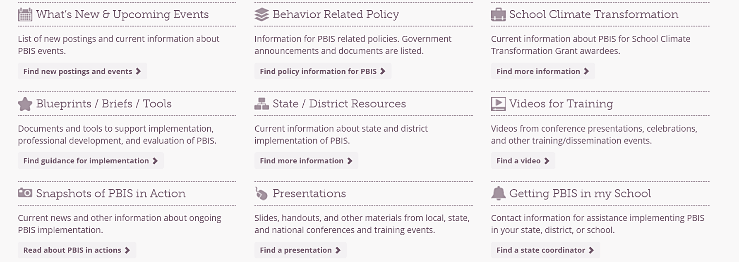
Positive Behavioral Interventions & Supports (PBIS)
Resources
https://www.pbis.org/
National School Mental Health Implementation Guidance Modules
Notes:
The National PBIS Center has a number of practical resources to help schools implement schoolwide positive reinforcement systems that promote positive behaviors.
https://www.pbis.org/

Slide 26


Interconnected Systems Framework (ISF)
Advancing Education Effectiveness: Interconnecting School Mental Health and School-Wide Positive Behavior Support
  https://www.pbis.org/resource/advancing-education-effectiveness-interconnecting-school-mental-health-and-school-wide-positive-behavior-support
National School Mental Health Implementation Guidance Modules
Notes:
The Interconnected Systems Framework (ISF) described in this monograph describes efforts to interconnect Positive Behavioral Interventions and Supports (PBIS) and School Mental Health (SMH) systems to improve educational outcomes for all children and youth, especially those with or at risk of developing mental health challenges.

Slide 27

Interconnected Systems Framework (ISF)
4-Part Series:
The ”Why” and the “What” of ISF
The “How” of ISF
Integrating School Mental Health and PBIS (1)
Integrating School Mental Health and PBIS (2)
https://cars-ta.groupsite.com/page/project-aware
National School Mental Health Implementation Guidance Modules
Notes:
In response to federal grantee requests for more information on how to integrate school mental health and multi-tiered systems of supports (MTSS) including Positive Behavior Interventions and Supports, the Now is the Time Technical Assistance Center put together a 4-part webinar series on the Interconnected Systems Framework.
The webinar series is located on the Technical Assistance platform for the Center for Applied Research Solutions (CARS):
https://cars-ta.groupsite.com/page/project-aware

Slide 28
proactively build healthy relationships and a sense of community
Quality Indicator
Best Practices
To what extent did your district/school use best practices to promote or use classroom and school-based strategies to proactively build healthy relationships and a sense of community to prevent and address conflict and wrongdoing?
Use processes to proactively build relationships and a sense of community.
Consider whether traumatic exposure plays a role in behavior.
Use circles and groups for students to share their feelings, build relationships, and solve problems.
Teach and model problem-solving.
National School Mental Health Implementation Guidance Modules
Notes:
A fourth area of mental health promotion that has received increased attention and evidence of effectiveness are strategies to proactively build healthy relationships and a sense of community to prevent conflict and address wrongdoing. Many schools and districts refer to this set of practices as restorative practices.
Consider - To what extent did your district/school use best practices to promote or use classroom and school-based strategies to proactively build healthy relationships and a sense of community to prevent and address conflict and wrongdoing?
Best practices for this indicator include:
Use informal and formal processes that are trauma-informed, healing-centered, culturally responsive, anti-racist and equitable, and that precede wrongdoing, to proactively build relationships and a sense of community to prevent conflict and wrongdoing.
Consider whether traumatic exposure plays a role in student behavior.
Use circles, groups and other trauma-informed, healing-centered, culturally responsive processes to provide opportunities for students to share their feelings, build relationships and solve problems, and when there is wrongdoing, to play an active role in addressing the wrong and making things right.
Teach and model healing and restorative problem solving and conflict resolution skills in the classroom.

Slide 29
Restorative Practices
Restorative Practices
Strategies
Community conferencing
Community service
Peer juries
Restorative circle
Conflict resolution
Peer mediation
Informal practices
Outcomes
Increases in:
  School climate
  Student connectedness
  Parent and community engagement
  Academic achievement
Decreases in:
  Discipline disparities
  Fighting
  Bullying
  Suspensions
https://www.iirp.edu/
National School Mental Health Implementation Guidance Modules
Notes:
Restorative practices prevent and address conflict and wrongdoing by proactively building healthy relationships and a sense of community.
Restorative practices can improve relationships between students, students and educators, and even between educators, whose behavior often serves as a role model for students. These practices promote inclusiveness, relationship-building, and problem-solving.
Restorative practices not only reduce exclusionary discipline responses, but also promote a sense of safety and mutual respect on campuses by strengthening relationships, reducing bullying and violence, and repairing harm whenever possible. They also build social capital among school communities by engaging all students and school staff in the delivery and receipt of practices that facilitate shared decision making and communication.
Restorative practices include:
Community conferencing - a practice that provides students and educators with effective ways to prevent and respond to school conflicts. Community conferencing involves the participation of all stakeholders affected by the behavior and allows everyone to contribute to the conflict resolution process.
Community service allows individuals to restore a harm to the school community by providing a meaningful service that contributes to their individual improvement.
Peer juries allow students who have broken a school rule and trained student jurors to collectively discuss why the rule was broken, who was affected, and how the referred student can repair the harm caused.
A restorative circle is a versatile restorative practice that can be used proactively to develop relationships and build community, or reactively to respond to a wrongdoing or conflict. Circles can be used to teach social skills such as listening, respect, and problem solving. Circles provide people an opportunity to speak and listen to one another in a safe atmosphere and allow educators and students to be heard and offer their own perspectives. Circles can be used to celebrate student accomplishments, begin and end the day, and discuss difficult issues.
Conflict resolution programs provide students with instruction in problem-solving and self-control skills. These programs teach students how to manage potential conflict, defuse situations, assuage hurt feelings, and reduce any inclination to retaliate after a conflict.
One method of resolving conflict is through peer mediation. Peer mediation trains students to help other students resolve differences.
Informal practices are small ways educators and other school personnel can influence a positive environment. These practices include using affective statements, which communicate people’s feelings (e.g., I feel happy when you complete your homework because it shows me how well you understand the topic), and affective questions, which cause people to reflect on how their behavior has affected others (e.g., what were you thinking of at the time?); other examples include proactive engagement with students and families, mentor relationships, community service, and lunch time table talks.
Restorative practices have demonstrated several positive outcomes including:
Improved school climate (Mirsky, 2007; Mirsky & Watchel, 2007)
Increased student connectedness, greater parent and community engagement, improved academic achievement (Gonzalez, 2012)
Decreases in discipline disparities, fighting, bullying, and suspensions (Armour, 2013; Baker, 2009; Gonzalez, 2012; Suvall, 2009)

Slide 30
promote or use discipline policies and practices
Quality Indicator
Best Practices
Define problem behaviors and appropriate strategies to address them.
Train and support school staff.
Develop a multi-tiered system of supports.
Use restorative practices.
Use graduated responses that limit involvement of law enforcement and eliminate exclusionary discipline.
Examine suspensions/expulsions by demographic group.
To what extent did your district/school use best practices to promote or use discipline policies and practices aimed at reducing exclusionary responses?
National School Mental Health Implementation Guidance Modules
Notes:
Consider - To what extent did your district/school use best practices to promote or use discipline policies and practices aimed at reducing exclusionary responses?
Although disciplinary infractions may suggest that Tier 2 or Tier 3 services are warranted, school or district policies to limit exclusionary discipline are implemented universally for all students.
The objective here is to reduce exclusionary discipline practices such as out of school suspensions or expulsions unless absolutely necessary.
Best practices for this indicator include:
Collaborate with students and families representative of diverse cultural groups and identities to define problem behaviors and appropriate strategies to address them.
Implement discipline policies and procedures that are trauma-informed and healing-centered.
Implement discipline policies and procedures that are culturally responsive, anti-racist, and promote equity.
Describe discipline process in narrative format or depict graphically.
Include documentation procedures in discipline protocol.
Train and support school staff in evidence-informed, culturally responsive crisis de-escalation strategies and techniques.
Train and support staff in equitable implementation of disciplinary practices in ways that reduce racial/ethnic disproportionality in discipline responses.
Develop a multi-tiered system of culturally responsive, anti-racist emotional and behavioral health services and supports for students at risk for disruptive behavior related to mental health concerns or trauma exposure.
Use restorative practices that encourage student disciplinary practices that focus on repairing the harm caused by an incident and allowing the people most affected by the incident to participate in its resolution.
Use a process of graduated responses that are clearly defined, do not re-traumatize youth, limit involvement of law enforcement (e.g., School Resource Officers, community police), and eliminate exclusionary disciplinary practices when possible.
Examine number of suspensions/expulsions by demographic group to better understand any differences in policies or practices contributing to disproportionality and disparity.

Slide 31
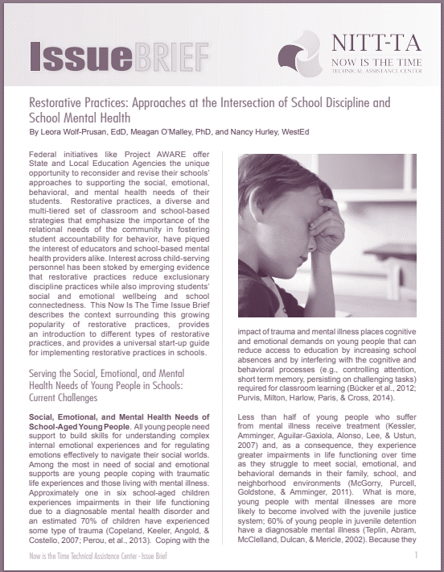
Restorative Practice: Approaches at the Intersection of School Discipline and School Mental Health
Review of restorative practice approaches and specific practices
Benefits of restorative practices
  Snapshots from the field
Guidance for launching and implementing restorative practices
(Wolf-Prusan, O’Malley, & Hurley, n.d.)
Notes:
This Issue Brief, developed by the Now is the Time Technical Assistance Center, describes a rise in use of restorative practices in schools, introduces different types, and provides a universal start-up guide for implementation.
The brief can be located on the Technical Assistance platform for the Center for Applied Research Solutions (CARS):
https://cars-ta.groupsite.com/page/project-aware

Slide 32

What is Mental Health Literacy?
What Is Mental Health Literacy?
Knowledge and beliefs about mental disorders, which aid in their recognition, management, or prevention
4 integrated components
  Obtaining and maintaining positive mental health
  Understanding mental disorders and their treatments
  Decreasing stigma related to mental disorders
  Enhancing help-seeking efficacy
    Know where to go; know when to go; know what to expect when you get there; know how to increase likelihood of “best available care” (skills and tools)
(Jorm, 2000; Kutcher et al., 2016)
National School Mental Health Implementation Guidance Modules
Notes:
Next, we will discuss mental health literacy for all students and staff. Mental health literacy has been defined as “knowledge and beliefs about mental disorders which aid their recognition, management or prevention.”
Mental health literacy consists of several components, including:
understanding how to obtain and maintain positive mental health;
understanding mental disorders and their treatments;
decreasing stigma related to mental disorders; and,
enhancing help-seeking efficacy (which refers to knowing when and where to seek help and developing competencies designed to improve one’s mental health care and self-management capabilities).
In the context of districts and schools, mental health literacy programs are relevant for students, parents, and staff to develop knowledge and help-seeking efficacy for themselves as well as how to support others.

Slide 33
increase mental health literacy
Quality Indicator
Best Practices
To what extent did your district/school use best practices to increase mental health literacy for all students and staff?
Develop a clear plan for assessing current mental health literacy.
Collaborate with key stakeholders to meaningfully and feasibly promote mental health literacy.
Deliver and evaluate professional learning opportunities.
Develop activities with key stakeholders.
Deliver activities throughout the year.
Reassess on a routine basis.
National School Mental Health Implementation Guidance Modules
Notes:
Consider - To what extent did your district/school use best practices to increase mental health literacy for all students and staff?
Best practices for this indicator include:
Develop a clear plan for assessing current mental health literacy of students and school staff, as baseline data and to inform further improvement goals.
Work with students, caregivers, and school staff of various cultural identities and groups to determine the most meaningful, feasible ways to promote mental health literacy.
Deliver and evaluate culturally responsive professional learning opportunities, from pre-K-12, to
Understand how to optimize and maintain good mental health for themselves and others.
Understand stress and trauma and mental health conditions and their treatment.
Reduce stigma about mental health needs and supports and understand the ways that culture and oppression influence mental health, stigma, and help-seeking behaviors.
Increase skills to link students to mental health prevention or intervention supports when needed.
Ensure mental health literacy activities and skills taught are culturally relevant and build on cultural strengths and assets of diverse cultural groups and identities.
Ensure mental health literacy activities are developed with and communicated by students, caregivers, and members of the school community who represent diverse cultural groups and identities.
Ensure mental health literacy activities are ongoing throughout the school year (i.e., activities go beyond a one-time training or educational materials posted in the building).
Reassess mental health literacy on a routine basis to monitor progress and inform team planning for ongoing activities.

Slide 34

Strategies to Increase
Mental Health Literacy
Invite your local NAMI to give a presentation to students and teachers.
Participate in a mental health awareness campaign.
Use teacher-delivered mental health curricula.
Collaborate with organizations to implement specific mental health literacy training and support in your school or district.
National School Mental Health Implementation Guidance Modules
Notes:
Schools and districts incorporate mental health literacy in different ways depending on what students, parents and staff feel will be most relevant and impactful in the community.
Here are some ideas to get started:
Invite your local NAMI to give a presentation to your students and teachers. NAMI’s Ending the Silence presentation discusses the warning signs of mental health conditions and what steps to take if a loved one is showing symptoms of a mental illness. These talks are tailored for different audiences, including students, school staff, and families.
Collaborate with your state’s mental health association to participate in campaigns for mental health awareness, e.g., children’s mental health awareness. In MD, Children’s Mental Health Matters is a statewide education campaign to raise awareness of children’s mental health needs. It is coordinated and supported by the Mental Health Association of Maryland, the Maryland Coalition of Families and Maryland Department of Health and Mental Hygiene – Behavioral Health Administration. https://www.childrensmentalhealthmatters.org/
Collaborate with organizations to help implement specific mental health literacy training and support in your school or district, such as Mental Health First Aid or Youth Mental Health First Aid, which provide training on how to identify, understand, and respond to signs of mental illnesses and substance use disorders.
Use teacher-delivered mental health curricula, e.g., curriculum by Kutcher et al. for middle and high schools http://teenmentalhealth.org/schoolmhl/school-mental-health-literacy/mental-health-high-school-curriculum-guide/download-the-guide/. The guide consists of educator and student modules focused on understanding mental health, reducing stigma, and seeking help.

Slide 35


Mental Health Literacy Resources
Resources
Mental Health Literacy Resources
Mental Health Essentials for Educators
Teachers deliver content in classrooms.
  Obtaining and maintaining positive mental health
  Understanding mental disorders and their treatments
  Decreasing stigma related to mental disorders
  Enhancing help-seeking efficacy
Youth Mental Health First Aid
Training in how to identify, understand, and respond to signs of mental illnesses and substance use disorders.
Notes:
These are two widely adopted mental health literacy programs.
Mental Health Essentials for Educators is available on mentalhealthcollaborative.org. It aims to help teachers to be familiar with and comfortable with their understanding of mental health and mental health disorders and to share this information with students.
Teachers deliver content in classrooms:
Obtaining and maintaining positive mental health
Understanding mental disorders and their treatments
Decreasing stigma related to mental disorders
Enhancing help-seeking efficacy
To purchase the curriculum: http://teenmentalhealth.org/product/mental-health-high-school-curriculum/
Youth Mental Health First Aid is an 8 hour public education course which teaches participants about the unique risk factors and warning signs of mental health concerns in youth. It emphasizes the importance of early intervention and how to approach and refer an individual in crisis or contending with mental health concerns.
https://www.mentalhealthfirstaid.org/
To learn more about taking a Youth Mental Health First Aid Course, please visit, https://www.mentalhealthfirstaid.org/take-a-course/

Slide 36

What Is Social and Emotional Learning (SEL)?
What Is Social and Emotional Learning (SEL)?
“The process through which children and adults understand and manage emotions, set and achieve positive goals, feel and show empathy for others, establish and maintain positive relationships, and make responsible decisions.” (www.casel.org)
National School Mental Health Implementation Guidance Modules
Notes:
The final specific Tier 1 practice to consider is social emotional learning skill development for all students.
Social and emotional learning (SEL) is the process through which children and adults understand and manage emotions, set and achieve positive goals, feel and show empathy for others, establish and maintain positive relationships, and make responsible decisions. (www.casel.org)

Slide 37
support SEL skill development for all students
Quality Indicator
Best Practices
To what extent did your district/school use best practices to support SEL skill development for all students?
Develop a plan for assessing SEL skills.
Identify existing activities/programs that support SEL skill development.
Select or adapt SEL skill development practices for your students.
Develop practices with students, caregivers, and community members.
Monitor implementation of practices.
Reassess on a routine basis.
National School Mental Health Implementation Guidance Modules
Notes:
Consider - To what extent did your district/school use best practices to support SEL skill development for all students?
Best practices for this indicator include:
Develop a clear, plan for assessing current SEL skills among staff and students, as baseline data and to inform your team’s plan to inform further improvement goals.
Incorporate SEL skills that promote anti-racism and equity, including recognizing and making sense of oppressive social forces, effecting societal/system change, challenging injustice, and affirming diverse ways of being (e.g., diverse ways of expressing emotion).
As a team with school staff, community partners, caregivers, and students (who represent diverse cultural groups and identities), identify current activities or programs that support SEL skill development in the school and assess to what degree they are being implemented with fidelity and achieving desired outcomes.
As a team with school staff, caregivers, and students (who represent diverse cultural groups and identities), identify, select, and/or adapt SEL skill development practices or programs that meet the needs and strengths of all students.
Ensure SEL skill development activities are developed with and communicated by students, caregivers, and members of the school community who represent diverse cultural groups and identities.
Monitor implementation of SEL skill development activities for fidelity, feasibility, cultural responsiveness, and acceptability to school staff, students, and families.
Re-assess SEL skill development on a routine basis to monitor progress and inform feedback to school staff and team planning for ongoing activities.

Slide 38
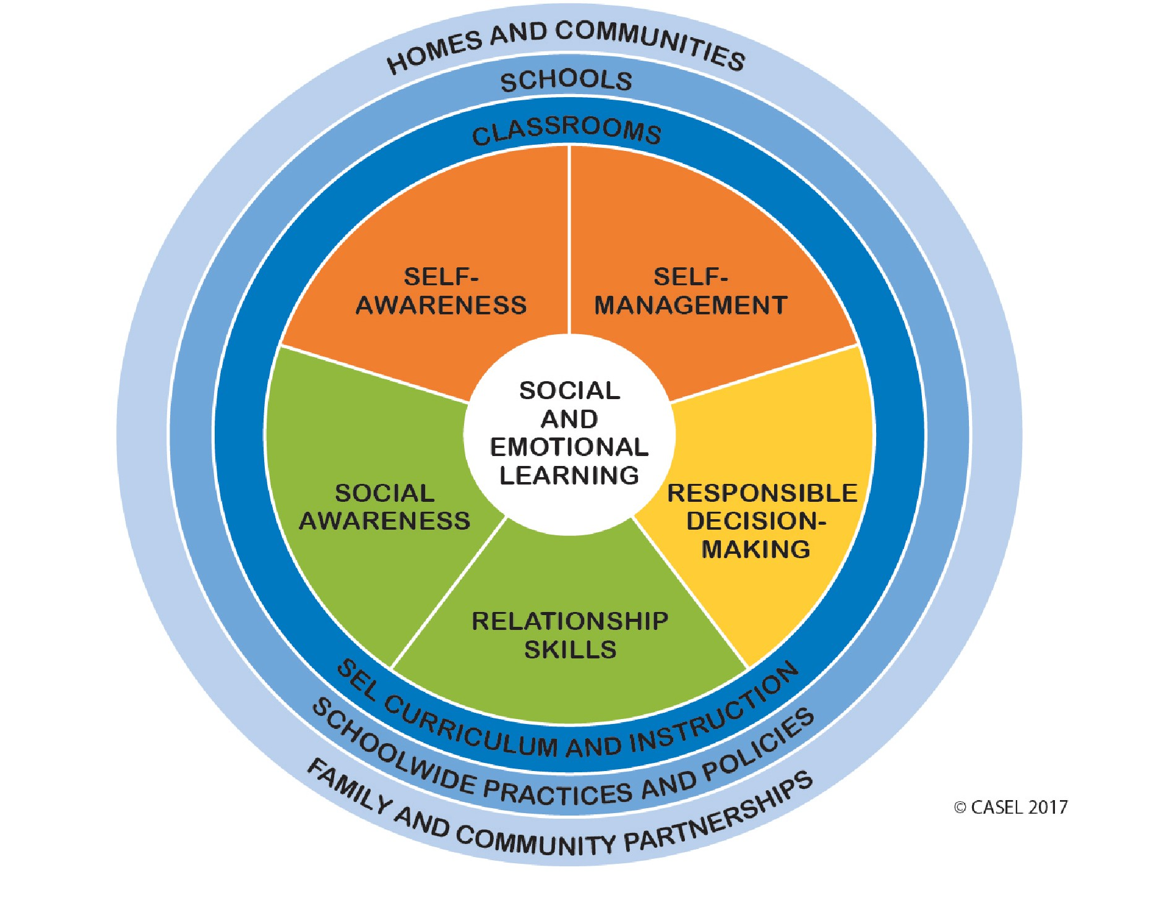
Core SEL Competencies
Core SEL Competencies
Increases in:
Academic achievement
Prosocial behavior
Social emotional skills
Positive self-image
Decreases in:
Conduct problems
Emotional distress
Substance use
Self-awareness
Self-management
Social awareness
Relationship skills
Responsible decision-making
National School Mental Health Implementation Guidance Modules
Notes:
A commonly used SEL framework was developed by the Collaborative for Academic, Social and Emotional Learning (CASEL, 2017 – see https://casel.org/what-is-sel/)
It includes five core domains of SEL competencies:
1) Self-awareness: Know your strengths and limitations, with a well-grounded sense of confidence, optimism, and a “growth mindset.”
2) Self-management: Effectively manage stress, control impulses, and motivate yourself to set and achieve goals.
3) Social awareness: Understand the perspectives of others and empathize with them, including those from diverse backgrounds and cultures.
4) Relationship skills: Communicate clearly, listen well, cooperate with others, resist inappropriate social pressure, negotiate conflict constructively, and seek and offer help when needed.
5) Responsible decision-making: Make constructive choices about personal behavior and social interactions based on ethical standards, safety, and social norms. (www.casel.org )
There is a robust and continuously growing research base demonstrating the desired outcomes associated with social emotional learning. Increases in academic achievement, prosocial behavior, social emotional skills and positive self-image have been found, in addition to decreases in conduct problems, emotional distress and substance use.

Slide 39
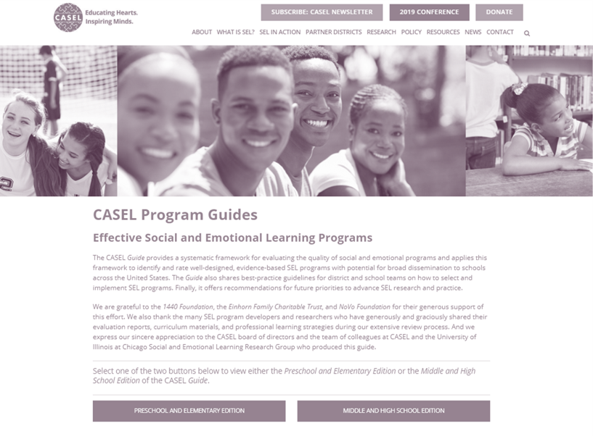
CASEL Program Guides
Resources
CASEL Program Guides
Provides guidance for educators about how to select and implement SEL programs
CASEL SELect programs are based on a rigorous, evidence-based review process
Use this and the CASEL District Resource Center (https://drc.casel.org) to self-assess your readiness and capacity for SEL, plan your SEL implementation
National School Mental Health Implementation Guidance Modules
Notes:
CASEL’s SELect program guides provide guidance for educators about specific programs to choose and implement.
The CASEL District Resource Center has a team self-assessment for districts to gauge their capacity and readiness for SEL implementation - https://drc.casel.org

Slide 40
District Example
Austin Independent School District implemented SEL in all 129 schools. Each campus has a assigned SEL specialist who provides professional development, observes SEL lessons, and provides feedback on instruction and integration of SEL skills and concepts in the classroom. Administrators and teams work with these specialists to develop SEL goals and action plans. This process started with a steering committee that worked for 12 months to clarify the SEL vision and develop 5 priorities related to district-wide SEL integration. Visit https://www.austinisd.org/sel to learn more.
National School Mental Health Implementation Guidance Modules
Notes:
This example illustrates how one district was able to scale up their SEL implementation to all the schools in their district.
Austin Independent School District has implemented SEL in all 129 schools. Each campus has an assigned SEL specialist who provides professional development, observes SEL lessons, and provides feedback on instruction and integration of SEL skills and concepts in the classroom. Campus administrators and teams work with these specialists to develop SEL goals and action plans. This process started with a steering committee that worked for 12 months to clarify the SEL vision and develop five priorities related to district-wide SEL integration. Visit https://www.austinisd.org/sel to learn more.

Slide 41
Mental Health Promotion
Implementation and Fidelity Indicators
National School Mental Health Implementation Guidance Modules
Notes:
The second half of this presentation focuses on quality indicators and best practices that can be applied to any mental health promotion (Tier 1 service or support).

Slide 42
determine whether mental health promotion (Tier 1) services and supports are evidence-informed?
Quality Indicator
Best Practices
To what extent did your district/school use best practices to determine whether mental health promotion (Tier 1) services and supports are evidence-informed?
Create an intervention selection committee.
Use national evidence-based practice registries.
Use resources that center and affirm identities of people from historically marginalized groups to inform selection of evidence informed interventions.
Consider fit with valued outcomes, settings, and populations.
Review evidence of success.
National School Mental Health Implementation Guidance Modules
Notes:
Consider - To what extent did your district/school use best practices to determine whether mental health promotion (Tier 1) services and supports are evidence-informed?
In addition to considering how many of your Tier 1 services and supports were evidence-informed, your team may wish to evaluate the degree to which you are using best practices to evaluate whether something is evidence-informed. You could do this before selecting an evidence-based practice or to critically evaluate practices you are currently implementing.
Best practices for this indicator include:
Create a program and practice selection committee with diverse representation, including school mental health and health staff, community providers, administrators, teachers, students, and caregivers.
Use national evidence-based practice registries (e.g., IES What Works Clearinghouse, Blueprints for Healthy Youth Development, OJJDP Model Programs Guide, Society of Clinical Child & Adolescent Psychology Effective Child Therapies) and research literature.
Use resources that center and affirm the identities of individuals from groups that have been historically marginalized to inform selection of evidence-informed interventions.
In selecting a program or intervention consider whether:
Randomized controlled trials (RCTs) for the intervention demonstrate effectiveness and valued outcomes with the intended student population.
The settings (e.g., urban/suburban/rural/frontier; school/outpatient/inpatient) are comparable to the intended setting.
The outcomes are consistent with those valued and prioritized by members of the school community.
The intervention is culturally responsive, in that it reflects cultural norms and values of the diverse cultural groups of students.
The intervention is demonstrated to be effective with diverse cultural groups and identities.
The intervention is effective at reducing disparities.
Review of evidence of success (e.g., process or outcome data from program evaluation or quality improvement efforts, fidelity data) in schools with similar characteristics and student populations.

Slide 43
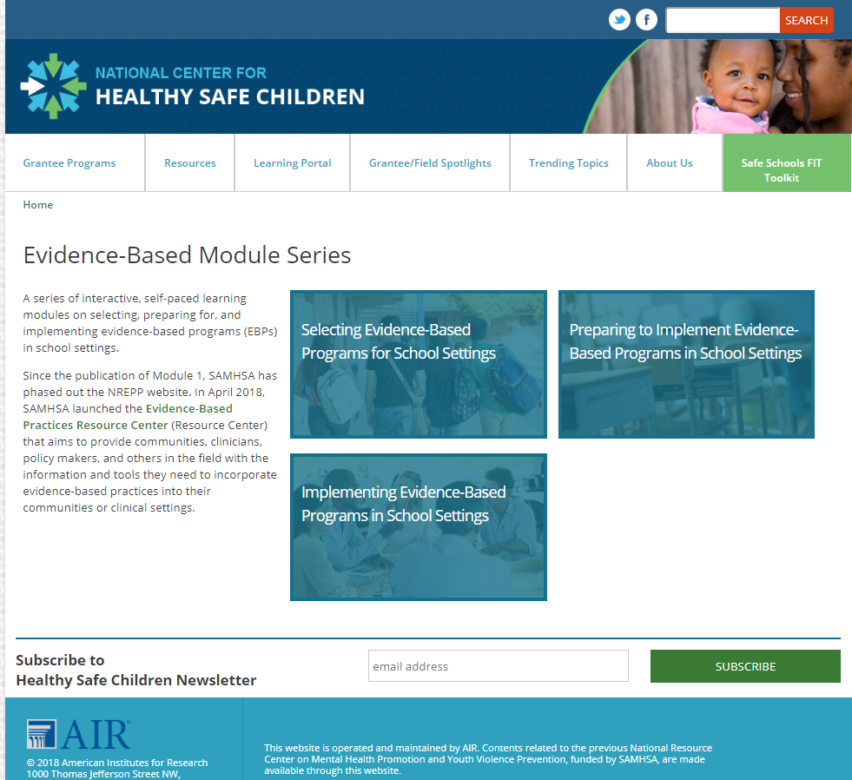
Sources of Evidence
Sources of Evidence
Resources
Published studies
Evidence-based practice developers
Schools and communities implementing the evidence-based practice
Evidence-based practice (EBP) registries
Model Programs Guide
https://www.ojjdp.gov/mpg
IES What Works Clearinghouse
https://ies.ed.gov/ncee/wwc/
Blueprints for Healthy Youth Development
https://www.blueprintsprograms.org/about
Society of Clinical Child & Adolescent Psychology
https://effectivechildtherapy.org/therapies/
https://healthysafechildren.org/learning-module-series/evidence-based-module-series
Notes:
There are many sources of intervention evidence to consider including:
Sources of evidence include:
Published studies: Published studies describe how the program has been tested and the outcomes that it has influenced.
Evidence-Based Practice developers: Developers can describe available implementation supports, how to monitor fidelity of implementation, the feasibility of adaptation, and solutions to implementation challenges.
Schools and communities implementing the Evidence-Based Practices: Other schools and communities can describe their experience with implementation and, if relevant, adaptations to the EBP.
Evidence-Based Practices Registries: EBP Registries provide information about the EBP’s evidence base, features, training requirements, and cost. Examples include the Model Programs Guide, IES What Works Clearinghouse, Blueprints for Healthy Youth Development, and Society of Clinical Child & Adolescent Psychology.
These are described in more detail in the Evidence-Based Practice modules developed by the Mental Health Promotion and Youth Violence Prevention Center that supported the Safe Schools Healthy Students grant program.

Slide 44
fit the unique strengths, needs, and cultural/linguistic considerations of your students and families
Quality Indicator
Best Practices
To what extent did your district/school use best practices to ensure Tier 1 services and supports are equitable and fit the unique strengths, needs, and cultural/linguistic considerations of your students and families?
Create an EBP selection committee with diverse representation.
Review your school’s student body.
Review your school’s mental health needs and strengths.
Review costs associated with implementation.
Evaluate training requirements.
Pilot test the new practice.
Adapt the practice.
National School Mental Health Implementation Guidance Modules
Notes:
Consider - To what extent did your district/school use best practices to ensure Tier 1 services and supports fit the unique strengths, needs and cultural/linguistic considerations of your students and families?
Any service or support you adopt or implement must of course fit the unique characteristics of the students and their families in your school or district.
Best practices for this indicator include:
Collect data on social and cultural demographics (i.e., age, disability, ethnicity, gender identity and expression, language, national origin, race, religion, sexual orientation, sex, socioeconomic status, etc.) and disaggregate data to ensure equitable engagement in Tier 1 supports.
Create an intervention selection committee with diverse representation (e.g., school and community mental health providers, school administrators, teachers, students, caregivers)
Consider intervention fit with unique school considerations through a review of:
School’s student body, inclusive of age, disability, ethnicity, gender identity and expression, language, national origin, race, religion, sexual orientation, sex, socioeconomic status.
School’s and community’s mental health needs, and strengths.
Evaluate fit of existing or prospective interventions with respect to the strengths, needs and cultural/linguistic consideration of students, families, and communities to inform adoption, adaptation, or abandonment of interventions.
Pilot test new practices with school population to help inform fit.
As appropriate, adapt the practice to fit school population unique considerations, and evaluate impact of adaptations.

Slide 45
Selecting Evidence-Based Programs
Resources
Selecting Evidence-Based Programs
Includes worksheets and tools to assess:
Intended population of intervention
Intervention target
Tier of support (based on severity level)
Intervention delivery
Readiness to implement an EBP
Menu of options to measure impact
Notes:
The Selecting Evidence-Based Practices for Schools guide, developed by the National Center for Mental Health Promotion and Youth Violence Prevention in partnership with the National Center for School Mental Health, provides detailed, practical information about EBP selection in schools.
It includes worksheets and tools for your team to assess any prospective or current EBP in terms of its relevance to your student population, intervention target, tier of service, mode of delivery, readiness and impact evaluation capacity.

Slide 46

Evidence-Based Programs in
School Settings
Resources
Evidence-Based Programs in
School Settings
3-part webinar series on evidence-based programs in schools
  Selecting
  Implementing
  Preparing
http://airhsdlearning.airws.org/EBPModule1/story_html5.html
Notes:
This 3-part series on evidence-programs in schools, developed by the National Center for Mental Health Promotion and Youth Violence Prevention in partnership with the National Center for School Mental Health, includes 3 parts:
Selecting Evidence-based Programs for Schools
Implementing
Preparing
http://airhsdlearning.airws.org/EBPModule1/story_html5.html

Slide 47
ensure adequate resource capacity to implement
Quality Indicator
Best Practices
To what extent did your district/school use best practices to ensure adequate resource capacity to implement mental health promotion (Tier 1) services and supports?
Evaluate:
  Staffing capacity needed to implement services and supports.
  Availability of staff with training in providing culturally responsive, anti-racist, and equitable supports.
  Implementation supports.
  Costs of training and implementation.
Determine whether staffing, supports, and costs are achievable.
National School Mental Health Implementation Guidance Modules
Notes:
Consider - To what extent did your district/school use best practices to ensure adequate resource capacity to implement mental health promotion (Tier 1) services and supports?
Of course at this point you might be wondering exactly how much it will cost in staff time to train, implement, and monitor mental health promotion activities being implemented. Consideration of these factors is absolutely essential to optimize the fit of any intervention with your local school or district.
Best practices for this indicator include:
Evaluate staffing capacity needed to implement services and supports, including staff training requirements, qualifications, and staff time.
Evaluate staffing capacity in terms of availability of staff with training and/or expertise in providing culturally responsive, anti-racist, and equitable Tier 1 supports.
Evaluate implementation supports (ongoing training, coaching, peer support, supplies) needed to implement services and supports with fidelity.
Evaluate costs associated with training and implementation.
Determine whether staffing, implementation supports, and costs of services and supports are achievable within current school mental health system.

Slide 48
Intervention Planning Form
Resources
Intervention Planning Form
National School Mental Health Implementation Guidance Modules
Notes:
** Planning form included in printed materials (no link in resources)
This is an intervention planning form developed by the NCSMH for teams to consider all the relevant details of the capacity needed for implementation prior to deciding to adopt a new practice or intervention.
This form is intended to support the mapping of current or prospective programs and guide conversations about realistic capacity needed and available, as well as to consider all interventions “side by side” to highlight any areas of duplication or overlap.

Slide 49
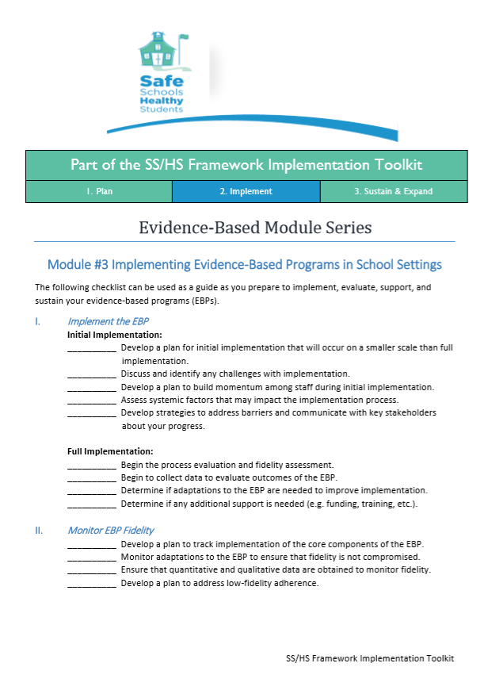
Implementing EBPs in School Settings Checklist
Resources
Implementing EBPs in School Settings Checklist
Develop a plan to track implementation of core components of the EBP.
Monitor adaptations to the EBP to check fidelity.
Ensure that quantitative and qualitative data are obtained to monitor fidelity.
Develop a plan to address low-fidelity adherence.
https://healthysafechildren.org/sites/default/files/EBP-ModulesChkltsMod-3-508.pdf
Notes:
This checklist for Implementing EBPs in School Settings: https://healthysafechildren.org/sites/default/files/EBP-ModulesChkltsMod-3-508.pdf is brief and intended to support planning and teaming processes.

Slide 50
support training and professional development, including ongoing implementation supports
Quality Indicator
Best Practices
To what extent did your district/school use best practices to support training and professional development, including ongoing implementation supports, for mental health promotion (Tier 1) services and supports?
Provide interactive training.
Provide ongoing support for implementation.
Ensure trainings and supports appropriately attend to cultural responsiveness, anti-racism, and equity.
NOTE: Distributing materials and one-time didactic trainings without follow-up support are not best practices to support implementation.
National School Mental Health Implementation Guidance Modules
Notes:
Consider - To what extent did your district/school use best practices to ensure adequate resource capacity to implement mental health promotion (Tier 1) services and supports?
The research is clear that training and professional development is absolutely necessary to support implementation. However, it doesn’t stop there. Training should be interactive, and because one-time training rarely results in meaningful practice change, ongoing implementation supports such as coaching and consultation are equally important. Distribution of materials and one-time didactic training without follow-up support are not best practices to support training and implementation of practices and are generally necessary but insufficient to support implementation in schools.
Best practices for this indicator include:
Provide interactive trainings (with opportunity for skills practice, role plays, action planning).
Provide ongoing support for implementation (by regular coaching, consultation, or supervision that includes skills practice, role plays, and corrective feedback, as well as fidelity monitoring and feedback processes).
Ensure trainings and other implementation supports appropriately attend to cultural responsiveness, anti-racism and equity.
NOTE: Distribution of materials and one-time didactic trainings without follow-up support are not best practices to support training and implementation of practices and are generally necessary but insufficient to support implementation in schools.

Slide 51
What Does the Research Say About Training?
One-time training may improve knowledge or attitudes, but not practice.
Ongoing coaching and consultation predicts skill learning and application.
Train-the-trainer models require substantial oversight.
80% success after 3 years of implementation with appropriate planning and ongoing support.
National School Mental Health Implementation Guidance Modules
Notes:
One-time trainings may improve knowledge or attitudes, but not actual practice. Coaching and consultation about the practices directly in the classroom or school setting where they are delivered is the best way to support implementers (such as clinicians, teachers, peer leaders, parent advocates) to learn and apply the skills to deliver the practice or program. The “gold standard” of training is an interactive workshop with materials and ongoing coaching or consultation.
Train the trainer models are increasingly popular for the cost and time effectiveness of investing in the training and coaching of a smaller group of individuals to train others. However, the research literature supporting the effectiveness of this strategy is mixed at best and thus we recommend if you use this model, you build in a substantial amount of oversight for the trainers and their trainees to ensure fidelity.
Finally, it is important to recognize that training is not an event, it is a process. This is the same with implementation overall. Even with the best planning and support, implementation projects take about 3 years to achieve about 80% success. In order to maximize the return on your investment in training days and materials, ongoing supports should be included.

Slide 52
monitor fidelity of mental health promotion
Quality Indicator
Best Practices
To what extent did your district/school use best practices to monitor fidelity of mental health promotion (Tier 1) services and supports?
Identify fidelity monitoring tools.
Ensure your tool or system measures adherence to content, quality of delivery, and logistics.
Determine frequency of fidelity measurement.
Establish a benchmark.
Monitor and track adaptations.
Provide feedback to keep improving.
National School Mental Health Implementation Guidance Modules
Notes:
Consider - To what extent did your district/school use best practices to monitor fidelity of mental health promotion (Tier 1) services and supports?
Fidelity monitoring goes hand in hand with ongoing implementation supports. In fact, fidelity monitoring activities can be built into coaching and consultation models by adding a fidelity tool or measure to inform specific topics to discuss or skills to model.
Best practices for this indicator include:
Identify fidelity monitoring tools specific to the practice you are implementing or develop a tool specific to the practice and the implementation context in school (based on fidelity monitoring tools for similar evidence-based practices). Tools might involve reviewing student records or progress, directly observing school staff who are implementing the practice and/or talking with anyone implementing or receiving the practice
Ensure your fidelity monitoring tool or system measures the following:
Adherence to intervention’s core content (what is being implemented)
Adaptations to maximize cultural fit and relevancy
Quality of program delivery (manner in which facilitator delivers/implements program)
Logistics (conducive implementation environment, number/length of sessions implemented)
Participant responsiveness to and staff engagement in services and supports by cultural group or identity (I.e., age, disability, ethnicity, gender identity and expression, language, national origin, race, religion, sexual orientation, sex, socioeconomic status) relevant to the program and school community
Determine frequency of fidelity measurement based on what is feasible and will yield actionable information
Establish a benchmark for acceptable levels of feasibility (e.g., not acceptable, adequate, excellent)
Monitor and track changes or adaptations to the practice
Provide feedback to anyone implementing and use the results to continuously improve, adapt, and sustain implementation

Slide 53
What Is Fidelity Monitoring?
A system of evaluating the degree to which an intervention or program is implemented as intended, which requires you to:
  Clarify what the intervention or program intends to achieve.
  Monitor and track the extent to which intentions are achieved.
  Analyze why actions and/or methods are leading to observed outcomes.
National School Mental Health Implementation Guidance Modules
Notes:
Fidelity monitoring can be used to measure the presence of a program, practice or initiative as it is used in daily practice. This involves clarifying what the program intends to achieve, in terms of skill development or competencies included and the extent to which a person – the implementer – achieved those intentions.
When implementing fidelity monitoring tools, consider the following:
Use formal fidelity monitoring tools included within intervention materials.
Schedule routine “implementation check-ins” for team to review training materials and discuss whether the intervention procedures were followed accurately.
Create a checklist of key intervention steps that can be used to monitor fidelity through live observation or records review.
Schedule times for a team member to observe implementation of the intervention and complete the fidelity tool or checklist.
Adaptations or changes to the content are also a natural part of implementation.
Document adaptations and determine whether adaptations are appropriate as a team.
Seek input from implementers and program developers or trainers.
Determine how to balance fidelity benchmarks and adaptations for each program or practice being implemented.
Use implementer feedback and EBP developer input.
For example, if a teacher says they can only deliver a 30-minute session for a program that is intended to be 45-minutes, that is a necessary adaptation for the school context. It may be beneficial to work with the developer or obtain input from other schools or districts implementing the program.
Create feedback loops with the data, using data constructively to learn from and support implementers over time.
Provide feedback on strengths and areas for improvement.
Fidelity data can also be used to indicate how well the program or practice is fitting in the school or district context; some programs or practices will inevitably be a better fit than others, and fidelity data can be used to make decisions about whether to continue implementation and focus energy on sustainability.

Slide 54
Fidelity Monitoring Checklist
Resources
Fidelity Monitoring Checklist
Identify fidelity monitoring tools.
Determine the frequency of fidelity measurement.
Establish a benchmark for acceptable levels of fidelity.
Monitor adaptations.
Notes:
This resource, Planning Checklist for Monitoring Fidelity of Evidence-Based Practices (EBPs). is a basic fidelity monitoring checklist developed by the NCSMH in collaboration with the American Institutes for Research that can be used to plan for the monitoring of fidelity for a specific practice or program.
The intention of this checklist is to provide a quick reference for different considerations during the planning process, including the identification of fidelity monitoring tools, determining how often to collect fidelity data, setting an “acceptable” benchmark, and monitoring and documenting changes or adaptations that are occurring in the school setting.

Slide 55
Fidelity Monitoring
Plan ahead for fidelity monitoring methods and tools before implementation.
Decide how to strike a balance between fidelity and adaptation.
  Fidelity – degree to which a program or practice is implemented as intended.
  Adaptation – how much, and in what ways, a program or practice is changed to meet local circumstances.
Share fidelity data back with implementers and other key members of the team to make continuous improvements.
National School Mental Health Implementation Guidance Modules
Notes:
The intervention selection process is a great time to think about how you will monitor fidelity.
Some evidence-based programs have a fidelity monitoring tool, and in other cases you might have to develop a new tool. This can be as informal as routine “check-ins” about implementation using the initial training materials as a guide. Or, fidelity monitoring methods can include a records review with a tool or checklist of items that might indicate the practice was implemented as intended (although if everything that is done is not documented, records review can be limited).
The most common way to monitor fidelity is via a formal observation of implementation with ratings of specific aspects of the implementation.
Adaptation is a natural part of implementation. Document it and determine how much and what type of adaptations are appropriate as a team with input from implementers and program developers or trainers. Your team will need to decide how to balance fidelity benchmarks and adaptations for each program or practice you’re implementing.
Implementer feedback and EBP developer input can be very helpful in this process. For example, if a teacher tells you she can only deliver the program in 30-minute sessions but the manual is written for 45-minute sessions, that is a necessary adaptation for the school context about which you may need to work with the developer and even obtain input from other schools/districts implementing the program to decide how to change.
Finally, you should always create feedback loops with the data, meaning that the findings are used constructively to learn from and support implementers over time. Make sure to provide feedback on strengths and areas for improvement. Fidelity data can also be used within your district or school mental health team to indicate how well the program or practice is fitting in the school context with your students. Some programs or practices will inevitably be a better fit than others, and fidelity data can be used to make decisions about whether or not to continue implementation and focus energy on sustainability.

Slide 56
District Example
One large urban school district decided to implement Restorative Practices district-wide, but started with select schools to closely monitor fidelity and implementation to inform sustainable scale-up. Every adult in the school attended a 1-day interactive training, including instructional and non-instructional staff and community partners. A fidelity monitoring tool was developed and a team of 2 Restorative Practices trainers employed by the district conducted 2-day trainings for each school, followed by ongoing consultation and coaching and fidelity monitoring every fall and spring. The fidelity metric included a principal interview, staff interview, student interview, restorative circle observation, and overall school observation. Scores fall in the ranges of “not implemented,” “developing,” or “effective.” Fidelity data were used in feedback and planning meetings with principals to plan targeted coaching.
National School Mental Health Implementation Guidance Modules
Notes:
This is an example of how one large urban school district used fidelity monitoring to support their implementation of Restorative Practices. It highlights the district’s investment in the ongoing consultation and coaching involved in the implementation process and how fidelity data were used in feedback loops to principals. An important aspect of this process was assuring school teams that the fidelity interviews and observations were intended to learn how best to support them, and would not be used in a punitive way or for accountability purposes. The coaches always provided feedback on strengths and improvement (if there was a previous assessment to compare to) and normalized that there are many components of Restorative Practices so every school will naturally have areas that need additional support to make happen throughout the building in a consistent way.

Slide 57
Questions to Consider
Are the services and supports evidence-based?
Do you have the right mix of mental health promotion services and supports for your students’ strengths, needs, and cultural and linguistic characteristics?
Are there programs being implemented that would benefit from fidelity monitoring?
Reflection:
What mental health promotion services and supports does your district/school provide?
National School Mental Health Implementation Guidance Modules
Notes:
Reflection:
What mental health promotion services and supports does your district/school currently provide to all students?
Of those services and supports:
Are they evidence-based?
Do you believe you have Tier 1 services and supports that are the best fit for the needs, strengths, and cultural and linguistic competencies of your students?
Do you have and current programs being implemented that would benefit from fidelity monitoring?

Slide 58

Discussion
Strategic Planning
State a specific goal for your district within this domain.
List 3 potential action steps to move this goal forward.
Discussion
How does this content fit with your district understanding and policy/practice related to mental health promotion?
National School Mental Health Implementation Guidance Modules
Notes:
We will now consider how this module and quality indicators fit with your understanding and implementation of mental health promotion.
Please work together with your group to state a specific goal for your district and then consider 3 potential action steps that could reasonably be taken to move the goal forward.

Slide 59
Resources
Resources
American Institutes for Research and the National Center for School Mental Health. (2018). Planning checklist for monitoring fidelity of evidence-based practices (EBPs). http://bit.ly/2HgRBWk
Barrett, S., Eber, L., & Weist, M. (2017). Advancing education effectiveness: Interconnecting school mental health and school-wide positive behavior support. Center for School Mental Health. https://www.pbis.org/resource/advancing-education-effectiveness-interconnecting-school-mental-health-and-school-wide-positive-behavior-support
Blueprints for Healthy Youth Development. (n.d.) Blueprints for healthy youth development. https://www.blueprintsprograms.org/about
Center for Disease Control and Prevention. (2018). Health-related quality of life (HRQOL). https://www.cdc.gov/hrqol/index.htm
Collaborative for Academic, Social, and Emotional Learning (CASEL). (n.d.). CASEL. www.casel.org
Collaborative for Academic, Social, and Emotional Learning (CASEL). (n.d.). CASEL Program Guides. https://casel.org/guide/
Collaborative for Academic, Social, and Emotional Learning (CASEL). (n.d.) District resource center: https://drc.casel.org
Dymnicki, A., Becker, K. D., Cunningham, D. L., & Anderson, K. L. (2014, October). Evidence-Based Module Series. Online Learning Module product of the National Resource Center for Mental Health Promotion and Youth Violence Prevention, Substance Abuse and Mental Health Services Administration.
National School Mental Health Implementation Guidance Modules

Slide 60
Resources
Resources
Education Development Center. (n.d.). A framework for effectively implementing evidence-based programs and practices (EBPs). http://www.promoteprevent.org/sites/www.promoteprevent.org/files/resources/Framework%20for%20Effectively%20Implementing%20Evidence-Based%20Programs_Practices%20%282%29.pdf
Flook, L., Goldberg, S. B., Pinger, L., Bonus, K., & Davidson, R. J. (2013). Mindfulness for teachers: A pilot study to assess effects on stress, burnout, and teaching efficacy (MBSR). Mind, Brain, and Education, 7(3), 182–195. https://doi.org/10.1111/mbe.12026
Frank, J.L., Reibel, D., Broderick, P., Cantrell, T. & Metz, S. (2015). The effectiveness of mindfulness-based stress reduction (MBSR) on educator stress and well-being: results from a pilot study. Mindfulness, 6, 208–216. https://doi.org/10.1007/s12671-013-0246-2
Harris, A. R., Jennings, P. A., Katz, D. A., Abenavoli, R. M., & Greenberg, M. T. (2016). Promoting stress management and wellbeing in educators: Feasibility and efficacy of a school-based yoga and mindfulness intervention (CALM). Mindfulness, 7(1), 143–154. https://doi.org/10.1007/s12671-015-0451-2
Hart, P. M., Wearing, A. J., Conn, M., Carter, N. L., & Dingle, A. R. K. (2000). Development of the School Organisational Health Questionnaire: A measure for assessing teacher morale and school organizational climate. British Journal of Educational Psychology, 70(2), 211–228. https://doi.org/10.1348/000709900158065
Hudnall Stamm, B. (2009). Professional Quality of Life: Compassion Satisfaction Fatigue Version 5 (ProQOL). https://proqol.org/uploads/ProQOL_5_English.pdf
National School Mental Health Implementation Guidance Modules

Slide 61
Resources
Resources
Institute of Education Services. (n.d.). What Works Clearinghouse. https://ies.ed.gov/ncee/wwc/
Jennings, P. A., Frank, J. L., Snowberg, K. E., Coccia, M. A., & Greenberg, M. T. (2013). Improving classroom learning environments by Cultivating Awareness and Resilience in Education (CARE): Results of a randomized controlled trial. School Psychology Quarterly, 28(4), 374. https://doi.org/10.1037/spq0000035
Mental Health Collaborative. (n.d.). Mental health for educators: Knowledge and tools for the classroom. https://www.mentalhealthcollaborative.org/programs/mental-health-essentials-for-educators-part-1/
National Center for Healthy Safe Children. (n.d.). Evidence-based module series. https://healthysafechildren.org/learning-module-series/evidence-based-module-series
National Center for Healthy Safe Children. (n.d.) Evidence-based module series: Module #3 Implementing evidence based programs in school settings. https://healthysafechildren.org/resource/selecting-evidence-based-programs-school-settings
National Center for Mental Health Promotion and Youth Violence Prevention. (n.d.). Selecting evidence-based programs. https://healthysafechildren.org/resource/selecting-evidence-based-programs
National Center for Mental Health Promotion and Youth Violence Prevention. (n.d.). Selecting evidence-based programs in school settings. https://healthysafechildren.org/resource/selecting-evidence-based-programs-school-settings
National School Mental Health Implementation Guidance Modules

Slide 62
Resources
Resources
National Center for School Mental Health. (n.d.). Intervention planning form. https://dm0gz550769cd.cloudfront.net/shape/a2/a22be8263910aca821bb40c04fc8a086.pdf
National Center for School Mental Health. (n.d.). Organizational Well-Being Inventory for Schools (OWBI-S). https://shape.3cimpact.com/owbi
National Center for School Mental Health. (n.d.). Planning checklist for monitoring fidelity of evidence-based practices (EBPs). https://dm0gz550769cd.cloudfront.net/shape/6a/6ace1f979015ac4593afa1281ec7361d.pdf
National Center for School Mental Health (2023). School Mental Health Quality Guide: Mental health promotion services & supports (tier 1). https://www.schoolmentalhealth.org/media/som/microsites/ncsmh/documents/quality-guides/Tier-1.pdf
National Center on Safe Supportive Learning Environments. (n.d.). ED School Climate Surveys (EDSCLS). https://safesupportivelearning.ed.gov/edscls
National Center on Safe Supportive Learning Environments. (n.d.). School climate improvement resource package. https://safesupportivelearning.ed.gov/scirp/about
National Center on Safe Supportive Learning Environments. (n.d.). School climate measurement. https://safesupportivelearning.ed.gov/safe-and-healthy-students/school-climate
Now Is the Time Technical Assistance. (n.d.). Using the Interconnected Systems Framework in Now Is the Time, Project AWARE. https://cars-ta.groupsite.com/page/project-aware
National School Mental Health Implementation Guidance Modules

Slide 63
Resources
Resources
Office of Juvenile Justice and Delinquency Prevention. (n.d.). Model programs guide. https://www.ojjdp.gov/mpg
Positive Behavioral Interventions & Supports. (n.d.). Positive behavioral interventions and supports. https://www.pbis.org/
Positive Behavioral Interventions & Supports. (2020). Creating Effective Classroom Environments Plan Template. https://www.pbis.org/resource/creating-effective-classroom-environments-plan-template
Positive Behavioral Interventions & Supports. (2022). Supporting and responding to students’ social, emotional, and behavioral needs: Evidence-based practices for educators. https://www.pbis.org/resource/supporting-and-responding-to-behavior-evidence-based-classroom-strategies-for-teachers
Renshaw, T. L. (2022). Teacher Subjective Wellbeing Questionnaire (TSWQ): Measure and user guide. https://osf.io/6548v
Renshaw, T. L., Long, A. C., & Cook, C. R. (2015). Assessing teachers’ positive psychological functioning at work: Development and validation of the Teacher Subjective Wellbeing Questionnaire. School Psychology Quarterly, 30(2), 289. https://doi.org/10.1037/spq0000112
Schott Foundation. (n.d.). Toolkit & infographic: What are restorative practices? https://schottfoundation.org/restorative-practices/
National School Mental Health Implementation Guidance Modules

Slide 64
Resources
Resources
Shockey, T. M. (2017). Health-related quality of life (HRQOL): Variation across occupation groups. Centers for Disease Control and Prevention. https://blogs.cdc.gov/niosh-science-blog/2017/07/26/hrqol/
Society of Clinical Child & Adolescent Psychology. (2018, April 24). Evidence-based therapies. https://effectivechildtherapy.org/therapies
TeacherWISE. (n.d.). About us. https://teacherwise.org/
Winwood, C., & McEwan, B. (2013). A practical measure of workplace resilience: Developing the Resilience at Work Scale. http://d4462130.u92.platformpublishing.com.au/wp
content/uploads/2013/10/RAWScaleArticleJOEM.pdf
Wolf-Prusan, L., O’Malley, M., & Hurley, N. (n.d.) Restorative practices: Approaches at the intersection of school discipline and school mental health. https://dm0gz550769cd.cloudfront.net/shape/5d/5d75418901f4ed14b77d94193032dc8e.pdf
Working with Resilience. (n.d.). Resilience at Work® individual scale. https://www.workingwithresilience.com.au/measure-resilience/rw-scale
Youth Mental Health First Aid. (n.d.). Take a course. https://www.mentalhealthfirstaid.org/take-a-course/
National School Mental Health Implementation Guidance Modules

Slide 65
References
References
Anderson, C., Barnes, M. S., Beane, C., Bishop, J., Davis, E., Fishkind, P., & Truman, S. (2014). Restorative practices: Fostering healthy relationships & promoting positive discipline in schools. Advancement Project. https://advancementproject.org/resources/restorative-practices-fostering-healthy-relationships-promoting-positive-discipline-in-schools/
Durlak, J. A., Weissberg, R. P., Dymnicki, A. B., Taylor, R. D., & Schellinger, K. (2011). The impact of enhancing students’ social and emotional learning: A meta-analysis of school-based universal interventions. Child Development, 82, 405–432. https://doi.org/10.1111/j.1467-8624.2010.01564.x
Jorm, A. F. (2000). Mental health literacy: Public knowledge and beliefs about mental disorders. The British Journal of Psychiatry, 177(5), 396 –401. https://doi.org/10.1192/bjp.177.5.396
Kutcher, S., Wei, Y., & Coniglio, C. (2016). Mental health literacy: past, present, and future. The Canadian Journal of Psychiatry, 61(3), 154–158. https://doi.org/10.1177/0706743715616609
National Center on Safe Supportive Learning Environments. (n.d.) School climate. https://safesupportivelearning.ed.gov/safe-and-healthy-students/school-climate
Sklad, M., Diekstra, R., Ritter, M. D., Ben, J., & Gravesteijn, C. (2012). Effectiveness of school-based universal social, emotional, and behavioral programs: Do they enhance students’ development in the area of skill, behavior, and adjustment? Psychology in the Schools, 49(9), 892–909. https://doi.org/10.1002/pits.21641
National School Mental Health Implementation Guidance Modules

Slide 66

This work is supported by grant SM081726 from the Department of Health and Human Services, Substance Abuse and Mental Health Services Administration.
Module content was developed by the National Center for School Mental Health in partnership with the MHTTC Network Coordinating Office.
Acknowledgments
National School Mental Health Implementation Guidance Modules

