Slide 1
Managing Chronic Pain in the Patient Centered Medical Home Webinar Series
Christian Klepper, PsyD, Mid-America MHTTC
Tyler Brown, PsyD, Medstar National Rehabilitation Hospital
Chase Grosse, PsyD, Floyd Family Medicine Residency
Brandy Clarke, PhD, Mid-America MHTTC

Slide 2
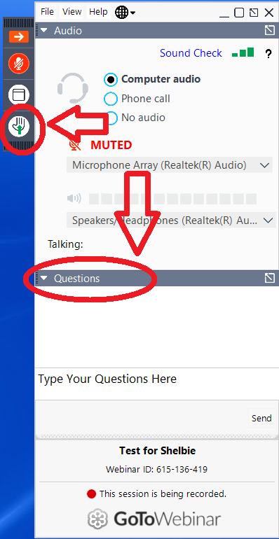
Asking Questions
Mobile
Web
Option 1: Raise your hand to ask a question aloud.
Option 2: Type your question in to have it read for you.

Slide 3
We, Drs. Clarke, Klepper, Grosse & Brown, have no financial, personal, or professional conflicts of interest in this training titled “Managing Chronic Pain in the Patient Centered Medical Home Webinar Series”.

Slide 4
Evaluation and follow up
At the end of this session, you will be asked to complete a brief evaluation sent via email.
Because this event is federally funded, we are required to ask about participants’ satisfaction with our services.
To maintain our funding, we are required to get 80% follow-up.
We greatly value your feedback and participation in the survey!!

Slide 5
What is the Mid-America MHTTC?
Funded by the Substance Abuse and Mental Health Services Administration
Five-year grant of $5.2 million
Awarded to Dr. Joseph Evans at the University of Nebraska Medical Center
Serves to align mental health systems and professional competencies with evidence-based practices
Operates in Missouri, Iowa, Nebraska and Kansas
Provides free/low cost training and technical assistance on a variety of topics germane to effective mental health practice

Slide 6
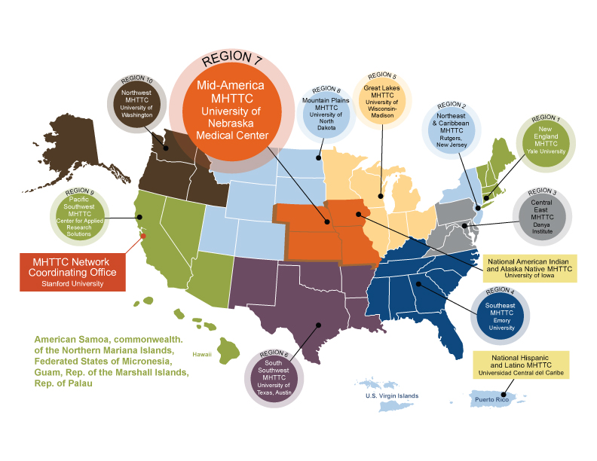
10 Regional Centers
National Hispanic & Latino Center
National American Indian and Alaska Native Center
Network Coordinating Office
Notes:
10 Regional Centers​
National Hispanic & Latino Center​
National American Indian and Alaska Native Center​
Network Coordinating Office​

Slide 7
Mid-America MHTTC Team
Brandy Clarke:
Project Director
Bill Baerentzen:
Project Coordinator
Shinobu Watanabe-Galloway:
Program Evaluator
Lauren Robinson:
Communications
Shelbie Johnson:
Grant Manager

Slide 8
MHTTC Services
Training Levels
Universal: Conference presentations, newsletters, brief consultation
Targeted: Online courses, webinar series, focused knowledge-sharing, short-term training, replication guides
Intensive: Ongoing relationship between the TTC program and agency receiving services
Outcomes
Universal: Increased reach of information and tools about evidence-based practice
Targeted: Increased motivation to use and apply specific interventions
Intensive: Policy and program changes with implementation of interventions by users

Slide 9
Specialized Training Topics
Integrated behavioral health in primary care
School mental health
Serious mental illness
Behavioral health workforce development

Slide 10
Integrated Care Program
Brandy Clarke, PhD
Project Director
Rachel Valleley, PhD
IC Program Director
Holly Roberts, PhD
Faculty Trainer
Christian Klepper, PsyD
IC Program Coordinator
Eryn McMaster, PhD
Faculty Trainer

Slide 11
Integrated Behavioral Health in Primary Care
MHTTC staff have 20+ years of experience integrating behavioral health into primary care in 40+ rural, suburban, and urban sites

Slide 12
Training and TA in Integrated Care
Quality Indicators of Integrated Behavioral Health in Primary Care
Evidence-based behavioral health interventions for children and adults applied in integrated care settings
Technical Assistance on Implementation of Integrated Care
Online Courses focused on Integrated Care and Special Topics in Pediatric and Adult Services (in development)

Slide 13
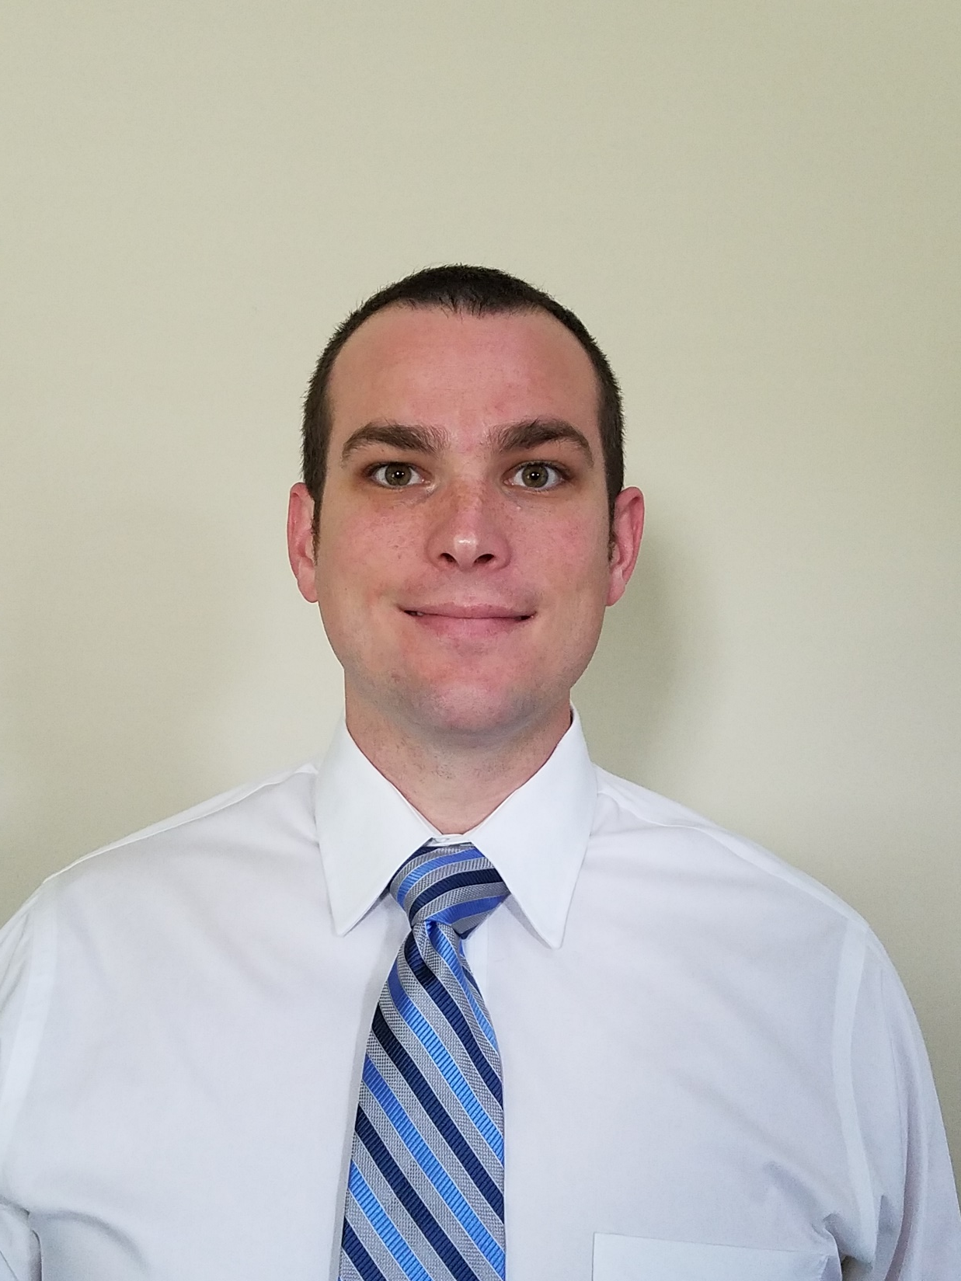
Introductions
Dr. Tyler Brown is a second-year postdoctoral fellow at Medstar National Rehabilitation Hospital in Washington, DC. He completed his Psy.D. in Clinical Psychology at Mercer University in Atlanta, GA. Dr. Brown has six years of supervised experience working in psychology with an emphasis on rehabilitation and health related issues including chronic pain, spinal cord injury, amputation, stroke, multiple sclerosis, and brain injury. Dr. Brown is a licensed Psychology Associate in the District of Columbia and recently Licensed Psychologist in the state of Virginia. He is also a member of the APA Division 22 Rehabilitation and Division 38 Health Psychology organizations.
Dr. Chase Grosse is the Director of Behavioral Medicine at the Floyd Family Medicine Residency in Rome, Georgia. Dr. Grosse graduated from Mercer University. He completed an internship in health service psychology at the University of Texas at Tyler Health Sciences Center. He completed his fellowship in Clinical Health Psychology at Ascension Genesys Hospital in Grand Blanc, Michigan. Throughout his graduate and training programs, Dr. Grosse has focused on integrating behavioral health, including behavioral pain management, into medical settings and training medical residents and fellows.

Slide 14
Actionable Goals
Identify elements of a biopsychosocial assessment
Assess for common comorbid issues
Identify free or low cost assessment tools
Describe the role of a behavioral health provider in the team-based assessment of pain
Identify strategies for connecting assessment to intervention

Slide 15
Review of Previous Content
Models of pain
Gate control
Loeser
Fear avoidance
Biopsychosocial assessment
Role of BH provider in management of chronic pain

Slide 16
Key Domains and Their Interaction
Physical
Functioning
Affect/Psychiatric
Cognitive
Social
Culture
Spiritual
Values (love, work, play, health)
Physical environment
In Primary Care this is targeted. Less open ended questioning.
Notes:
Fxn/Behavior – What does your pain keep you from doing? Work/Love/Play. If not for the pain what would you be doing? Sleep? Magic wand questions. Return to Losier's linear model – Behaviors are observable! What are they doing!? – Facial expressions, limping, guarding, vocalizations. Take note!
Affect – mental health or subclinical sx. Comorbidities (discussed later in this presentation)
Physical – Where does it hurt? What makes it better/worse 1-10 scale. Time of day. Activity. Before/After. The type of pain will drive the intervention despite overlap.
Cognitive – What does your pt think about your pain. You get a lot of this from the other questions. I hate this… Why me… I don’t deserve statements, My life is ruined. What is their self-talk?
Social – Relationships. How do the people most important to the pt react to their invisible illness.
Spiritual – Don’t leave this out. People may feel betrayed or gain strength from their beliefs. This may lead to an excellent intervention. Again Values, Meaning. What is important to them.
Other illnesses, dxs, substance use. Often already in the chart but you can still screen.
L/W/P – Part of FACT Contextual interview
Robinson, P., Gould, D., Strosahl, K., (2011) Real Behavior Change in Primary Care: Improving Patient Outcomes & Increasing job satisfaction. New Harbinger, Oakland.
Hunter, C., Goodie, J., Oordt. M, Dobmyer, A., (2014) Integrated Behavioral Health in Primary Care: Step–by-Step Guidance for Assessment and Intervention. American Psychological Association, Washington D.C..

Slide 17
Literacy, Health Literacy, and Numeracy
Identify knowledge gaps and the population
Limited health literacy and low numeracy skills are often unrecognized by healthcare providers
Associated with
Adverse health effects
Poor self-management skills
Lower adherence
Higher hospitalization rates, ED utilization
Lack of preventative care
Notes:
This is a vulnerable, high risk patient.
loosely dependent on educational attainment
This type of education happens during all stages of the pt interaction.
Griffey R. T., et al. (2016). Shared Decision Making in the Emergency Department Among Patients with Limited Health Literacy: Beyond Slower and Louder. Academic Emergency Medicine.

Slide 18
Literacy, Health Literacy, and Numeracy
Slower and louder is not the answer
Avoid jargon
Bridging statements if you are compelled
Consider developmental level
Working with children
Respectfully confirm understanding
More in the intervention section
Notes:
Even for pt with poor reading skills, speaking slowly tends to make listeners focus on single words rather than the whole message.

Slide 19
Assessment of Pain
Rating of pain
1-10 scale
Faces Pain Scale
Description of pain
Location
Etiology (if known)
Stabbing, dull, sharp, burning, tingling
Temporal order (time of day)
Aggravating and alleviating factors
Coping strategies – active, passive
History of treatment
Effectiveness

Slide 20
Patient Centered Outcomes Questionnaire
Measure of current pain and outcome expectations
Uses standard 0-10 Likert scale to ask patients to assess their usual, desired, successful treatment, importance of improvement, and expected outcomes across several areas:
Pain
Fatigue
Emotional Distress
Interference with Daily Activities

Slide 21
Functioning
Current level of functioning/impairment
What is the patient not doing that they used to do?
Work/school
Friends/family
Hobbies/extracurricular activities
ADLs
What do they want to be better or different?
If you didn’t have this pain, what would you be doing?

Slide 22
Tampa Scale of Kinesiophobia (TSK)
Measure of fear of movement/avoidance
17 item Likert scale assessment of injury perception of pain:
I’m afraid that I might injury myself if I exercise
I am afraid that I might injure myself accidentally
Simply being careful that I do not make any unnecessary movements is the safest thing I can do to prevent my pain from worsening
“Beliefs that painful activity will result in damage and/or increased suffering and/or functional loss.” (Bunzli et al., 2015)

Slide 23
World Health Organization Disability Assessment Schedule (WHODAS 2.0)
Measures perceived disability on a Likert scale across 6 domains:
Cognition – understanding & communicating
Mobility – moving & getting around
Self-care – hygiene, dressing, eating & staying alone
Getting along – interacting with other people
Life activities – domestic responsibilities, leisure, work & school
Participation – joining in community activities
36-item and 12-item versions
World Health Organization offers Excel spreadsheet for scoring
Simple and Domain-weighted scoring calculations
Developed for disability across etiologies

Slide 24
Oswestry Low Back Pain Disability Questionnaire
Measure of perceived disability
10 question Likert asks about pain and functional ability across 10 domains:
Pain Intensity
Personal Care
Lifting
Walking
Sitting
Standing
Sleeping
Sex Life
Social Life
Traveling

Slide 25
Psychiatric Comorbidities
Internalizing issues
Mood, depression
Anxiety
Pain catastrophizing
PTSD/trauma history
When did the issues first start?
Did they precede the medical illness?
How often and for how long?
Prior history of therapy and outcomes

Slide 26
Patient Health Questionnaire (PHQ-9, PHQ-2, PHQ-A)
Depression Screener
PHQ-9 – 9 Likert scale questions asking about common depressive symptoms over the past 2 weeks
PHQ-2 – first two questions from PHQ-9
PHQ-A – modified for adolescents
Places scores into minimal, mild, moderate, and severe
REVIEW SUICIDE QUESTION BEFORE PATIENT LEAVES

Slide 27
Generalized Anxiety Disorder (GAD-7, GAD-2)
Anxiety screener
7 Likert scale questions asking about common anxiety symptoms over the past 2 weeks
GAD-2 – first two items
Places scores into minimal, mild, moderate, and severe

Slide 28
Sleep Assessment
Sleep quantity (number of hours)
Difficulty initiating or maintaining sleep
Perceived barriers to sleep
Sleep quality
Snoring? Restless/active sleeper? Rule-out sleep apnea or history of sleep study
Caffeine intake
Pre-sleep and bedtime rituals
Frequent daytime sleepiness or naps
Time spent in bed engaged in non-sleep activities

Slide 29
Cognitive
Worry
Self-talk
Rumination
Catastrophizing
Cognitive Functioning
Any changes in thinking or memory or thinking slower than normal?
Age
Medication Side Effects

Slide 30
Pain Catastrophizing Scale
Measure of pain-related worry and focus
13 Likert scale items that break down into three categories:
Rumination
I anxiously want the pain to go away
I can’t seem to keep it out of my mind
Magnification
I become afraid that the pain will get worse
I keep thinking of other painful events
Helplessness
I worry all the time about whether the pain will end
I feel I can’t go on

Slide 31
Social
Friends and Family
Conceptualization of pain
Modeling of pain behaviors
Interactions with Medical Systems
Miracle cure vs. Healing, vs. Acceptance
Hobbies, extracurricular activities
Isolation
Absent or decreased recreation
Healing activities
Culture
Allowances of pain
Spiritual
Betrayed or Uplifted
Perception of God
Vengeful or Loving – And Both?
Ask

Slide 32
Values
Sex and intimacy
Hobbies, interests, extracurricular activities
What does the patient like to do when pain is not a barrier?
What does he/she do when pain is a barrier?
How often are they engaging in these activities vs. how often they would like to?
What kind of things would they be doing if pain was not a barrier right now?
What aspects of their pain or perceived disability prevent them from engaging in these activities?

Slide 33
Sex and Intimacy
Sexual health and behavior is prevalent across lifespan
Normalize
How would you describe your sex life?
Expectation versus reality
Drive/Libido
Frequency
Relationship Stress
Modified positions
Using pillows for support
Side-based positions for pelvic pain
Redefining intimacy
The Ultimate Guide to Sex and Disability by Miriam Kaufman et. al

Slide 34
Physical Environment
Home environment
Concern for falls
Layout of the home
Living arrangements
Others in the home
Interactions with the outside world
Work environment
Social Security Disability

Slide 35
Assessment of Opioid Misuse Risk

Slide 36
Opioid Risk Tool (ORT)
Uses weighted predictors to create a categorical risk (low, medium, high) for men and women separately
Family history of substance abuse (alcohol, illicit, prescription)
Personal history of substance abuse
Age (16-45)
History of preadolescent sexual abuse (women only)
Psychological illness
ADHD
OCD
Bipolar
Schizophrenia
Depression
Very good sensitivity and specificity
94.4% identified as low risk did not display aberrant behavior
90.9% identified as high risk did display aberrant behavior
Notes:
Does not have to be administered directly to the patient
Webster, L. & Webster, R. (2005). Predicting aberrant behaviors in opioid-treated patients: Preliminary validation of the opioid risk tool. Pain Medicine, 6, 432-442.
https://www.drugabuse.gov/sites/default/files/files/OpioidRiskTool.pdf

Slide 37
Screener and Opioid Assessment for Patients with Pain – SOAPP-R (Updated Online SOAPP-8)
24 item screener administered to the patient (<10 min)
Simple Likert scale (0- never, 1- seldom, 2- sometimes, 3- often, 4- always)
Low (scores <9), Moderate (Scores 10-21), and High (22+)
Gives specific recommendations about considerations for individuals at each level
Scores at 18+ have a .81 sensitivity and .68 specificity

Slide 38
Example Considerations on SOAPP-R
High Risk:
Patients should also be told that they would be expected to initially give a urine sample for a toxicology screen during every clinic visit. They should also initially be given medication for limited periods of time (e.g., every 2-weeks).
Less abusable formulations should be considered (e.g., long-acting versus short-acting opioids, transdermal versus oral preparation, tamper-resistant medications).
Moderate Risk
Periodic urine screens are recommended
After a period in which no signs of aberrant behavior are observed, less frequent clinic visits may be indicated. If there are any violations of the opioid agreement, then regular urine screens and frequent clinic visits would be recommended.

Slide 39
Current Opioid Misuse Measure (COMM)
17 items on a Likert scale
Current behaviors for current opioid users
Face valid
Single cut off at 9
.77 sensitivity, .66 specificity
In the past 30 days, how often have you been in an argument?
In the past 30 days, how often have you had trouble controlling your anger (e.g., road rage, screaming, etc.)?
In the past 30 days, how often have you needed to take pain medications belonging to someone else?

Slide 40
Closing the Loop

Slide 41
Providing Feedback to Patient
Avoid setting “it's all in your head”
Lemon in the wound analogy
Be an expert!
Discuss behavioral barriers to pain management
Provide basic education on treatments for the these issues
Instill hope
Create buy-in for the patient

Slide 42
Integrated Team Communication
Integration – patient-centered team with a unified plan
Distill the information that you are putting in the note
Verbal Communication tools
SBAR – Situation, Background, Assessment, Recommendation/Request
DATAS – Demographics, Assessment, Test, Alerts, Status
I-PASS – Illness severity, Patient summary, Action list, Situational awareness, Synthesis by receiver
Others that could be adapted for BH provider communications
Communication via EHR
SOAP
APSO
Notes:
Your site may have already adopted something
QI projects
Patient safety outcome
Provider relationship outcomes

Slide 43
Links to Assessment Measures
Tampa Scale of Kinesiophobia: http://www.tac.vic.gov.au/__data/assets/pdf_file/0004/27454/tampa_scale_kinesiophobia.pdf
WHODAS 2.0: https://www.who.int/classifications/icf/whodasii/en/
Oswestry Low Back Pain Disability Questionnaire: http://www.rehab.msu.edu/_files/_docs/oswestry_low_back_disability.pdf
PHQ-9: https://www.integration.samhsa.gov/images/res/PHQ%20-%20Questions.pdf:
PHQ-A: https://www.integration.samhsa.gov/images/res/8.3.4%20Patient%20Health%20Questionnaire%20(PHQ-9)%20Adolescents.pdf
GAD-7: https://www.integration.samhsa.gov/clinical-practice/GAD708.19.08Cartwright.pdf
Pain Catastrophizing Scale: https://sullivan-painresearch.mcgill.ca/pdf/pcs/PCSManual_English.pdf
ORT: https://www.lynnwebstermd.com/opioid-risk-tool/
SOAPP-R: https://www.vcuhealth.org/media/file/Telehealth/SOAPP-R.pdf
COMM: http://mytopcare.org/wp-content/uploads/2013/05/COMM.pdf

Slide 44
References
Bunzli, S., Smith, A., Schutze, R., & O’Sullivan, P. (2015). What do people who score highly on the Tampa Scale of Kinesiophobia Believe? Clinical Journal of Pain, 31, 621-632.
Griffey R. T., et al. (2016). Shared Decision Making in the Emergency Department Among Patients with Limited Health Literacy: Beyond Slower and Louder. Academic Emergency Medicine.
Hunter, C., Goodie, J., Oordt. M, Dobmyer, A., (2014) Integrated Behavioral Health in Primary Care: Step–by-Step Guidance for Assessment and Intervention. American Psychological Association, Washington D.C..
Kaufman, M., Silverberg, C., & Odette, F. (2007). The ultimate guide to sex and disability. Cleis Press Inc.
Robinson, P., Gould, D., Strosahl, K., (2011) Real Behavior Change in Primary Care: Improving Patient Outcomes & Increasing job satisfaction. New Harbinger, Oakland.
Webster, L. & Webster, R. (2005). Predicting aberrant behaviors in opioid-treated patients: Preliminary validation of the opioid risk tool. Pain Medicine, 6, 432-442.

Slide 45
Next Steps
Upcoming Webinars:
Integrating Primary Care for Latinx Families
Thursday, March 5, 2020
Part 3: Management of Chronic Pain
Thursday, March 26, 2020
Follow Mid-America MHTTC:
@MidAmericaMHTTC
/MidAmericaMHTTC
/company/MidAmericaMHTTC

Slide 46
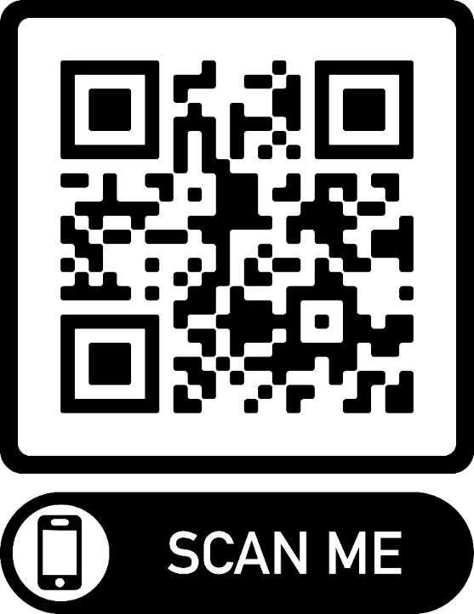
Join our mailing list! SCAN OR TEXT
Contact Us: Email: midamerica@mhttcnetwork.org
Phone: 402-552-7697
https://mhttcnetwork.org/centers/mid-america-mhttc/home

